Slide 1
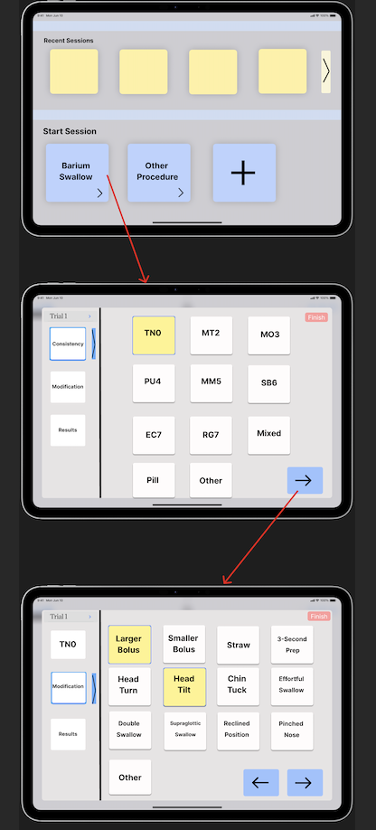
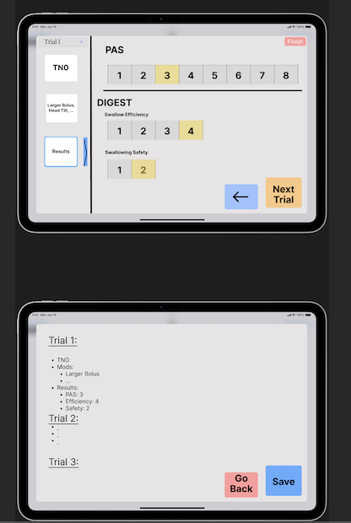
Design 1: Decision Selection Interface
This design option allows you to customize sets of ''options for trials, and then select options mid-trial which will be saved in a document at the end. Time stamps can be used to track when a decision was made, when the trial started and ended, etc.

Slide 2
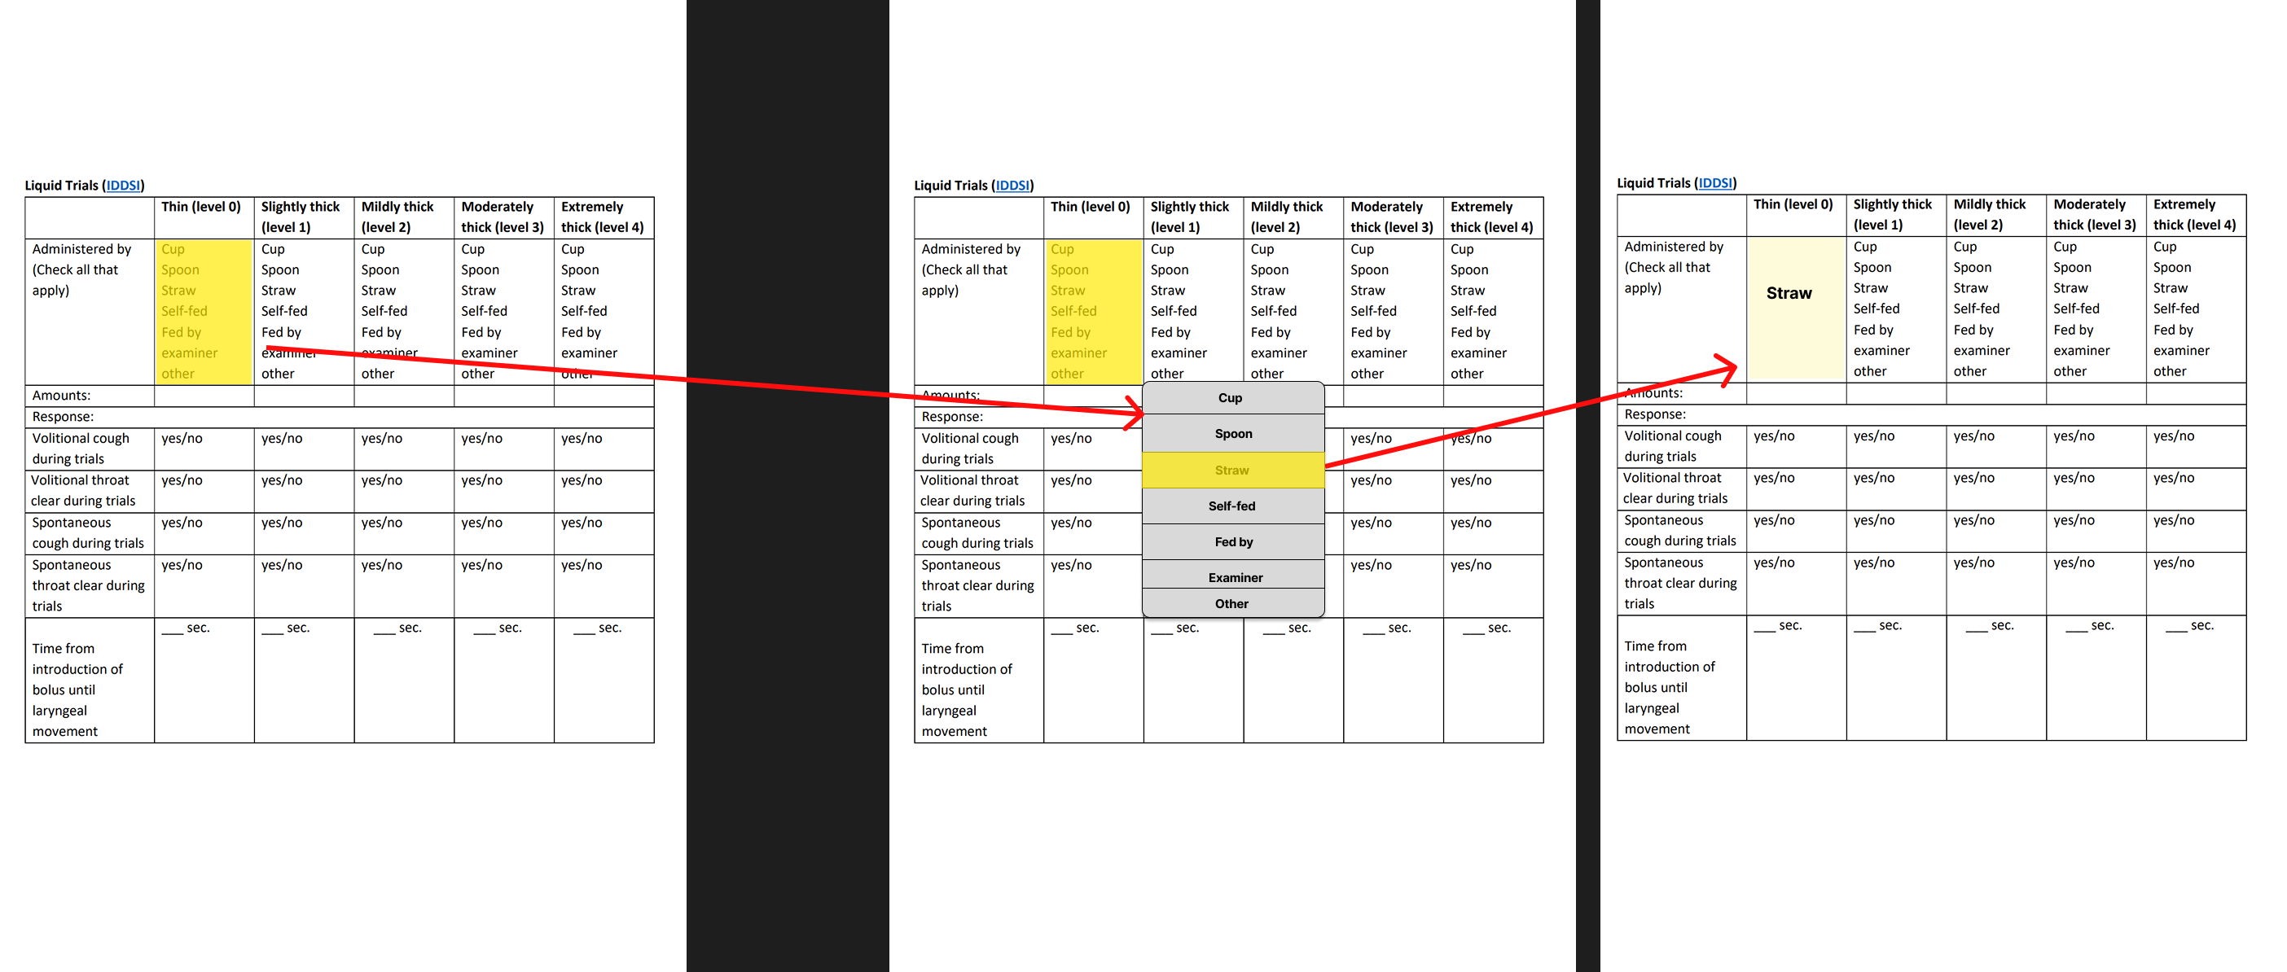
This interface would allow you to upload a document, similar to the one show below, and make it interactable. The selections made to the document in a session would be saved into a results sheet once the trial(s) is complete, along with an desired time stampts.
Design 2: Interactable Doc

Slide 3
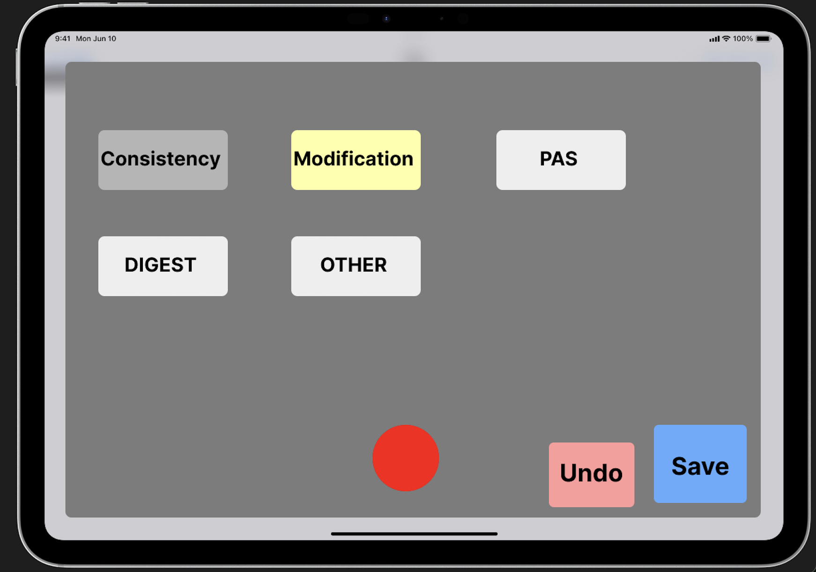
Design option 3: Audio Capturing
This design option allows you to select a category, click record (Which will take a quick audio snippet), and save these recordings to each of the categories.
Processing the audio to get a text-representation may be another possibility for this design.

Slide 4
Other options
A one-click decision tree.
This would be similar to option 1, but instead of selecting and the continuing, you would only need to click the option once for the next set to appear.
An audio only tool
This would likely be the most difficult to make security-compliant, but we could design the app to only record and save intended audio-text snippits.
Any other idea you have

