Slide 1
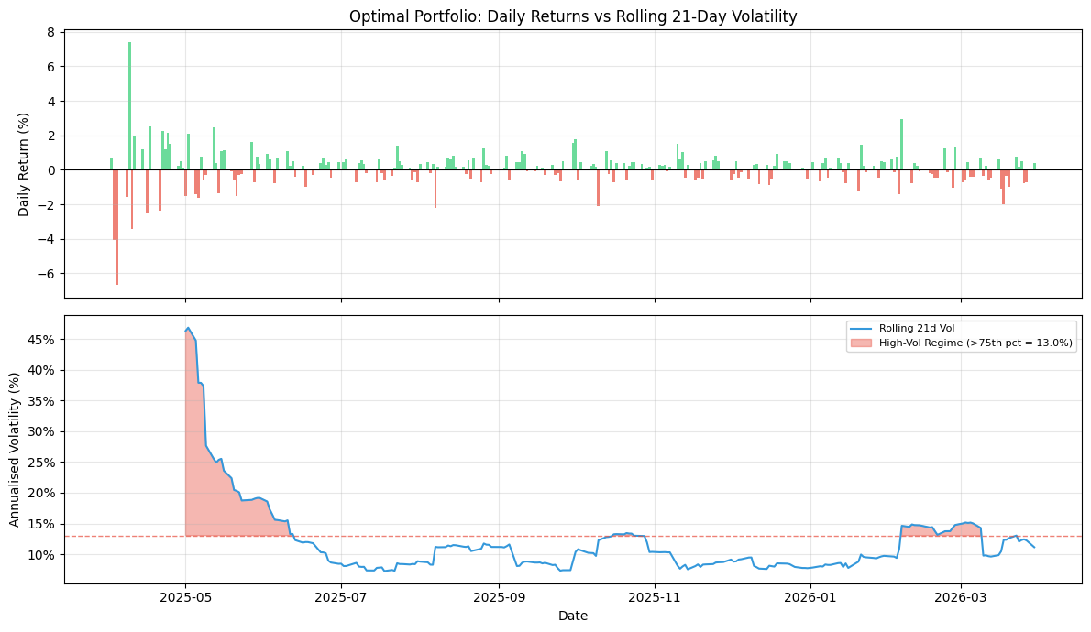
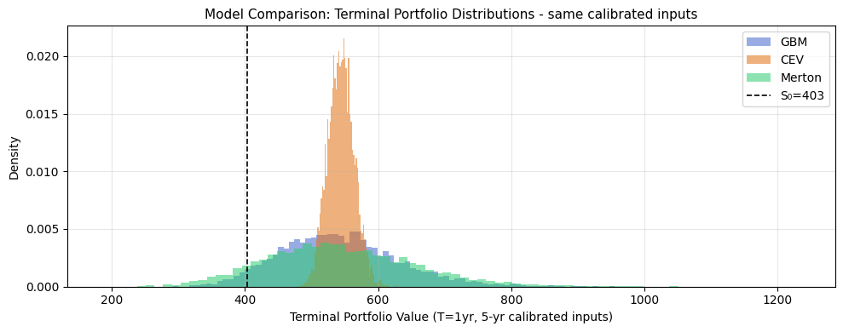
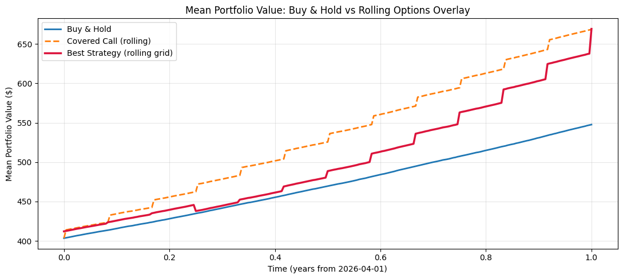
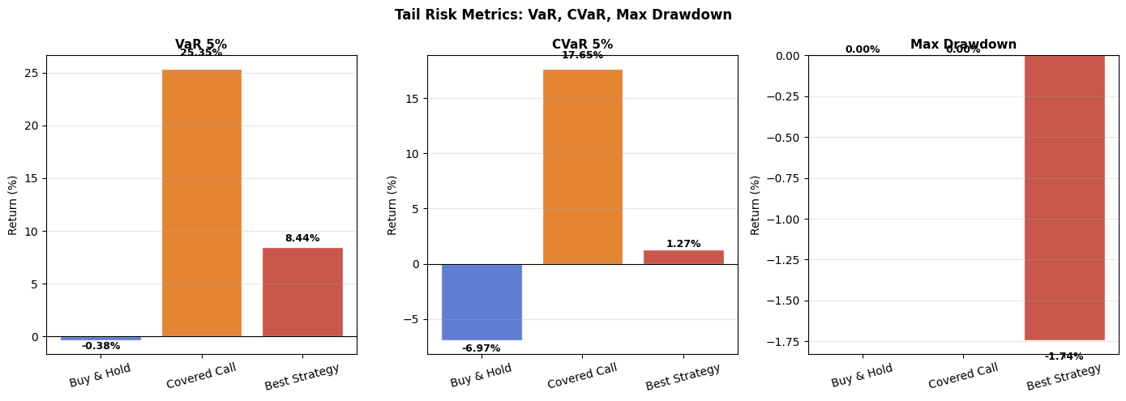
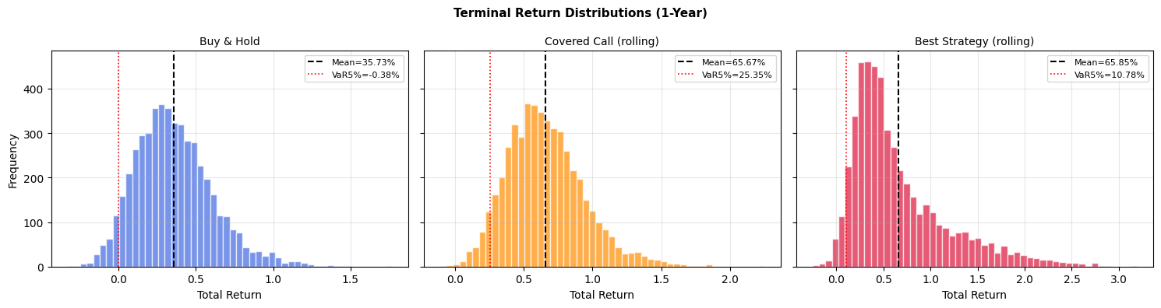
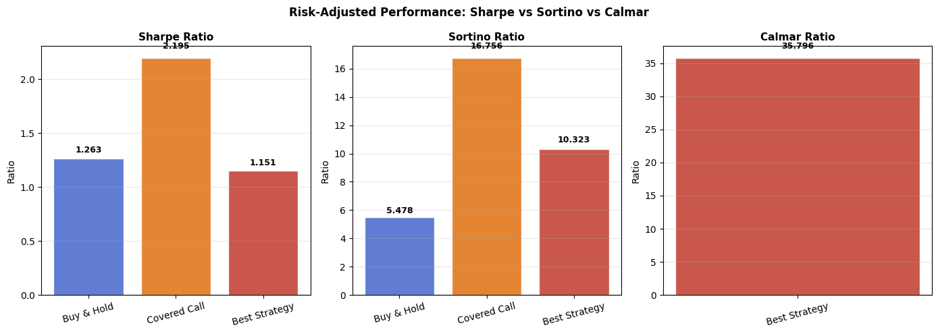
Quantitative Portfolio Analysis with Options Overlay
MAIN RESULTS
Portfolio Volatility Clustering (fig. 6 from notebook)
GBM/CEV/Merton Terminal Distributions (fig. 11)
S26 Quantitative Mentorship | Final Project
DATASET
31 large-cap equities + ETFs (Yahoo Finance)
5-yr calibration: 2020-04-01 to 2025-03-31 (1,255 days)
1-yr current: 2025-04-01 to 2026-03-31 (250 days)
Risk-free rate (^IRX, 13-wk T-Bill): 4.20%
S0 = $403.43 | mu = 29.95% | sigma = 16.68%
57/229 high-vol days, avg run = 19 days. Vol not constant over time.
Merton P5=$368.92 vs GBM P5=$405.16. Fat tails inflate put premiums.
Mean Portfolio Value: 3 Strategies (fig. 17)
Tail Risk: VaR, CVaR, Max Drawdown (fig. 19)
MODELS
GBM: 5,000 correlated paths (Cholesky)
CEV (gamma=0.75): leverage effect
Merton: jumps lambda=1.5 mu_J=-0.05
Heston: SPY-calibrated stoch. vol
Overlay: covered calls / puts / collars
KEY FINDING
CC (orange) accumulates premium step-wise. Best Strategy (red) switches CC -> collar -> puts over 12 rolls.
CVaR: B&H=-6.97% CC=+17.65% Best=+1.27%
Rolling options overlay improves CVaR from -6.97% (buy & hold) to +1.27% (best strategy). Covered calls dominate in the high-drift, high-IV environment: the 2% OTM call alone raises Sharpe from 1.263 to 2.195.
Terminal Return Distributions (fig. 20)
Sharpe / Sortino / Calmar (fig. 18)
Volatility clustering avg run = 19 days | Top corr: SPY-NVDA 0.77 | Heston RMSE = $13.25
VaR5%: B&H=-0.38% CC=+25.35% Best=+8.44% (positive = floor from premium income)
Sortino: B&H=5.48 CC=16.76 Best=10.32 | Calmar (Best only)=35.80

