Slide 1
340B Data Integration & Analytics Pipeline – Microsoft Fabric
Asad Patel
Email: asadpatel517@gmail.com
GitHub: https://github.com/apatel517
LinkedIn: https://www.linkedin.com/in/asad--patel
1

Slide 2
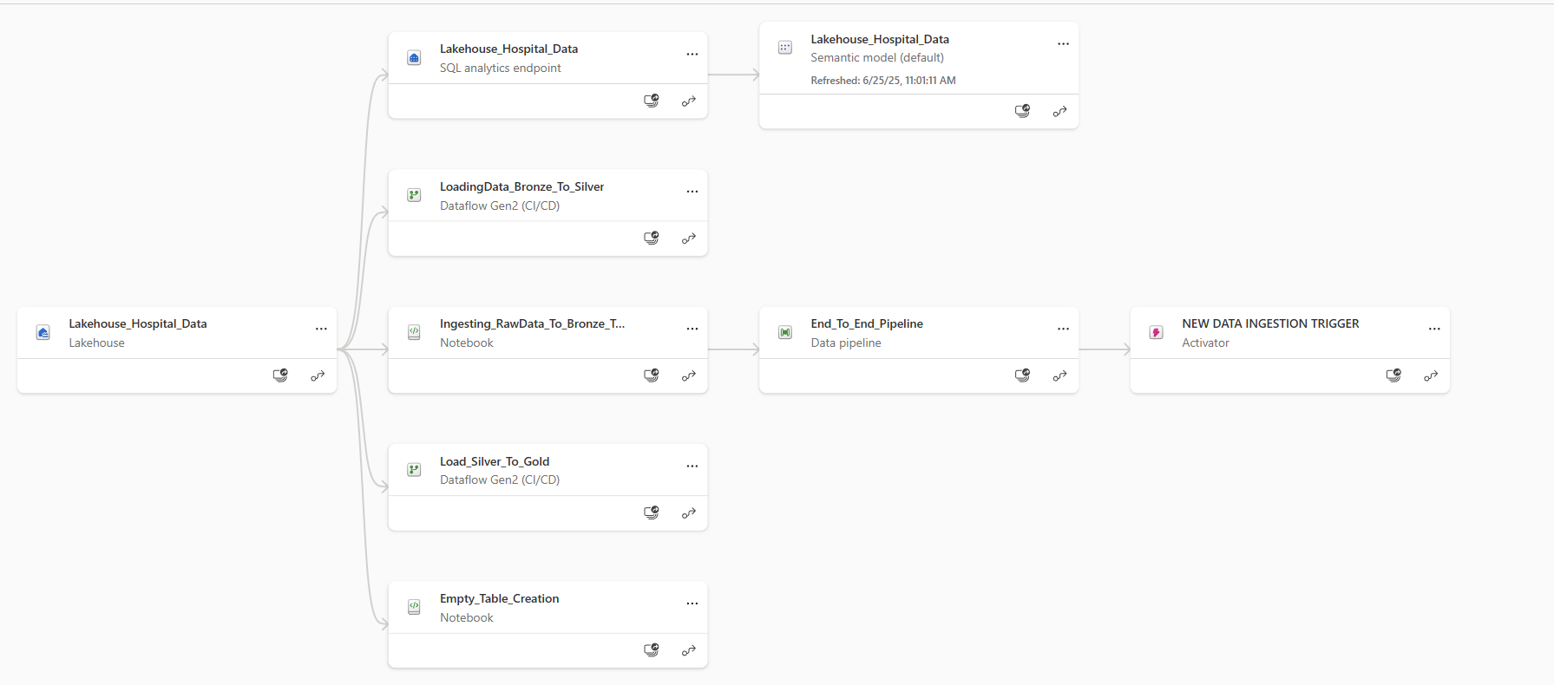
Executive Summary
This project was developed in a hospital setting where six pharmacy-related datasets are received monthly in raw CSV format. These datasets are loaded into a Microsoft Fabric Lakehouse and processed using the Medallion Architecture (Bronze → Silver → Gold).
The pipeline is fully automated: - Raw data is ingested into Bronze tables using a PySpark Notebook. - Dataflow Gen2 transforms and cleans the Bronze data into Silver tables. - A second Dataflow processes Silver tables into Gold tables into star-schema tables using fact and dimension modeling. - Gold tables are connected directly to a Power BI dashboard for visualization. - A Microsoft Fabric Data Pipeline is configured to automatically trigger the entire flow when new files arrive.
2

Slide 3
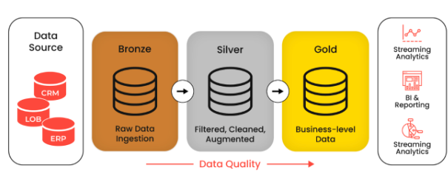
Architecture – Medallion Data Flow
Medallion Architecture Flow:
🗂️ Monthly Raw CSVs (OneLake) ⬇️ Triggered Pipeline 📓 Notebook (Ingest to Bronze Layer) ⬇️ 🔄 Dataflow Gen2 (Transform to Silver Layer) ⬇️ 🪙 Dataflow/SQL (Aggregate into Gold Layer) ⬇️ 📊 Power BI Dashboard (Connected to Gold Tables)
3

Slide 4
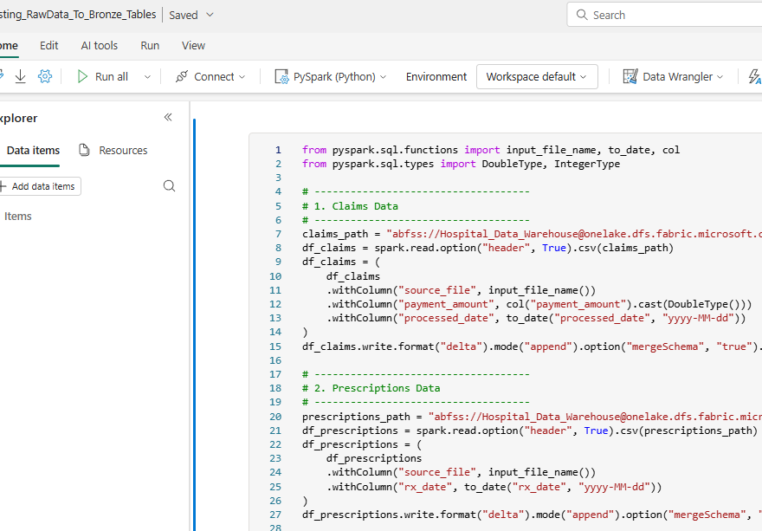
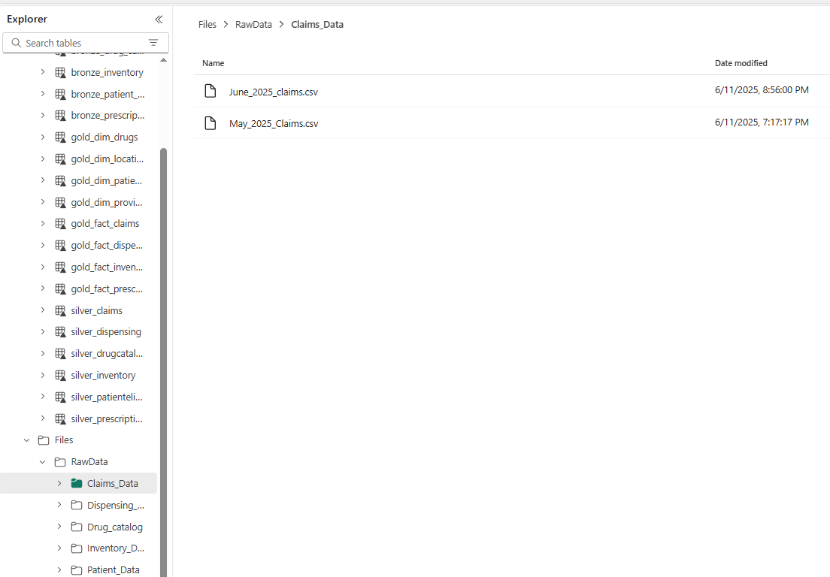
Bronze Layer – Raw Ingestion
Tool: PySpark Notebook
- Ingests raw CSV files from OneLake - Applies schema validation and basic data profiling - Stores raw but structured data in Lakehouse Bronze tables
4

Slide 5
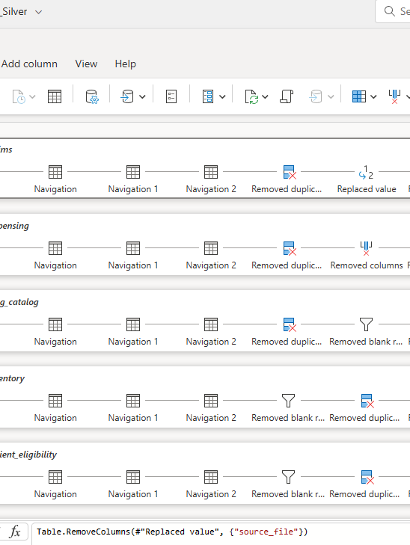
Silver Layer – Cleaning & Joins
Tool: Dataflow Gen2
- Cleans and standardizes Bronze table data - Deduplicates monthly entries using keys/timestamps - Performs joins across datasets (e.g., eligibility, claims, inventory) - Outputs structured, analytics-ready tables
5

Slide 6
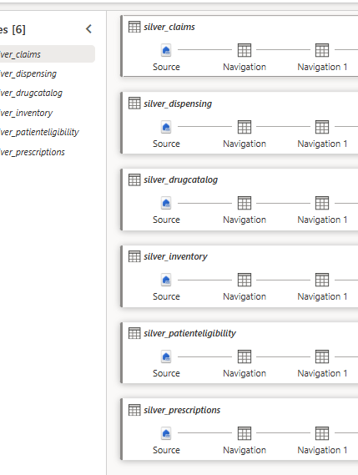
Gold Layer Details
Tool: Dataflow Gen2
Builds a star schema using fact and dimension tables for analytics.(Include schema or SQL screenshot)
Provides clean, joinable data for each subject area (Eligibility, Claims, Prescriptions, Inventory, etc.)
6

Slide 7
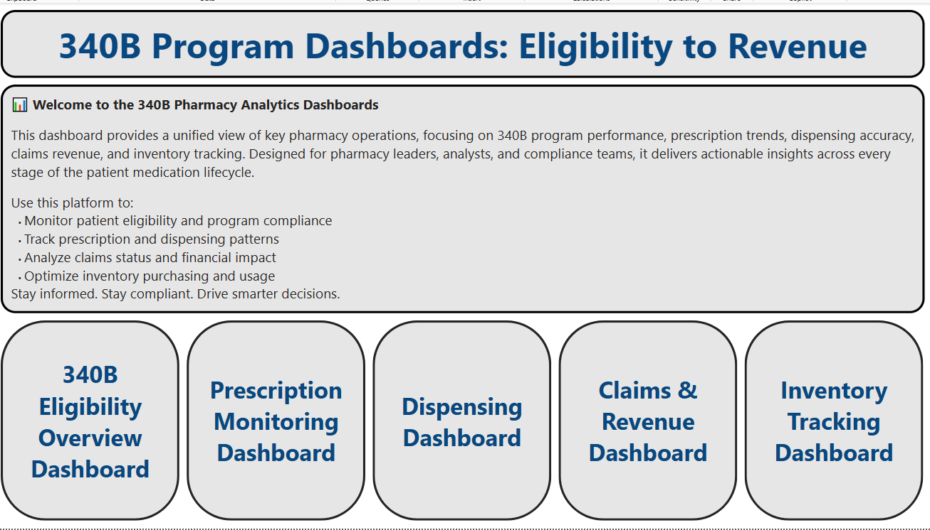
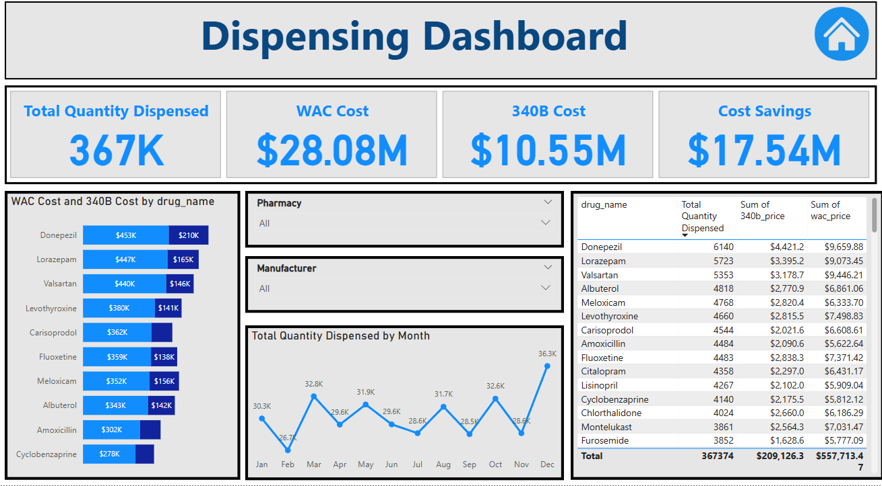
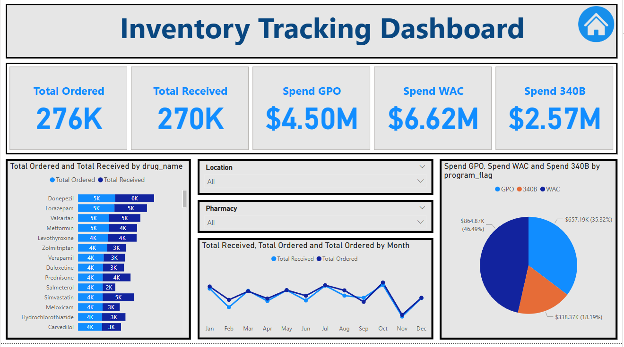
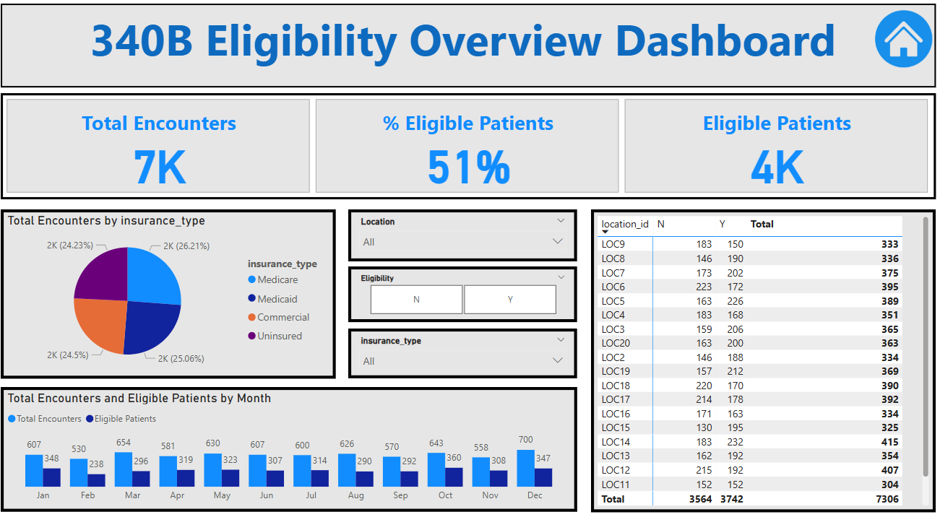
Power BI Dashboard
Connected to curated Gold tables
A single, unified entry point to navigate across dashboards for Eligibility, Prescription Monitoring, Dispensing, Claims & Revenue, and Inventory. Designed for pharmacy leadership and compliance teams to drive actionable insights with a few clicks
7

Slide 8
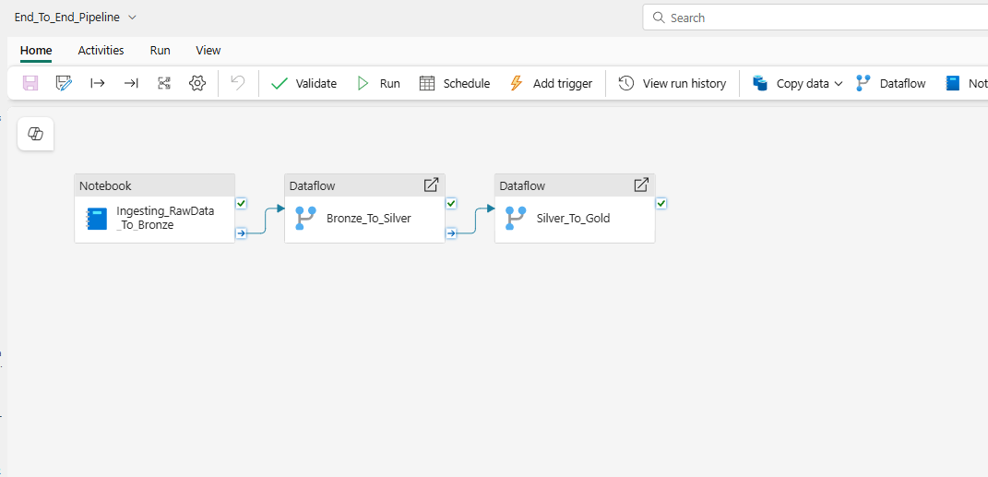
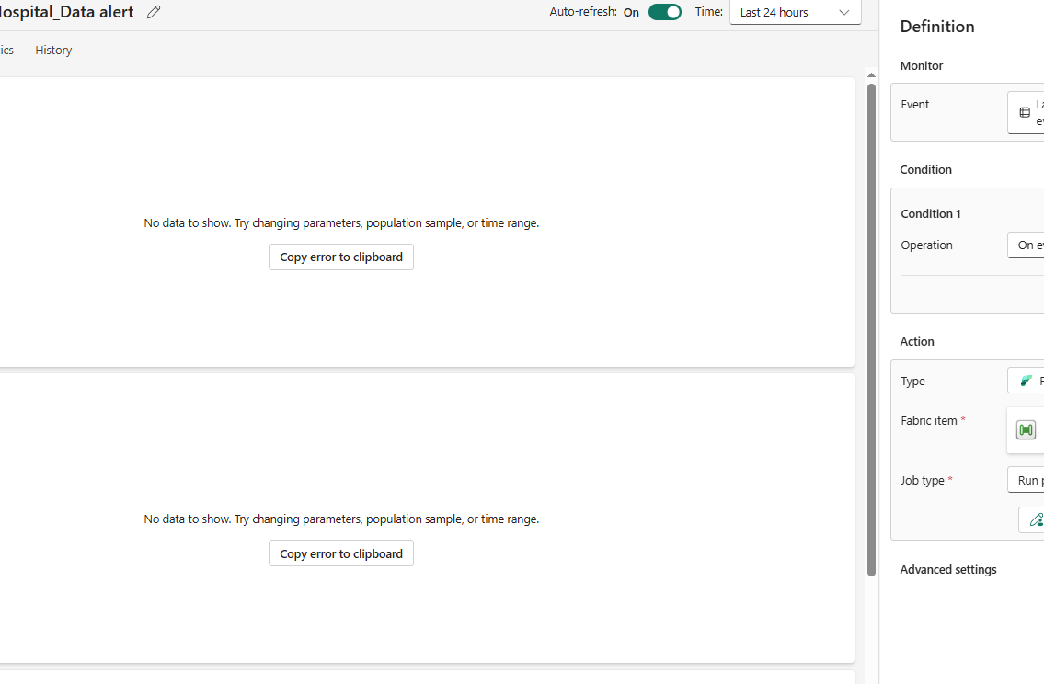
Pipeline Automation – Trigger Flow
Microsoft Fabric Data Pipeline:
- Triggered when new files arrive in OneLake folder - Executes PySpark Notebook to load Bronze layer - Automatically runs Dataflows to build Silver and Gold layers - No manual steps – monthly refresh runs end-to-end
8

Slide 9
Outcomes & Business Value
- ✅ Reduced manual data entry and errors - 🔄 Fully automated monthly processing - 📈 Real-time analytics and compliance tracking - 🧩 Modular and scalable design for other hospital datasets
9

Slide 10
Contact Information
To request a walkthrough or access to sample visuals:
📧 Email: asadpatel517@gmail.com
🌐 GitHub: https://github.com/apatel517
🔗 LinkedIn: https://www.linkedin.com/in/asad--patel
10

