Slide 1
Design Patterns
Flyweight

Slide 2
Agenda
Problem Statement
Contextual Forces
Example Scenarios
Data Modeling Process
Example Implementation
Code Walkthrough
Benefits and Downsides
Final Thoughts

Slide 3

Problem Statement
Objects take up memory. Many objects take
up more and more memory. How do we keep
the memory requirements from exploding as more items are created?
No problem, we just won’t load everything
into memory at once!

Slide 4
Contextual Forces
Sometimes there is no way around creating and maintaining
large numbers of objects in memory
Storage Costs
Performance of reading/writing to slower storage like disks
Monetary costs of data access in cloud environments
Hardware limitations
Less of a problem these days but smart devices still have additional restrictions than traditional desktop or server hardware
Security
Some items might require secure handling, for example a requirement the data can only live in encrypted memory
Filesystem Restrictions
Many file systems have hard limits on the size of files. In data intensive applications, the data may exceed file max sizes

Slide 5
Example Applications and Scenarios
While the Flyweight pattern is not discussed much, it is critical and
extensively used by each of us every single day
Text Editors and Word Processors
Particle systems
CAD/Drawing applications
File Browsers (Windows Explorer or MacOS Finder)
Inventory Systems
Complex UI Systems
Basically, anything that deals with many objects at once which have some sort of shared information!

Slide 6
Flyweight Data Modeling Process
Step 1
Identify Intrinsic vs Extrinsic Properties
Step 2
Encapsulate intrinsic data in object
Step 3
Build flyweight cache handling (factory)
Step 4
Utilize factory for data creation and retrieval
class TextCharacter {
value: string,
fontName: string
fontSize: number
fontColor: string
fontGlyph: byte[]
}
class TextCharacter {
value: string,
// Flyweight as reference
fontData: FontDataClass
}

Slide 7
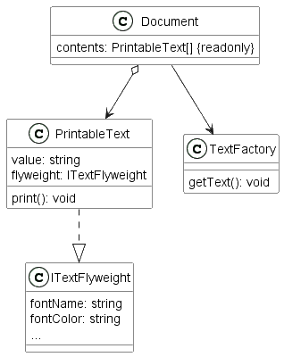
Example Implementation
Text Factory is responsible for creating, storing, and retrieving flyweights.
PrintableText utilizes the flyweight for intrinsic data while keeping track of extrinsic data (value)
Document contains content made up of PrintableText objects corresponding to the file contents
We can generate millions of PrintableText objects because the intrinsic data is cached and accessed by reference rather than storing all information in each text object

Slide 8
Code Walkthrough!

Slide 9
Benefits and Downsides
Pros
Cons
Massive room for memory optimization
Can provide clear separation of concerns on operations
Utilizes other patterns such as a factory to ensure consistent creation and retrieval of data
More processing power is needed due to cache maintenance
Each new object requires a cache check
Depending on implementation, you may not be able to preload flyweights leading to more dynamic allocations at runtime

Slide 10
Related Patterns
Much like the Factory pattern is used in many Flyweight implementations, the flyweights can be used in other patterns and workflows as well:
Both Strategy and State patterns can be implemented with the use of flyweights
Visitor pattern can behave similarly to how flyweights operate although generally implemented differently
The caching aspect of flyweights is reminiscent of memoization techniques
Multiton – a generalized singleton implementation for handling multiple types of objects

Slide 11
Final Thoughts
Flyweight provides a mechanism for efficiently managing large quantities of related objects by separating intrinsic and extrinsic information.
There is an increased code complexity due to handling of cache
Operations can be confusing since the operation is on the flyweight and not the unique object.
Memory efficiency comes at the cost of runtime object lookups leading to more processing operations

