Slide 1
Design Patterns
Abstract Factory Pattern

Slide 2
Agenda
Pattern Description
When To Use?
Code Examples
Pros/Cons
CSP Applicability
Summary
External Resources
Questions

Slide 3
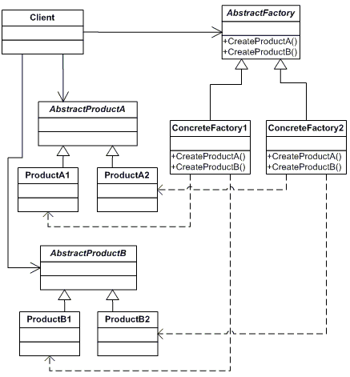
Pattern Description
The Abstract Factory Pattern can be described simply as a pattern to provide an interface allowing the creation of families or related or dependent objects without specifying their concrete classes
The Abstract Factory pattern is in the creational design pattern family.

Slide 4
When To Use
Nearly every type of software project can make use of the Abstract Factory pattern. As such, I’ll just list some common usages:
GUI element/control generation
Inside Frameworks allowing extensibility
When you don’t know the types ahead of time
Pooling operations as seen in TPL
When you need to create/group related objects outside the given capabilities of the platform (this is what we’ll do in the code example.

Slide 5
Code Example
Yay code!

Slide 6
Pros/Cons
Pros
Cons
Provides massive flexibility.
Often utilizes language features creating more elegant code (like generics).
Historical implementations show this pattern works.
Allows custom grouping of objects outside of initial design.
Can be harder to understand than a normal factory.
Advanced language features can be hard for junior devs to understand.
The flexible nature of the pattern leads to abuse.

Slide 7
CSP Applicability – Could we utilize this?
Wizard pages could be handled very well by the pattern.
Generic creation of market decisions and policy lines (doing this already).
Any dynamically-generated UI controls (loss summary screen for example).
Integration and extension with other components in the CSP family.

Slide 8
Summary
Very flexible design pattern that can be used to solve a wide range of problems.
Already used extensively in most frameworks (including .NET).
Allows extension of existing code without modifying said code.
As with all non-bacon things, can be overused.

Slide 9
External Resources
Wikipedia’s Abstract Factory Pattern page
https://en.wikipedia.org/wiki/abstract_factory_pattern
Source Making – Overview of pattern with examples
https://sourcemaking.com/design_patterns/abstract_factory
DoFactory
http://www.dofactory.com/net/abstract-factory-design-pattern

Slide 10
Questions
Questions?

