Slide 1
Design Patterns
Adapter Pattern

Slide 2
Agenda
Pattern Description
When To Use?
Code Examples
Pros/Cons
CSP Applicability
External Resources
Questions

Slide 3
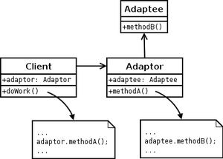
Pattern Description
The Adapter pattern allows otherwise incompatible classes to work together by providing an adapter interface for one class that the other expects.

Slide 4
When To Use
When an interface you cannot or would rather not change needs to interact with incompatible code.
When we need to call several objects with different interfaces in a consistent or generic manner.

Slide 5
Pros/Cons
Pros
Cons
Allows flexibility in changing ‘adaptee’ interface
Facilitates following SOLID principles by reducing need to modify client code
Extra layer of abstraction can unnecessarily complicate code

Slide 6
CSP Applicability – Could we utilize this?
Data access layer
Logging
Thoughts?

Slide 7
External Resources
DoFactory: Adapter Design Pattern
http://www.dofactory.com/net/adapter-design-pattern
Derek Banas: Adapter Design Pattern
https://www.youtube.com/watch?v=qG286LQM6BU
Wikipedia: Adapter
https://en.wikipedia.org/wiki/Adapter_pattern

Slide 8
Questions
Questions?

