Slide 1
Design Patterns
Bridge Pattern

Slide 2
Agenda
Pattern Description
When To Use?
Code Examples
Pros/Cons
Benefits
Downsides
CSP Applicability
Summary
External Resources
Questions

Slide 3
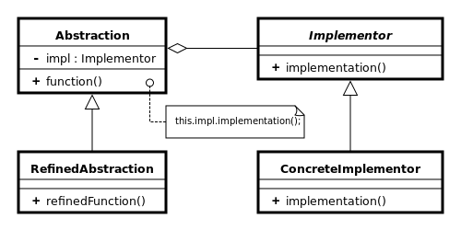
Pattern Description
The Bridge Pattern is used to decouple abstractions from their implementations. This is particularly useful when implementations or abstractions (but not both at once) are changing frequently.
The decorator pattern is in the structural design pattern family.

Slide 4
When To Use
The primary use of the bridge pattern is to provide a more maintainable solution to situations where one side of two related components is changing frequently.
This pattern is capable of further decoupling beyond basic abstraction. This is particularly useful when providing an API or framework to external consumers

Slide 5
Pros/Cons
Pros
Cons
Strong decoupling between components.
Allows flexibility between abstractions and implementations.
Can be implemented by using other patterns such as the Adapter Pattern providing vetted pattern security.
Code complexity can increase.
It can make debugging or troubleshooting more difficult given the decoupled nature of the pattern.
Hard to correctly implement after the fact making it less ideal for existing codebases.

Slide 6
CSP Applicability – Could we utilize this?
Can be used to facilitate versioning of logic
Each version would remain in place with the bridge implementation used to call the correct version.
Business rule generalization
With the bridge pattern, it would be possible to create discrete rule objects which can be called on various business objects such as a ClientRenewalPolicy or MarketListRow.
Custom behavior of controls
Have a grid with multiple uses? The bridge can be used to ensure proper initialization based on requirement.

Slide 7
Summary
The bridge pattern is super simple and provides a way of adding flexibility into a project.
Like most things in life, use in moderation. Excessive use within a codebase can lead to maintainability issues and harder debugging/troubleshooting.
While the bridge pattern is a pattern, it is often implemented using other patterns such as the adapter pattern.
It is generally better to design for the bridge pattern rather than adding it later given how it can fundamentally change the way objects communicate.

Slide 8
External Resources
Wikipedia’s Decorator Pattern page
https://en.wikipedia.org/wiki/Bridge_pattern
DoFactory – Overview of pattern with C# examples
http://www.dofactory.com/net/bridge-design-pattern
PluralSight – C# Design Strategies
https://www.pluralsight.com/courses/csharp-design-strategies

Slide 9
Questions
Questions?

