Slide 1
Design Patterns
Decorator Pattern

Slide 2
Agenda
Pattern Description
When To Use?
Code Examples
Pros/Cons
Benefits
Downsides
CSP Applicability
Summary
External Resources
Questions

Slide 3
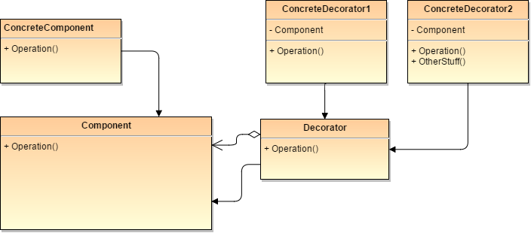
Pattern Description
The Decorator Pattern allows the developer to attach functionality to existing classes without the need to modify the original class or create a series of subtypes.
The decorator pattern is in the structural design pattern family.

Slide 4
When To Use
If the class in question needs additional functionality without modification to its interface.
When there are several independent ways of extending functionality.
A class needs flexibility in its behavior at run-time, not compile-time.

Slide 5
Pros/Cons
Pros
Cons
Dynamically add state to existing objects.
Reduces concrete subtype count.
Additive capabilities allow multiple behaviors to decorate an object.
Increases object responsibility
Maintainability/debugging issues when over-use of decorators occur.

Slide 6
Pattern Benefits
Traditional Subtyping
Benefits
Cookie
SugarCookie
?
?
OatmealCookie
Dynamically add state to objects.
Reduces concrete subtype count.
Additive capabilities allow multiple behaviors to decorate an object.
Regression safety.
Forces consumers to rely on abstractions.
Decoration
Cookie
Sugar
Oatmeal
Chocolate Chip
…

Slide 7
Pattern Downsides
Cookie
Sugar
Oatmeal
ChocolateChip
Frosted
Butter
Filled
GingerSnap
…
Snickerdoodle
Raisin
SugarFree
Downsides
Overuse pollutes design and increases complexity.
Decorators can complicate object initialization.
Nested decorators can be very hard to debug.
Forces consumers to rely on abstractions.

Slide 8
CSP Applicability – Could we utilize this?
Policies with different capabilities
Smart Market/Advantage Eligible decorators with view bindings to show the appropriate controls
Market Decisions/Responses
Decorate policies with decisions/responses rather than the duplicated code currently in place between them
Service Types
Has a service been ordered for a policy? Decorate it with Order information!

Slide 9
Summary
The decorator pattern is terrific for creating additional state in existing objects.
The pattern is generally better than traditional subtyping (although they aren’t mutually exclusive) when you’ll have a number of attributes/state that needs to be added to objects dynamically.
Like most things in life (except bacon), moderation is the best policy. Overuse will lead to maintainability issues.
How much is too much? It depends…
There are definitely areas in CSP that could benefit from the application of the decorator pattern.

Slide 10
External Resources
Wikipedia’s Decorator Pattern page
https://en.wikipedia.org/wiki/Decorator_pattern
DoFactory – Overview of pattern with C# examples
http://www.dofactory.com/net/decorator-design-pattern
CodeProject – Implementing the Decorator Pattern in C#
http://www.codeproject.com/Articles/479635/UnderstandingplusandplusImplementingplusDecoratorp
PluralSight – C# Design Strategies
https://www.pluralsight.com/courses/csharp-design-strategies

Slide 11
Questions
Questions?

