Slide 1
Design Patterns
Façade Pattern

Slide 2
Agenda
Pattern Description
When To Use?
Code Examples
Pros/Cons
CSP Applicability
External Resources
Questions

Slide 3
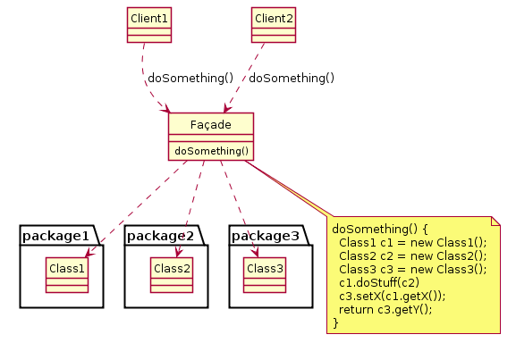
Pattern Description
The Façade Pattern provides access to a larger body of code through a simplified interface.

Slide 4
When To Use
When programming against a poorly designed or overly-complex API.
When the consuming code does not need to know about the details of the system behind the façade.

Slide 5
Pros/Cons
Pros
Cons
Decouples consuming code from code behind façade.
This facilities easier modification.
Simplifies use of potentially complex system for consumer.
Gives ability to define API for system behind façade without modifying system itself.
Details of system behind façade could be obfuscated to consumer.
Could serve only to complicate code when additional layer of abstraction is not useful.

Slide 6
CSP Applicability – Could we utilize this?
BPC Service
Façade BPC Service provides BPC client with interface for SmartBox and MasterData service calls.
Client does not need to know which database the service call originates from.
Service Façade for CSP client.
Simplified interface to consume both DMS services.
Thoughts?

Slide 7
External Resources
Wikipedia’s Façade Pattern page
https://en.wikipedia.org/wiki/Facade_pattern

Slide 8
Questions
Questions?

