Slide 1
Design Patterns
Factory Pattern

Slide 2
Agenda
Pattern Description
When To Use?
Code Examples
Pros/Cons
CSP Applicability
External Resources
Questions

Slide 3
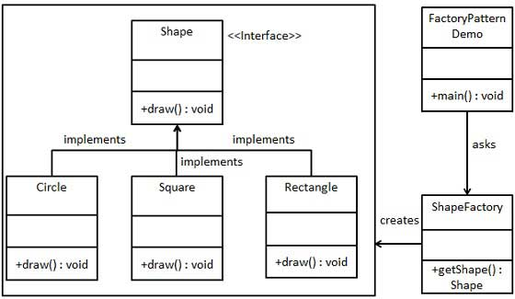
Pattern Description
The Factory pattern allows for the creation of objects of different types, which typically implement a common interface or base class, based on some input.

Slide 4
When To Use
When we are coding against a common interface and need to create objects of varying types.
When the client code does not need to know the details about how to initialize an object.
To consolidate object initialization code to a common location.

Slide 5
Pros/Cons
Pros
Cons
Facilitates simpler initialization of objects for client code.
Reduces code duplication.
Facilitates following SOLID principles by reducing need to modify client code that leverages factory
Same factory method must be updated to initialize each required subclass as they are added, breaks open/closed principle

Slide 6
CSP Applicability – Could we utilize this?
ClientRenewal page loading (load SO/MD models)
BPC Exception Helper
Autofac
Thoughts?

Slide 7
External Resources
TutorialsPoint: Factory Pattern
https://www.tutorialspoint.com/design_pattern/factory_pattern.htm
Derek Banas: Factory Design Pattern
https://www.youtube.com/watch?v=ub0DXaeV6hA
Wikipedia: Factory
https://en.wikipedia.org/wiki/Factory_(object-oriented_programming)

Slide 8
Questions
Questions?

