Slide 1
Design Patterns
Flyweight Pattern

Slide 2
Agenda
Pattern Description
When To Use?
Code Examples
Pros/Cons
CSP Applicability
Summary
External Resources
Questions

Slide 3
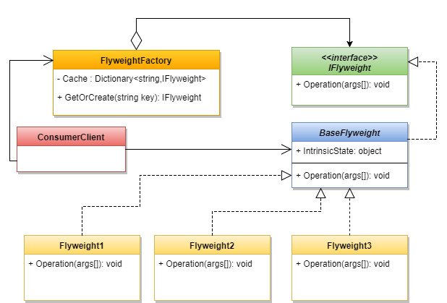
Pattern Description
The Flyweight Pattern is primarily used as an optimization technique for situations where there will be many objects, all sharing common information. A prime example is a word processor the base object (glyph) doesn’t also contain extrinsic data such as color and position.
The Flyweight pattern is in the structural design pattern family.

Slide 4
When To Use
When there are a large number of objects that are structurally the same.
When construction of objects is resource intensive, this pattern can be applied to reuse the constructions to increase performance.
Performance-intensive operations that are frequently used such as comparing strings. This is also known as string interning.
When writing applications for hardware with limited resources.
Often used in CAD and vector-based applications.

Slide 5
Code Example
Yay code!

Slide 6
Pros/Cons
Pros
Cons
Efficiently handle large numbers of small objects.
Lower memory costs due to reuse.
Applicable when object identity isn’t important.
Increased runtime for object construction due to lookups.
Extrinsic state may add additional computations.

Slide 7
CSP Applicability – Could we utilize this?
We’re already using this in a sense with our dependency injection setup, specifically the IoC containers.
Potential applicability in wizard pages with the expensive construction costs and similar structures.
Quote Manager grid objects.
Workflow types, service types, etc..

Slide 8
Summary
The flyweight pattern is a proven pattern for software that handles many small objects.
The separation of intrinsic and extrinsic state promotes separation of common data.
We’re already using it to a certain extent within other patterns inside CSP.
Additionally, C# itself utilizes the Flyweight pattern with the implicit string interning it does.

Slide 9
External Resources
Wikipedia’s Flyweight Pattern page
https://en.wikipedia.org/wiki/Flyweight_pattern
DoFactory – Overview of pattern with C# examples
http://www.dofactory.com/net/flyweight-design-pattern
See also:
https://en.wikipedia.org/wiki/String_interning
https://en.wikipedia.org/wiki/Hash_consing

Slide 10
Questions
Questions?

