Slide 1
Design Patterns
Prototype Pattern

Slide 2
Agenda
Pattern Description
When To Use?
Code Examples
Pros/Cons
CSP Applicability
Summary
External Resources
Questions

Slide 3
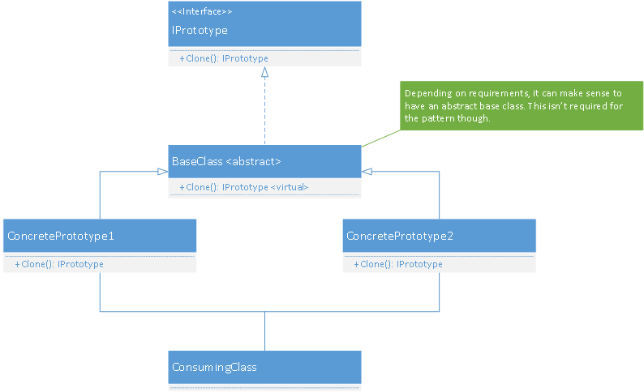
Pattern Description
The Prototype Pattern was introduced as a way to solve the problem of long-running or expensive object creation.
The Prototype Pattern is in the creational design pattern family.

Slide 4
When To Use
If an object’s creation logic is very complex and long-running.
When resources are limited but objects are complex and share structure or data.
Can be useful in languages that support dynamic classes (i.e. you can add methods/properties to the definition at will).

Slide 5
Code Example
Yay code!

Slide 6
Pros/Cons
Pros
Cons
Fast creation of objects with complex creation logic
Uses fewer resources to create objects
Evolving run-time changes in object structures
Can be useful to prevent network trips for creating objects
Separates construction from definition.
Limited (although some) application these days
If deep cloning is required, it can be difficult to implement correctly

Slide 7
CSP Applicability – Could we utilize this?
Wizard pages could utilize this pattern for initial creation when more than one wizard pages are needed
Technically it’s already being used by the summary pages under the hood
Quote Manager grid objects
If a process creates multiple workflows with shared data, this could be useful

Slide 8
Summary
The prototype pattern is a proven pattern for solving performance or resource limitations on complex classes.
It has limited applicability with the resources in today’s computers.
Applications that communicate over a network can use this pattern to create new objects without the need of contacting the server

Slide 9
External Resources
Wikipedia’s Prototype Pattern page
https://en.wikipedia.org/wiki/Prototype_pattern
DoFactory – Overview of pattern with C# examples
http://www.dofactory.com/net/prototype-design-pattern
DotNetTricks – Prototype Design Pattern
http://www.dotnettricks.com/learn/designpatterns/prototype-design-pattern-dotnet

Slide 10
Questions
Questions?

