Slide 1
Design Patterns
Proxy Pattern

Slide 2
Agenda
Pattern Description
When To Use?
Code Examples
Pros/Cons
CSP Applicability
External Resources
Questions

Slide 3
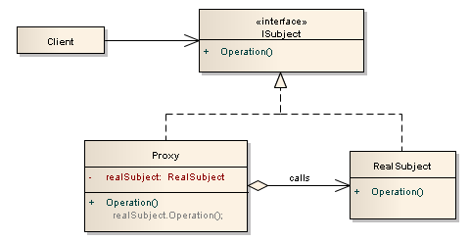
Pattern Description
The Proxy Pattern is very similar to adaptor, façade, and other “middle man” patterns with the difference being the interface remains the same while the implementation is altered.

Slide 4
When To Use
When you need to add additional functionality to existing code.
Often used for directing program flow based on extrinsic information.
Security Proxy: Protection guards on resources
Virtual Proxy: Representation of lazy-loaded data
Remote Proxy: Local representation of remote object

Slide 5
Pros/Cons
Pros
Cons
Proxy implementations have the same interface as the subjects resulting in easily-swapped and enhanced components
Very powerful, used extensively in abstract and dependency injection frameworks
Wide range of uses from resource guards to responsive user experience
Adds complexity to codebase.
Easy to over-use. All things besides bacon in moderation!
Depending on implementation, it can add performance costs.

Slide 6
CSP Applicability – Could we utilize this?
We’re already using it extensively with Autofaq and EF
It could be used to increase responsive feel of certain things like service order screen
Many places where assumptions of data are made that could use guards such as verifying object state.
Thoughts?

Slide 7
External Resources
Wikipedia’s Proxy Pattern page
https://en.wikipedia.org/wiki/Proxy_pattern
DoFactory’s Proxy Pattern page
http://www.dofactory.com/net/proxy-design-pattern

Slide 8
Questions
Questions?

