Slide 1
Design Patterns
Singleton Pattern

Slide 2
Agenda
Pattern Description
When To Use?
Code Examples
Pros/Cons
CSP Applicability
Summary
External Resources
Questions

Slide 3
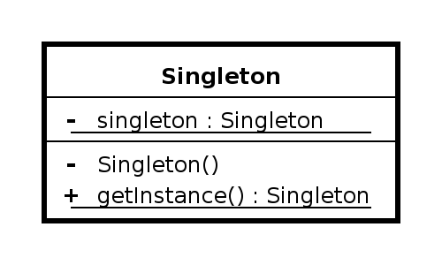
Pattern Description
The Singleton Pattern is commonly used in cases where the application requires a single instance of an object across concerns. This is accomplished by hiding the construction of the object from outside consumers and instead having the singleton class itself be responsible for creation.
The Singleton pattern is in the creational design pattern family.

Slide 4
When To Use
When there should only be a single instance of an object during the lifetime of the system (or multiple systems in a distributed environment).
When you need a way to get a handle on an object through a single execution path.
To replace heavy global variables.
You need easy control over lazy-loading capabilities.
Many design patterns are implemented either fully or in part with the singleton pattern.
Application-level state objects are usually singletons.

Slide 5
Code Example
Yay code!

Slide 6
Pros/Cons
Pros
Cons
Easily ensure only a single instance of an object can be created.
Helps enforce encapsulation.
Can be used when implementing other design patterns.
Lazy loading.
Tight control over how an object is created.
Can be over-used resulting in performance issues.
Is one of the more simple design patterns leading to over-use and incorrect usage.
Easy to run into issues in multi-threaded environments when implementer doesn’t fully understand thread safety

Slide 7
CSP Applicability – Could we utilize this?
We’re already using it in a number of places. Most notably our DI, AutoMapper, and service (like navigation service) implementations.
Additional areas we could utilize this pattern include:
CSP application state tracking
Wizard pages/Service Orders
As implementation details for a number of places an abstract factory would benefit.
Certain “global” variables fed into the different screens.

Slide 8
Summary
The Singleton pattern is one of the most common design patterns given it’s strong application fit over a variety of scenarios.
It’s often used as an implementation detail within larger design patterns.
Great when you require total control over the count of objects (generally just 1 hence the name).
As with all things in life except bacon, this pattern can and is often misused leading to people calling it an anti-pattern.

Slide 9
External Resources
Wikipedia’s Flyweight Pattern page
https://en.wikipedia.org/wiki/Singleton_pattern
DoFactory – Overview of pattern with C# examples
http://www.dofactory.com/net/singleton-design-pattern

Slide 10
Questions
Questions?

