Slide 1
Design Patterns
Visitor Pattern

Slide 2
Agenda
Pattern Description
When To Use?
Code Examples
Pros/Cons
CSP Applicability
External Resources
Questions

Slide 3
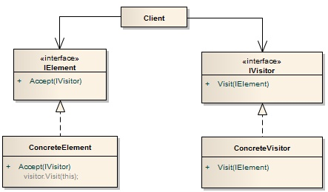
Pattern Description
The Visitor Pattern allows the developer to add functionality to classes of different types with little-to-no modifying of those classes themselves.

Slide 4
When To Use
When a similar operation needs to be performed on multiple objects of different types.
When the underlying class upon which you are adding functionality cannot be modified.

Slide 5
Pros/Cons
Pros
Cons
Aids in following open/closed principle.
Allows for extending functionality to classes you do not own or cannot modify
Overuse or misuse can introduce unnecessary complexity

Slide 6
CSP Applicability – Could we utilize this?
Business Rule application
“Visit” service order or market decision rows with visitors that apply business rules.
DMS Integration
“Visit” DMS-owned objects for to add CSP-specific functionality to them.
Thoughts?

Slide 7
External Resources
Wikipedia’s Visitor Pattern page
https://en.wikipedia.org/wiki/Visitor_pattern
Code Project – Visitor Design Pattern
https://www.codeproject.com/Articles/186185/Visitor-Design-Pattern
YouTube – Derek Banas: Visitor Design Pattern
https://www.youtube.com/watch?v=pL4mOUDi54o

Slide 8
Questions
Questions?

