Slide 1
FHIR Analysis

Slide 2

Medications Filter
dose_text contains 3 values (tripled dataset)
Distribution:
selected only dose_text = ordered

Slide 3
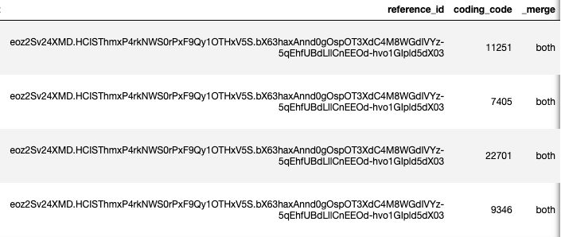
Medications Merge with Reference
Truncate reference ID: Medication/eyjwKorMBqjEpbu8Th4KksF1dbf61IXoqBgivnaprl0M3
Merge on reference_id

Slide 4

Medications Desc
Raw FHIR records: 14523
De-duplicated: 7148
Merge with references: 2283
Unique Users: 1082
Merge with medication_ref

Slide 5
Filter by ingredients
Remove non-coded medications (includes code=Nan)
Filter to keep only codes that are in Rxnorm ingredients
All medication records with references: 2283
Keeping only ones with ingredients: 2221

Slide 6
CCS Meds
Assign codes of all known ingredients from RxNorm database
Custom meds
Latest CCS Medication Records: 133,461
CCS Users: 37,073
(FHIR Users: 1082)
Users with FHIR and CCS meds: 508
FHIR users without CCS meds: 574

Slide 8
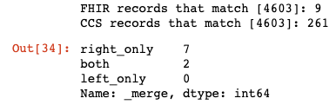
CCS & FHIR comparison: furosemide
Furosemide Rxcui: 4603
Both: 2
FHIR Only: 7
CCS Only: 0

Slide 9
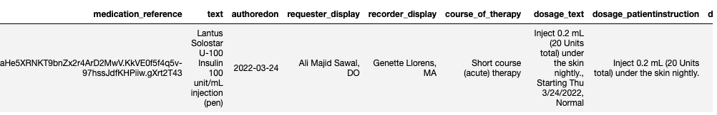
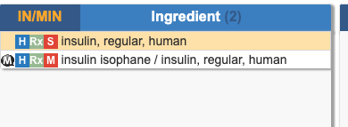
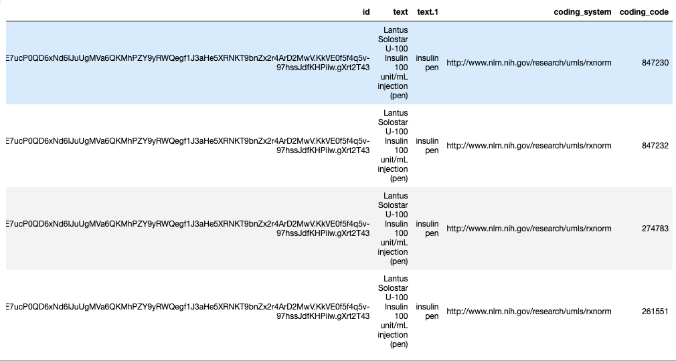
Ingredients are incompletely coded
Insulin: 253182
or 1008501

Slide 10
Furosemide
FHIR records with “furosemide” in the name → 21
FHIR records with code 4603 → 8

Slide 11
Medication Class | Both | CCS Only | FHIR Only
Insulin | 5 | 3 | 4
Furosemide | 2 | 2 | 7
Levothyroxine | 22 | 17 | 16
Statins | 63 | 33 | 30
Fluticasone | 48 | 20 | 19
SSRI/SNRI | 79 | 49 | 45
Aspirin | 16 | 7 | 51
Hypertension | 75 | 46 | 72
Allergy | 142 | 34 | 100
Albuterol | 6 | 13 | 51
OCP | 14 | 6 | 26
Sleep | 8 | 20 | 38
Vitamins | 12 | 6 | 167
Anxiety | 8 | 12 | 25
Anticoagulation | 7 | 7 | 9

