Slide 1

Python Programming. Advanced Course

Slide 2

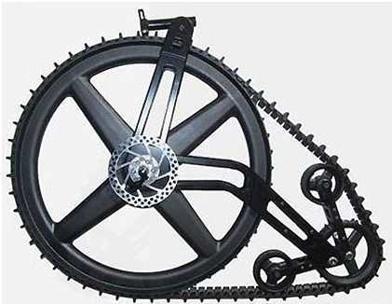
Have you ever create an own bicycle?

Slide 3

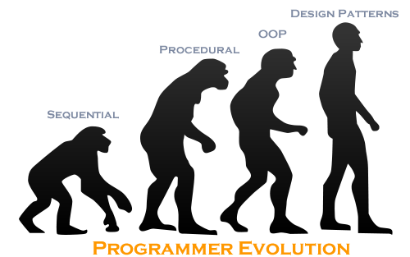

Slide 4
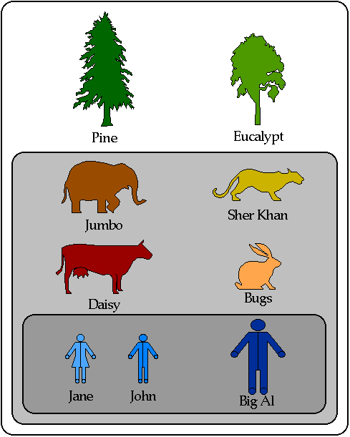
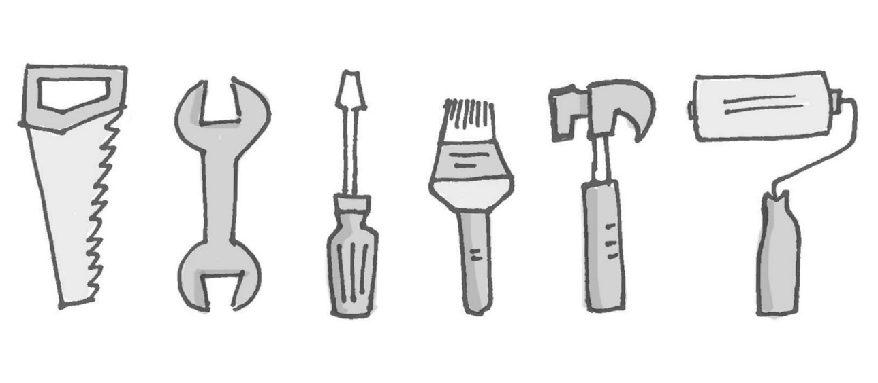
OOP
Slots
Meta Class
Abstract Class
Class Decorator
Magic methods
Abstract method

Slide 5
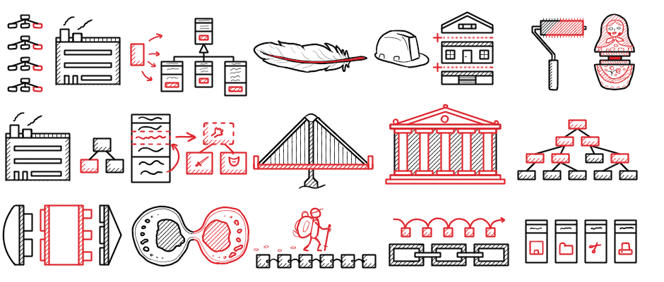
Design patterns
Definition Classification Applicability Criticism
Singleton
Command
Prototype
Observer
Flyweight
State
Decorator

Slide 6

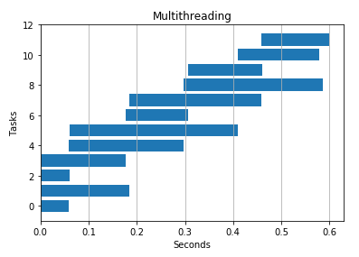
Asynchronous programming
Threading
Multiprocessing
Queue, pipe and the others mpc.
Asyncio

Slide 7
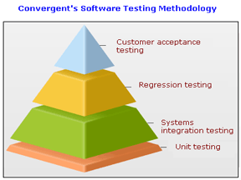
Testing
Unittest
Doctest
Pytest
Mocks

Slide 8
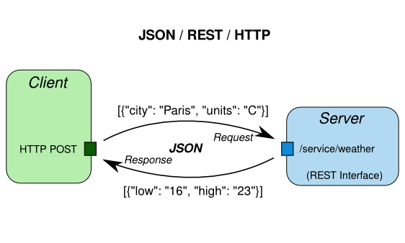
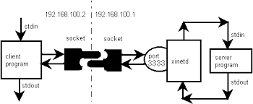
Parsers and Network Socket
JSON
YAML
XML
BS4
Selenium
Socket

Slide 9
Time. 30 hours
OOP
Design Patterns
Async
Testing
Socket
Parsers
3 x 2h = 6h
4 x 2h = 8h
4 x 2h = 8h
2 x 2 = 4 h
1 x 2 = 2h
1 x 2 = 2h
Notes:
Pycharm, git

