Slide 1
Adventures with
BaseX and web applications
Andy Bunce @apb1704
Feb 2013

Slide 2
BaseX and the Web
RESTXQ with server side templating, illustrated by a Graphviz service application
Installing and running BaseX on the openshift (Redhat) Platform as a service (PaaS)
RESTXQ with client side templating using Angular.js with signon using twitter or github Oauth
Connecting BaseX and Node.js illustrated with a chat application using socket.io and a BaseX chatbot with db:event

Slide 3
Part 1
A web application
With
RESTXQ

Slide 4
RESTXQ http://docs.basex.org/wiki/RESTXQ
RESTXQ, introduced by Adam Retter, is an API that facilitates the use of XQuery as a Server Side processing language for the Web.
RESTXQ has been inspired by Java’s JAX-RS API.
RESTXQ defines a set of XQuery 3.0 annotations for mapping HTTP requests to XQuery functions.
The XQuery functions generate and return HTTP responses.

Slide 5
Graphviz http://www.graphviz.org/
Open source graph (network) visualization project from AT&T Research. Has directed and undirected graph layout
i/p is string (dot)
o/p svg

Slide 6
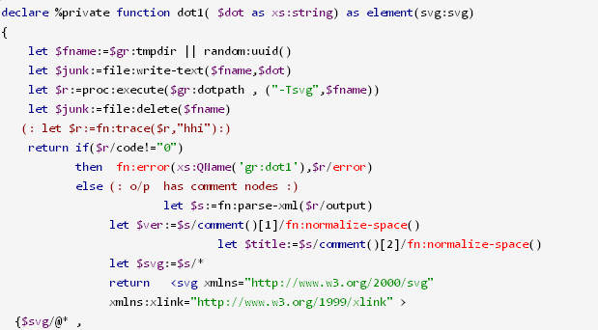
Graphviz from BaseX
Use proc:execute()
Sadly has no pipe in so use temp file

Slide 7
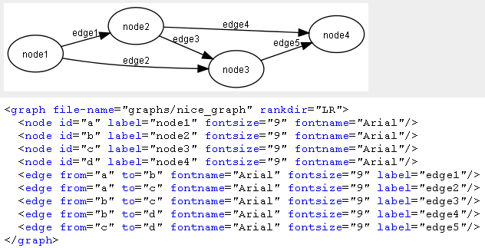
DOTML http://martin-loetzsch.de/DOTML/
DotML is a XML based syntax for the input language of the 'Dot' graph drawing tool

Slide 8
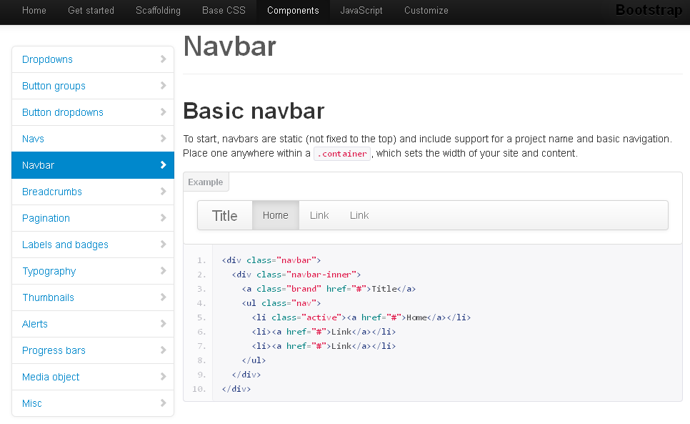
Twitter bootstrap http://twitter.github.com/bootstrap/

Slide 9
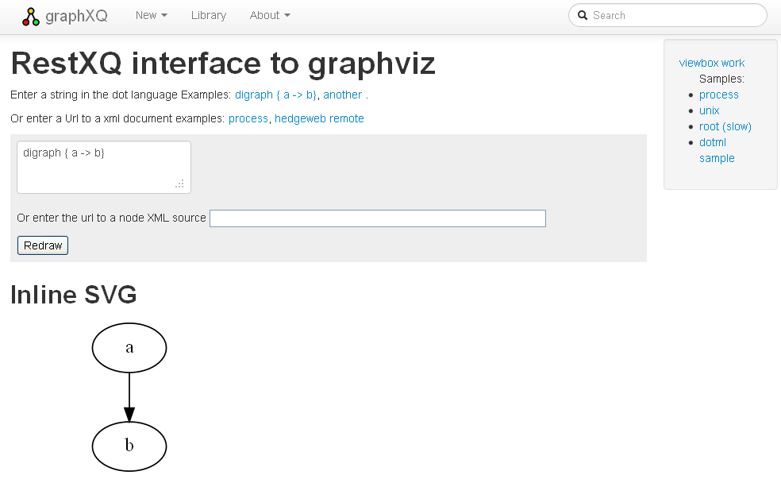
graphxq

Slide 10
Web page structure

Slide 11
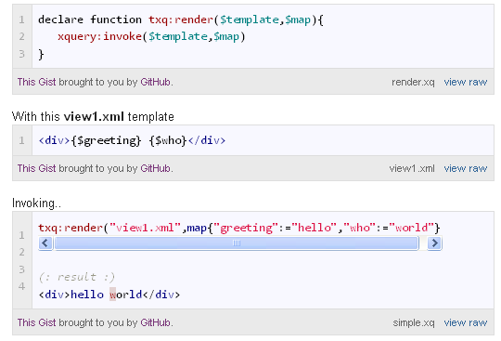
Templating http://cubeb.blogspot.com/2012/11/xquery-templating-engines-and-txq.html

Slide 12
Part 2
Running
in
the Cloud

Slide 13
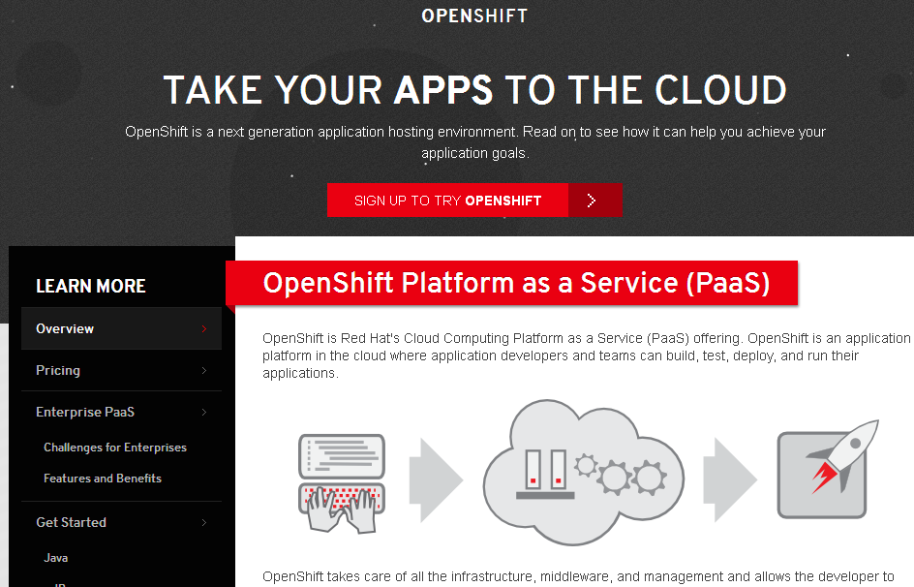
Openshift https://openshift.redhat.com/app/

Slide 14
Openshift features
Has Java (and Node.js) pre-installed
Has a free option
Provides ssh terminal access
(:~
: There are other similar services
: E.g. https://www.appfog.com/
:)

Slide 15
Openshift and BaseX
use the "Do it Yourself" or "DIY" application type.
creates a HTTP proxy specified by the environment variables OPENSHIFT_INTERNAL_IP and OPENSHIFT_INTERNAL_PORT.
Need to configure BaseX to use these and only allowed ports.

Slide 16
Part 3
Using Angulars.js
With
BaseX

Slide 17
angular.js http://angularjs.org/
AngularJS is an open-source JavaScript framework from Google.
Its goal is to augment browser-based applications with Model–View–Controller (MVC) capability.
Declarative data binding
Same space as XFORMS

Slide 18
JSON
Angular.js expects to receive and send JSON

Slide 19
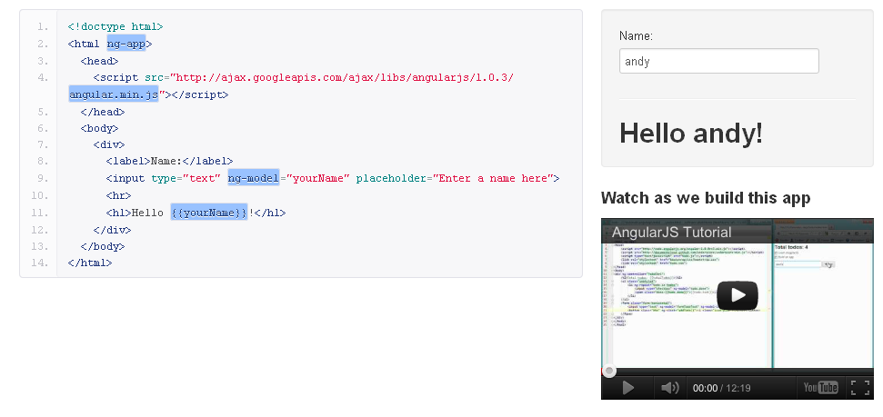
Angular.js Hello world

Slide 20
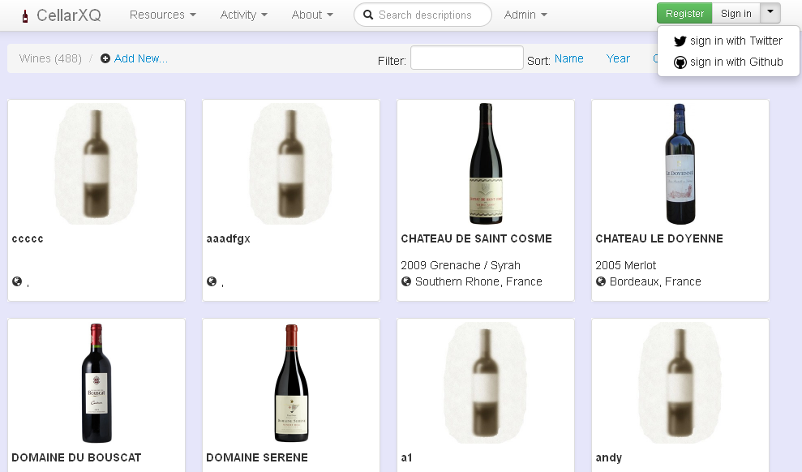
Cellarxq https://github.com/apb2006/basex-cellar

Slide 21
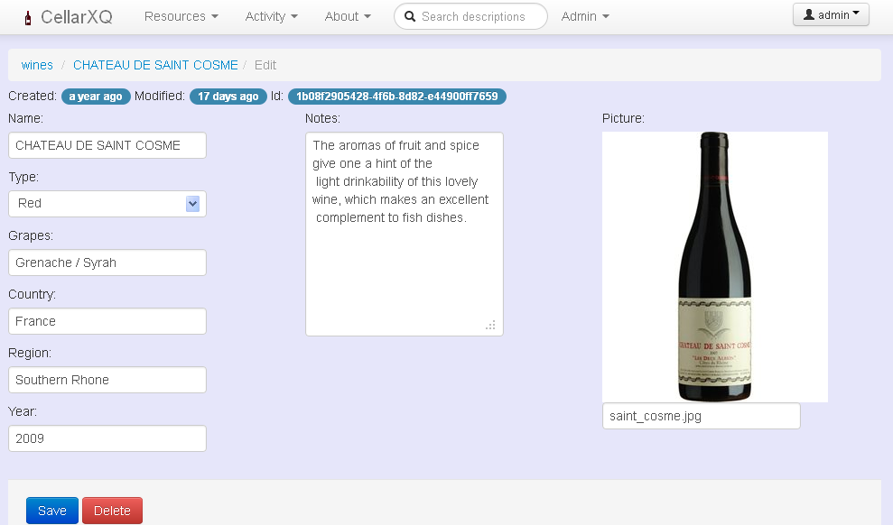
cellarxq

Slide 22
The user database
Defined at the application level, not BaseX user level

Slide 23
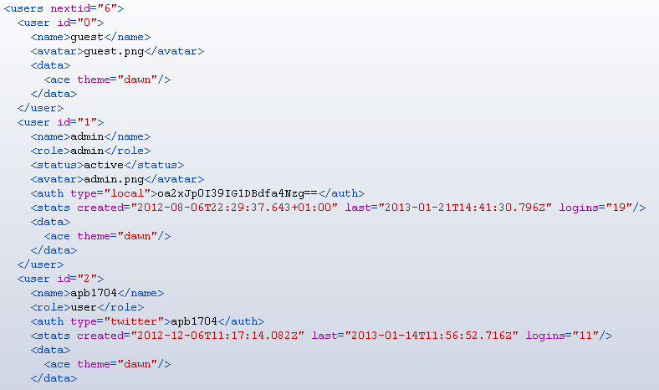
users.xml

Slide 24
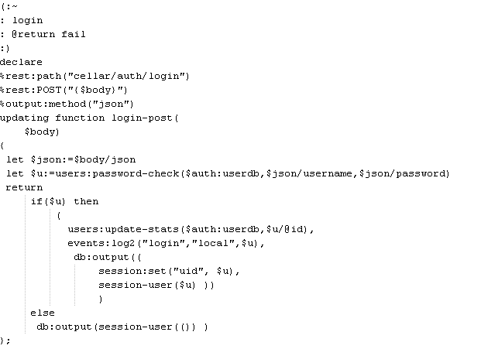
Sign in and user session

Slide 25
Register new user

Slide 26
Configuration
Use an XML in WEB-INF to hold secrets

Slide 27
Permissioning

Slide 28
Part 4
BaseX
with
Node.js

Slide 29
node.js http://nodejs.org/
is a platform built on Chrome's JavaScript runtime for easily building fast, scalable network applications.
uses an event-driven, non-blocking I/O model that makes it lightweight and efficient
perfect for data-intensive real-time applications that run across distributed devices.

Slide 30
Basex-node https://github.com/apb2006/basex-node
is a BaseX client for Node.js
Uses socket connections
Node.js and BaseX maybe on different hosts

Slide 31
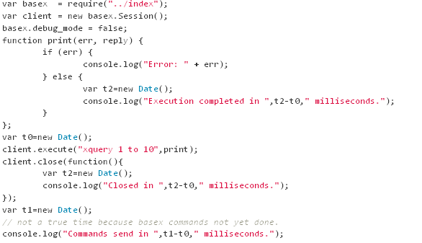
Basex-node sample

Slide 32
Socket.io http://socket.io/
Socket.IO is a JavaScript library for realtime web applications.
a server-side library for node.js
a client-side library that runs in the browser
uses the WebSocket protocol, but can fallback on other methods, such as Adobe Flash sockets, JSONP polling, and AJAX long polling

Slide 33
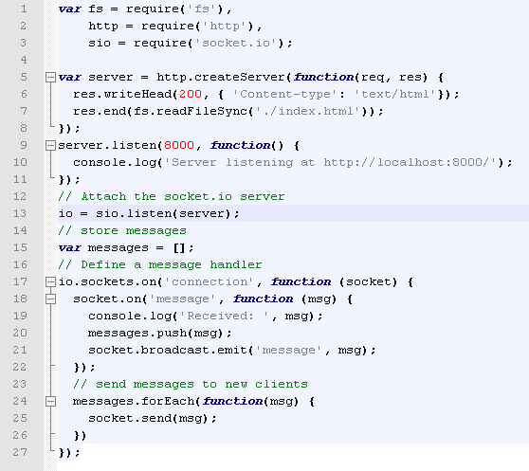
Chat server

Slide 34
db:event http://docs.basex.org/wiki/Database_Module#db:event
Executes a $query and sends the resulting value to all clients watching the Event with the specified $name. The query may also perform updates; no event will be sent to the client that fired the event.
db:event($name as xs:string, $query as item()) as empty-sequence()

Slide 35
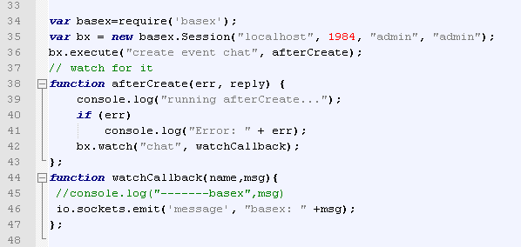
Add BaseX session

Slide 36
the End
Questions?

