Slide 1
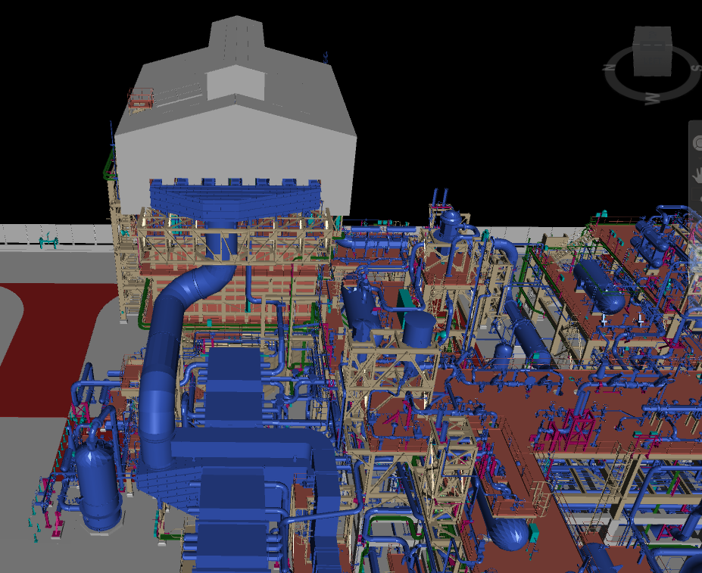


GDL
TRUST

Slide 2
Regression
We obtain the parameters by maximizing the Log Likelihood

Slide 3
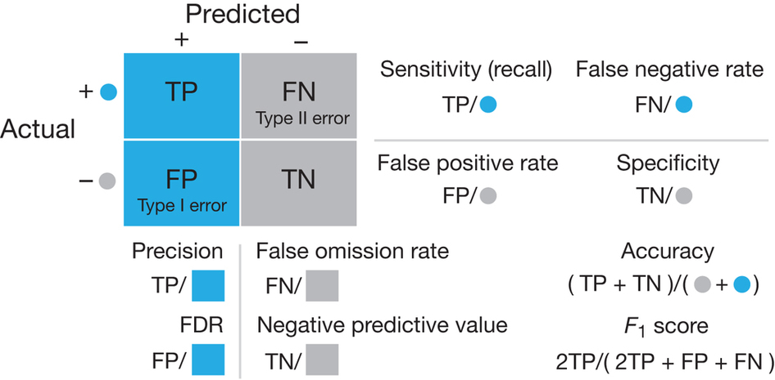
Receiver Operator Characteristic

