Slide 1
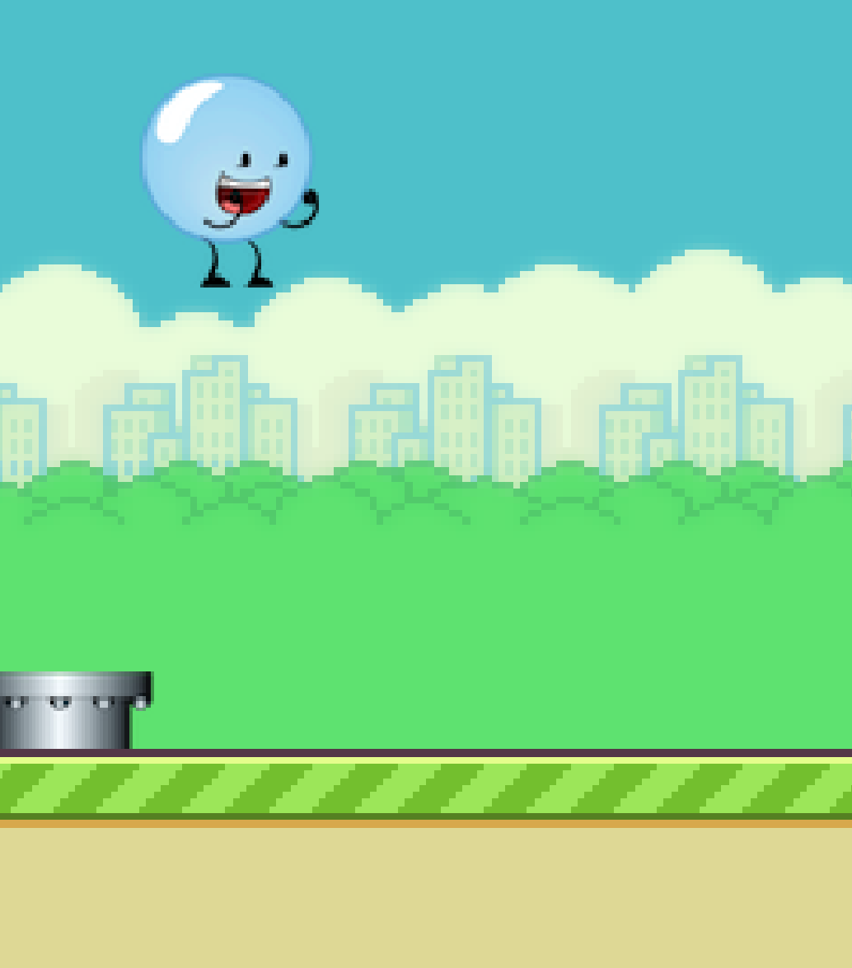
Implementing Proper Handwashing with the help of Persuasive Technology
Natalia Baker, Alec Winebrenner, Andrew Beers, K.C. Cole Woods, Adan Rutiaga

Slide 2
Foodborne Illness and Nosocomial Infections
Research shows that many of the disease-causing germs and bacteria are directly associated with poor hand washing hygiene habits of food service employees and healthcare professionals.
There aren’t any available technologies related to the problem of improper hand washing practices in the food and health industries.
Design a game that can run on most Android devices, and can be played at the same time the hands are being washed.
Averting the lack of interest and boredom that comes with the 30 seconds hand washing duration is a key concept in this project’s design.

Slide 3
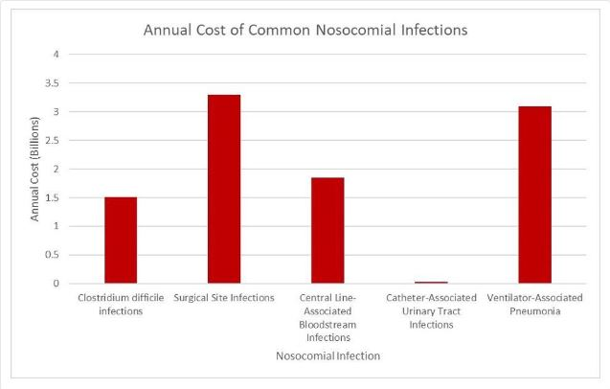
Statistics
The following graph demonstrates the cost of nosocomial infections in one year. These numbers are alarming when one considers that these diseases are inherently preventable.

Slide 4
Implementation
To combat this issue, we have created a game that the user can play whilst they wash their hands. A user interacts with the game via a foot pedal. By engaging with the game, the user is then more likely to spend more time washing their hands.
If results are statistically significant, this technology could be used in many more kitchens to help prevent the spread of disease.

Slide 5
Technologies
Android Studio/ Gradle – IDE with library manager and build tools.
LibGDX – Java library for game development.
GitHub – Work on code as a group and manage changes.
Keen.io – Analytics for game usage and hand washing duration.
Tablet Holder – Mount tablet permanently to wall.
Foot Pedal – Control the game while washing hands.

Slide 6
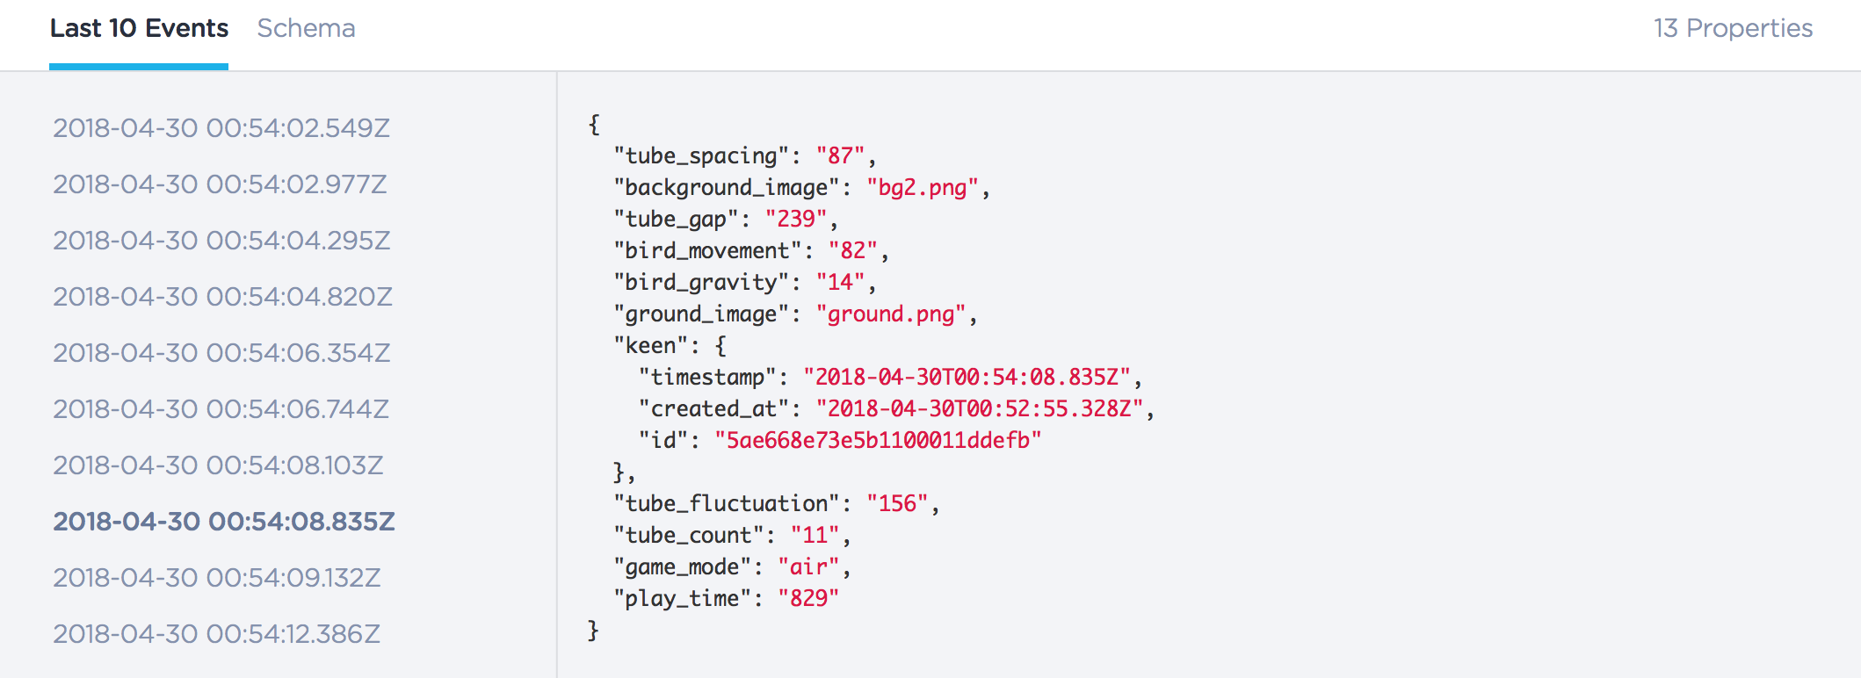
Keen.io Data Collection

Slide 7
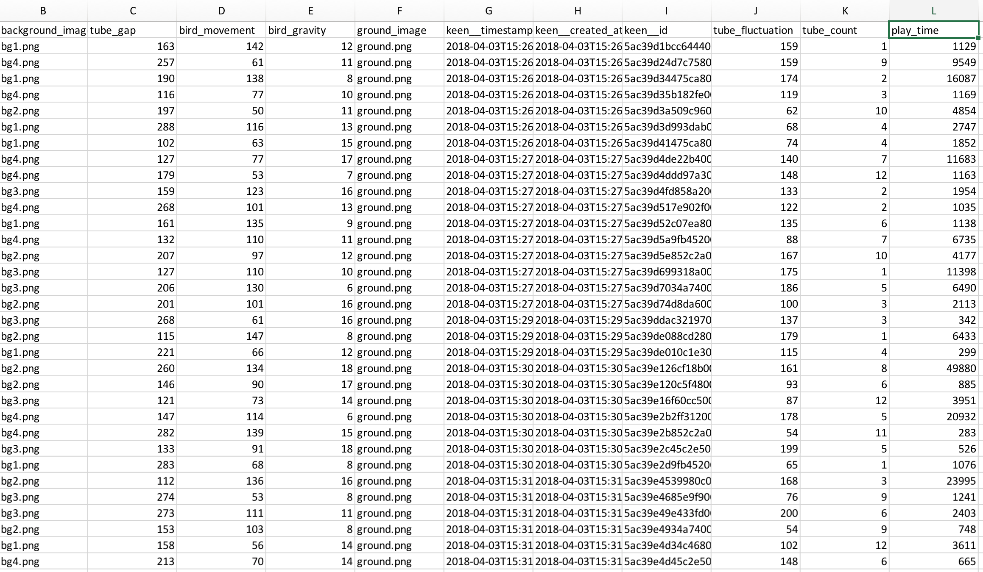
Excel Data Analysis
Data from Keen.io can be imported to Excel to discover data trends in gameplay and handwashing duration/frequency

Slide 8
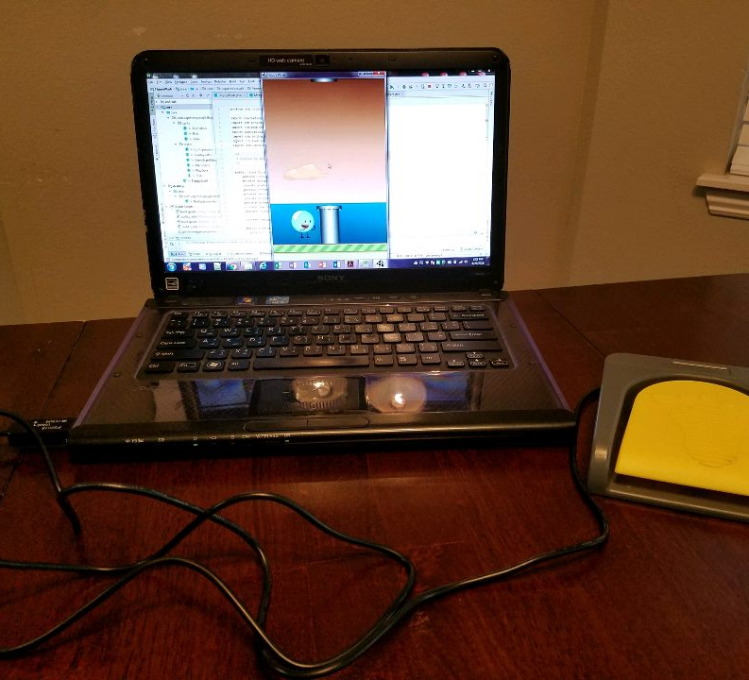
Results
After installing the game on a Windows Tablet, the project sponsor will deploy the game in U of A kitchen to determine whether this particular persuasive technology assists in improving proper handwashing techniques

Slide 9
Future Work
Migrate the game to a Windows Tablet to for Foot Pedal compatibility
1
Launch through Google Play Console to push updates and view crash logs
2
Add sensor to soap dispenser to verify that people are washing hands
3
Perform analytics on Keen.io data to determine extra hand-washing trends
4

Slide 10
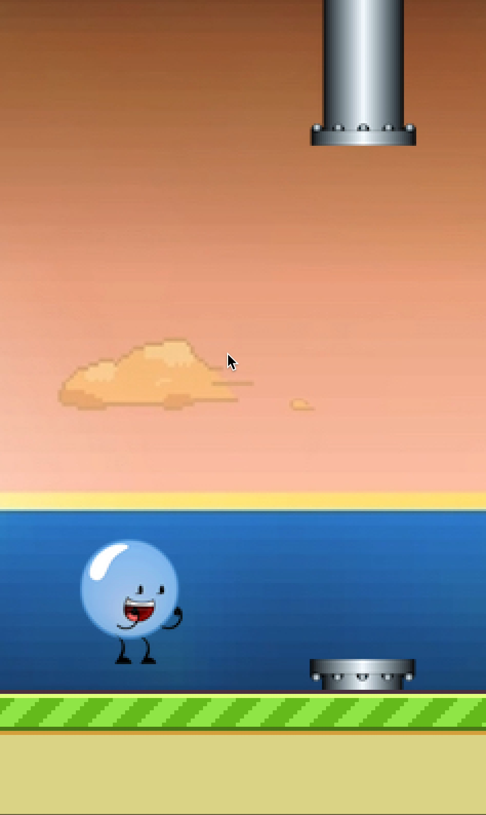
Live Demo/ Video

