Slide 1


A Multi-Tiered Framework for Mimotopes Optimization: Integrating Systematic Scanning with Deep-Learning Structural Proteomics
27nd of July, 2026

Slide 2
Agenda
  Background
  Data Analysis Workflow
  In Silico Variant Prioritization
  Structural Modelling
  Conclusion & Discussion
  References

Slide 3
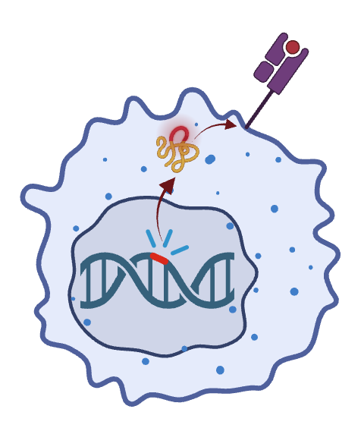


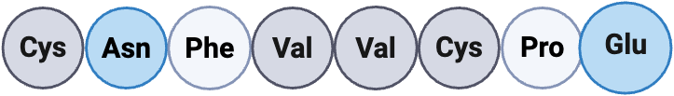



















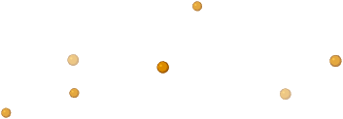




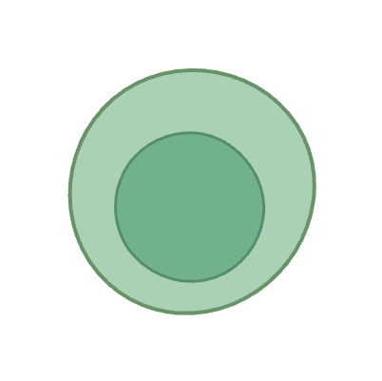
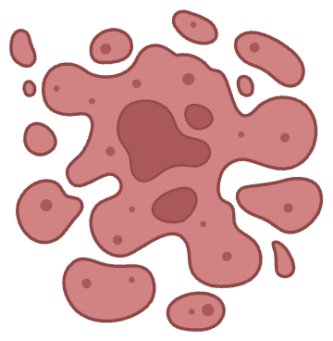






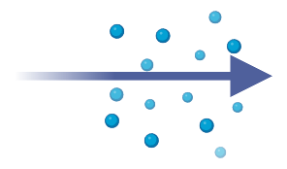





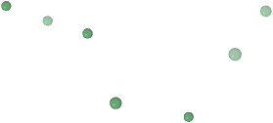

Tumor antigens are often poor immunogens
Tumor-derived peptide presented on MHC-I
Native peptide
Synthetic mimotope
Better TCR stimulation
  Many tumor antigens are self-antigens or differ only slightly from self
  High-affinity T cells recognizing these peptides are often deleted
  Even when peptide presentation occurs, the immune response can be weak
  This limits vaccine efficacy
Dendritic cell
Cytotoxic T cell
Synthetic mimotope
CD8
Stronger signaling
MHC-I
TCR
Weak CD8+ T-cell Activation
CD80
CD28
Tumor cell
Cross-recognition of the native tumor peptide
Germinal centre
Tumor site
Synthetic mimotope
PFN
MHC class I
Activation,
proliferation,
migration
GzmB
TCR
MHC I
TCR
Native peptide
low signaling
Cytotoxic T cell
CD80/
86
CD28
IFNγ
TNFα
Dendritic cell
T cell (naïve)
T cell (effector)
Cancer cell death

Slide 4
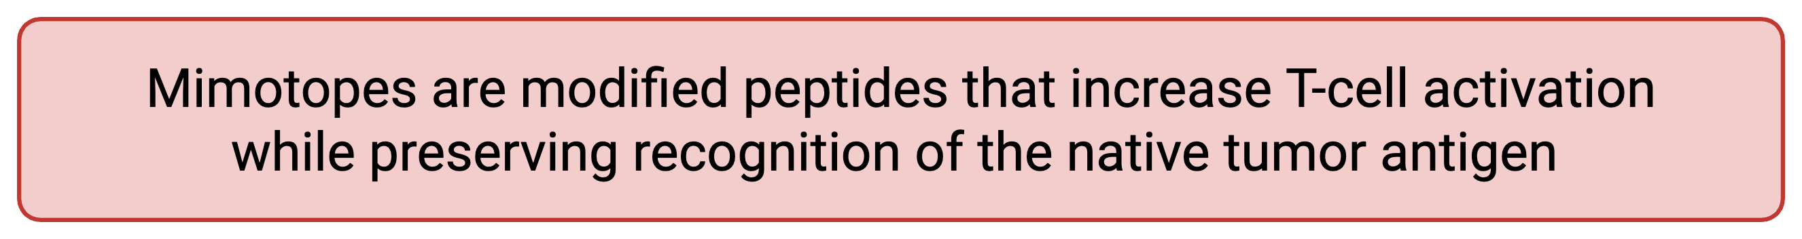
Tumor antigens are often poor immunogens
Tumor-derived peptide presented on MHC-I
Native peptide
Synthetic mimotope
Better TCR stimulation
  Many tumor antigens are self-antigens or differ only slightly from self
  High-affinity T cells recognizing these peptides are often deleted
  Even when peptide presentation occurs, the immune response can be weak
  This limits vaccine efficacy
Dendritic cell
Cytotoxic T cell
Synthetic mimotope
CD8
Stronger signaling
MHC-I
TCR
Weak CD8+ T-cell Activation
CD80
CD28
Tumor cell
Cross-recognition of the native tumor peptide
Germinal centre
Tumor site
Synthetic mimotope
PFN
MHC class I
Activation,
proliferation,
migration
GzmB
TCR
MHC I
TCR
Native peptide
low signaling
Cytotoxic T cell
CD80/
86
CD28
IFNγ
TNFα
Dendritic cell
T cell (naïve)
T cell (effector)
Cancer cell death

Slide 5





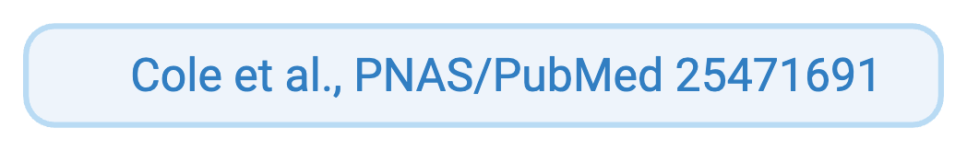


Real World Native Antigen Failures
WT Survivin (SVN53-67)
MART-1 WT (EAAGIGILTV)
gp100 WT (g209-1G)
Target: Glioblastoma & Solid Tumors
Target: Metastatic Melanoma
Target: Cutaneous Melanoma
Wildtype Survivin is universally overexpressed in cancer, yet the 9-mer core QCFFCFKEL exhibits negligible HLA-A*02:01 binding
Unmodified MART-1₂₆₋₃₅ failed to consistently elicit CTL expansion in clinical trials. Native Alanine at P2 destabilizes MHC-I anchor binding
Native gp100₂₀₉₋₂₁₇(ITDQVPFSV) produced minimal systemic T-cell responses in early human trials, necessitating anchor alteration (g209-2M) to stabilize the peptide.

Slide 6
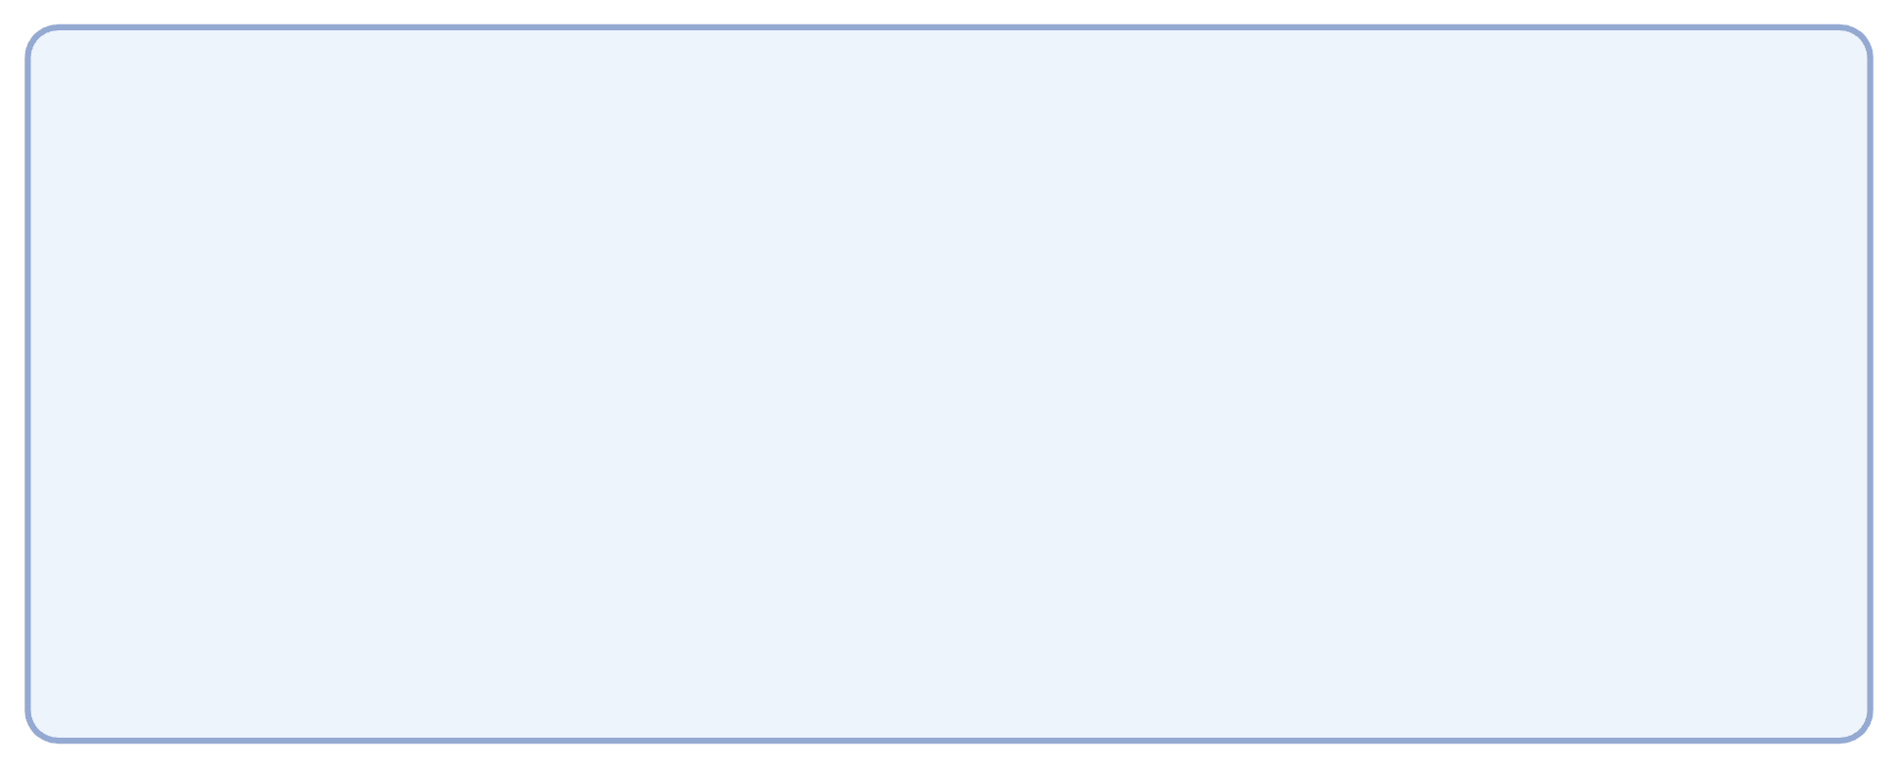
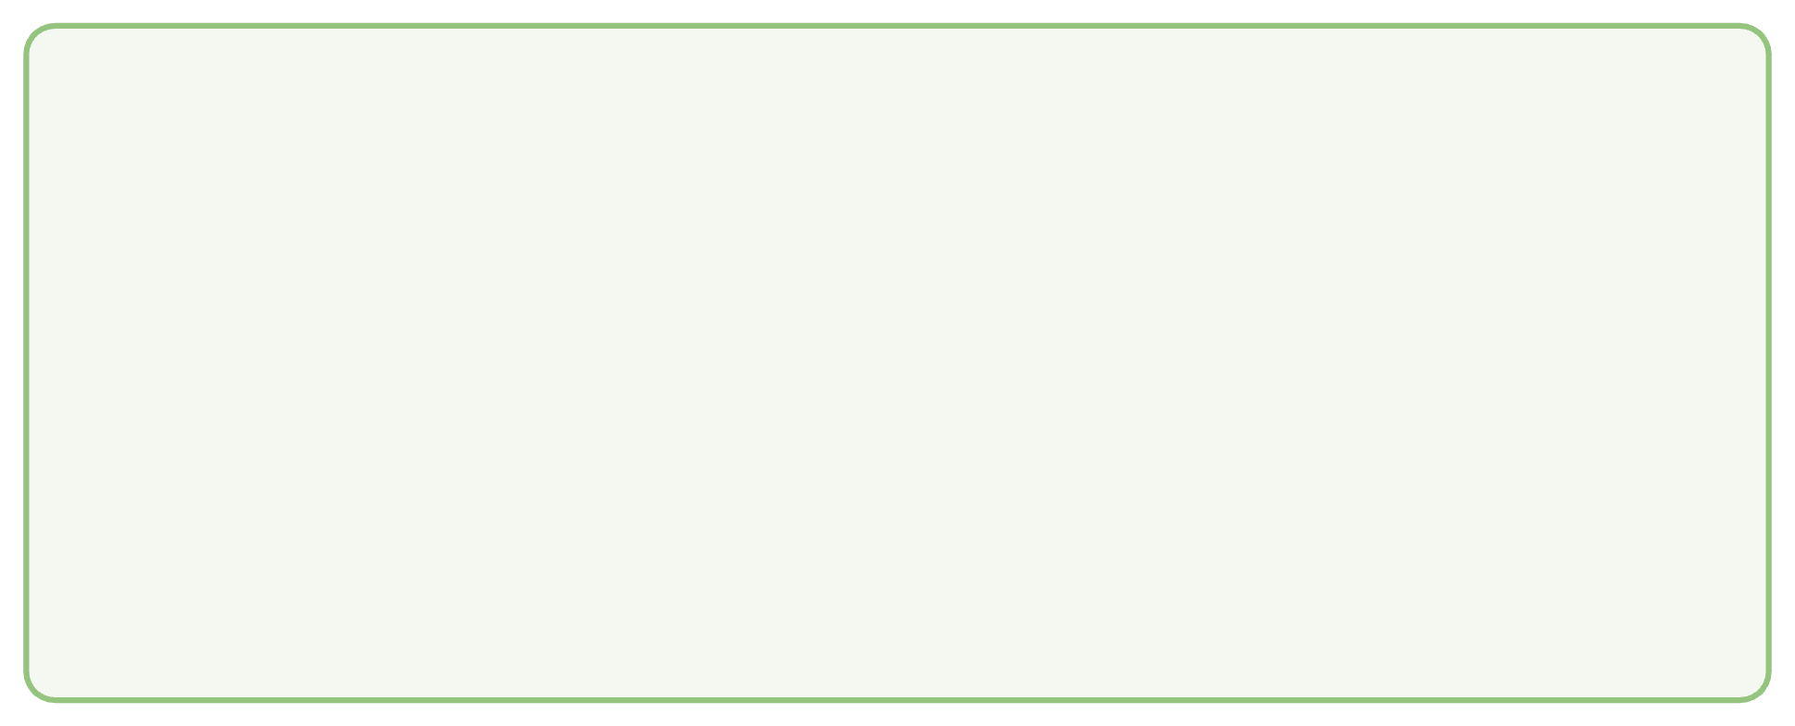
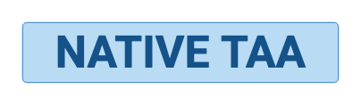
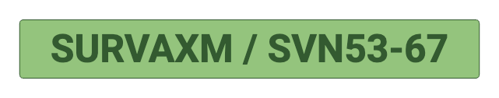





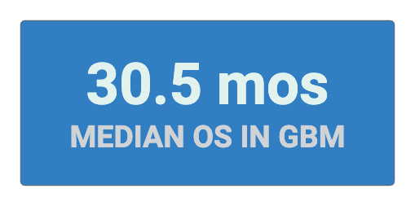
SurVaxM: Rational Mimotope Engineering
Wildtype Core 9-mer (AA 56-64)
Mimotope Core 9-mer (M57 Modification)
Q
F
F
C
F
K
E
L
Q
F
F
C
F
K
E
L
NCBI Ref / WT Survivin: Cysteine (C) at position 57 forms a weak P2 anchor. Rapid dissociation from HLA-A*02:01 groove prevents robust immune priming
SurVaxM C57M Engineering: Methionine (M) replacement at P2 provides optimal hydrophobic anchor docking, elevating MHC-I binding kinetics without altering TCR specificity
Clinical Milestone (Phase II Glioblastoma): SurVaxM (15-mer DLAQMFFCFKELEGW) coupled to KLH demonstrated strong CD8+ CTL expansion and high anti-survivin IgG titers, breaking self-tolerance to deliver 30.5 months median overall survival in GBM.

Slide 7
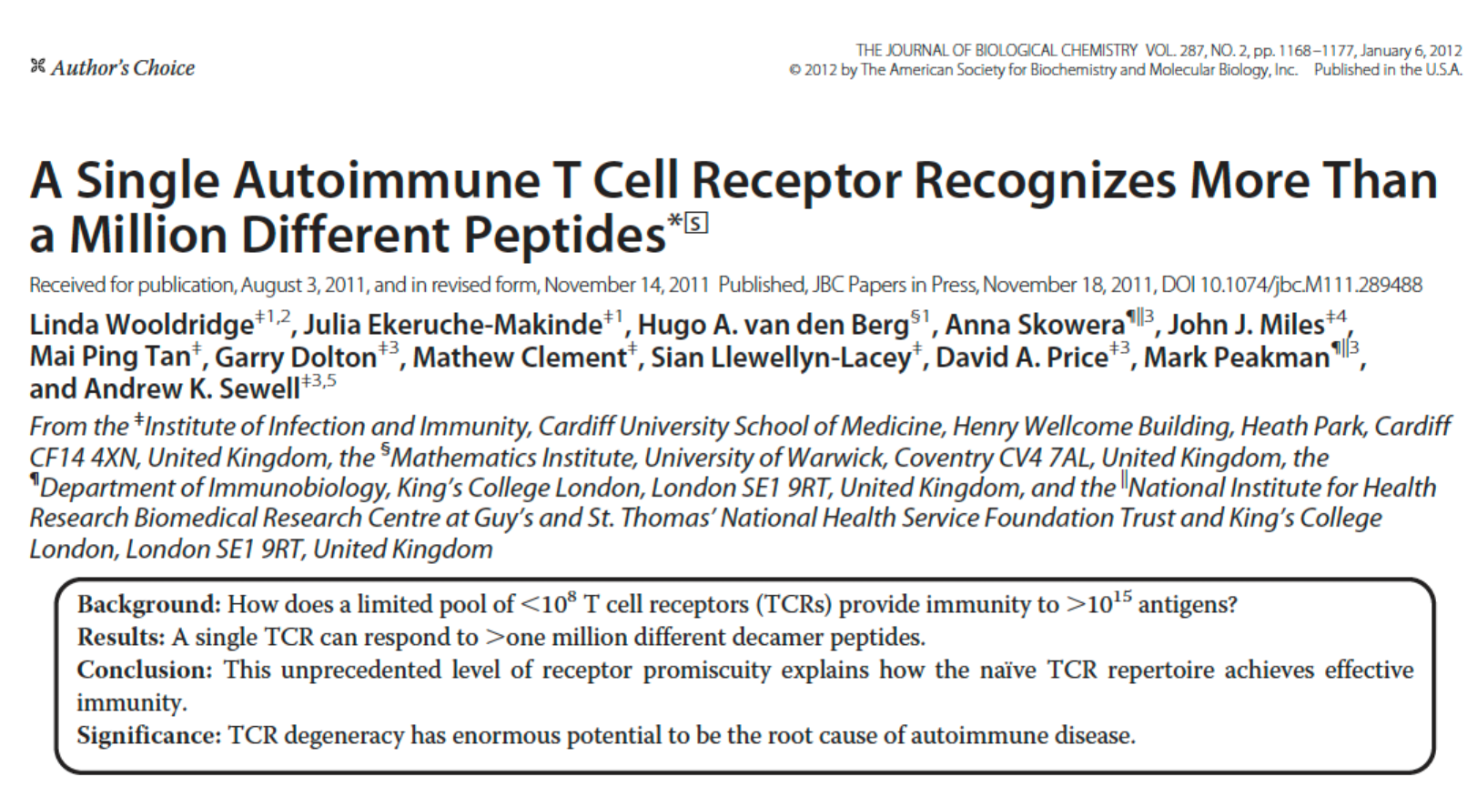
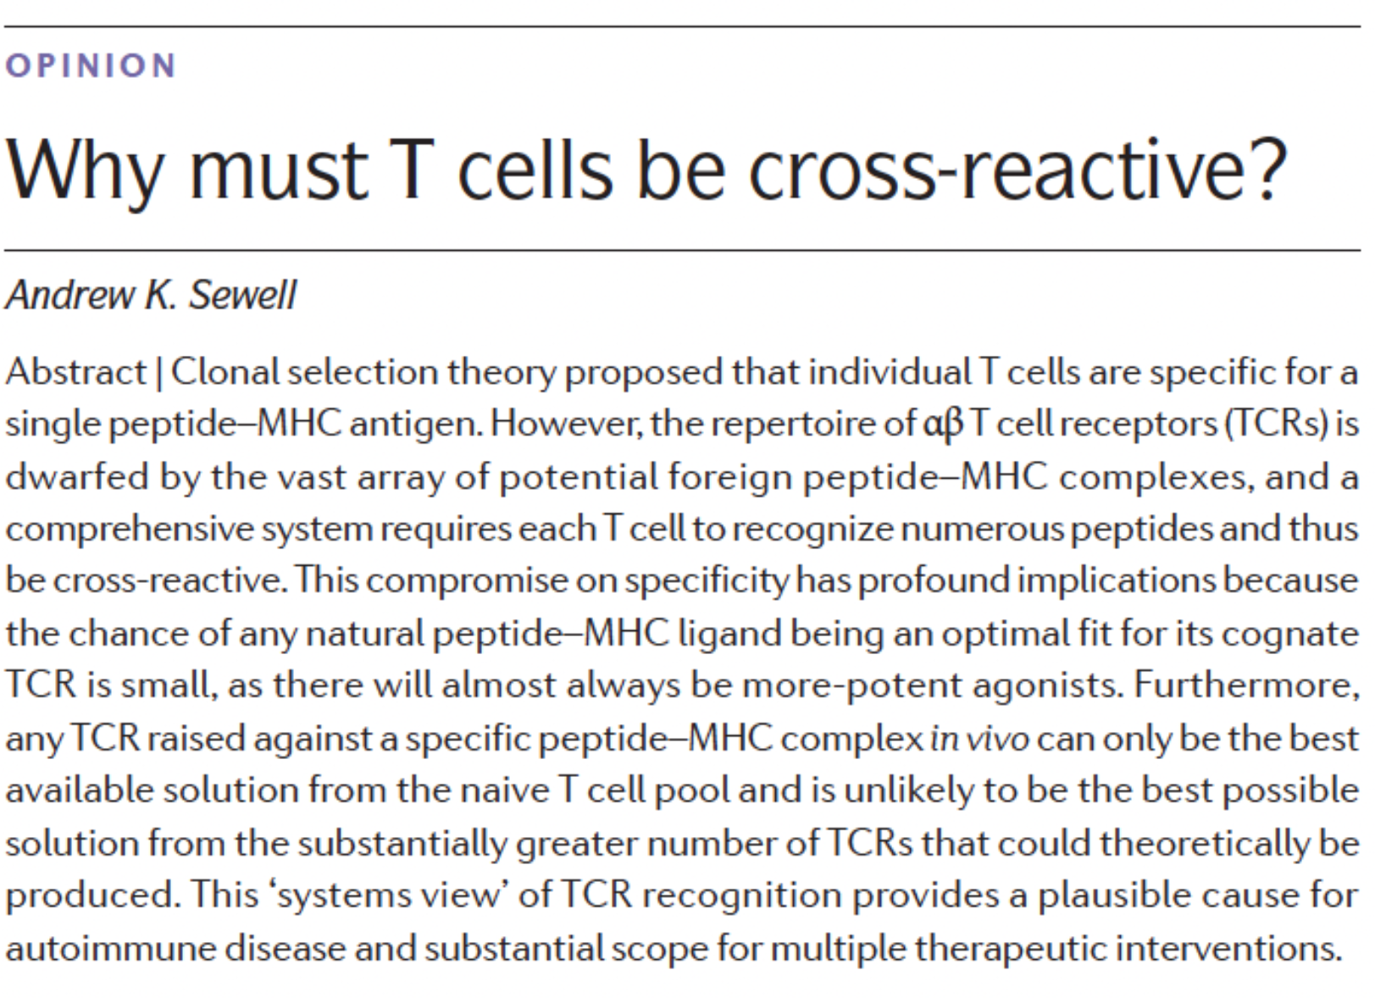
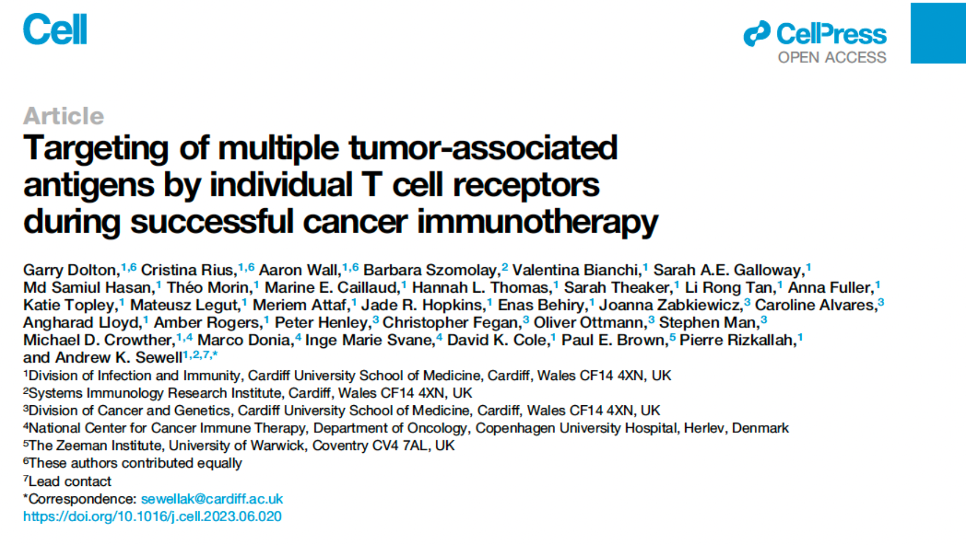
Andrew Sewell's Positional Scanning Approach
Synthetic Combinatorial Peptide Libraries (PS-CPLs)

Slide 8
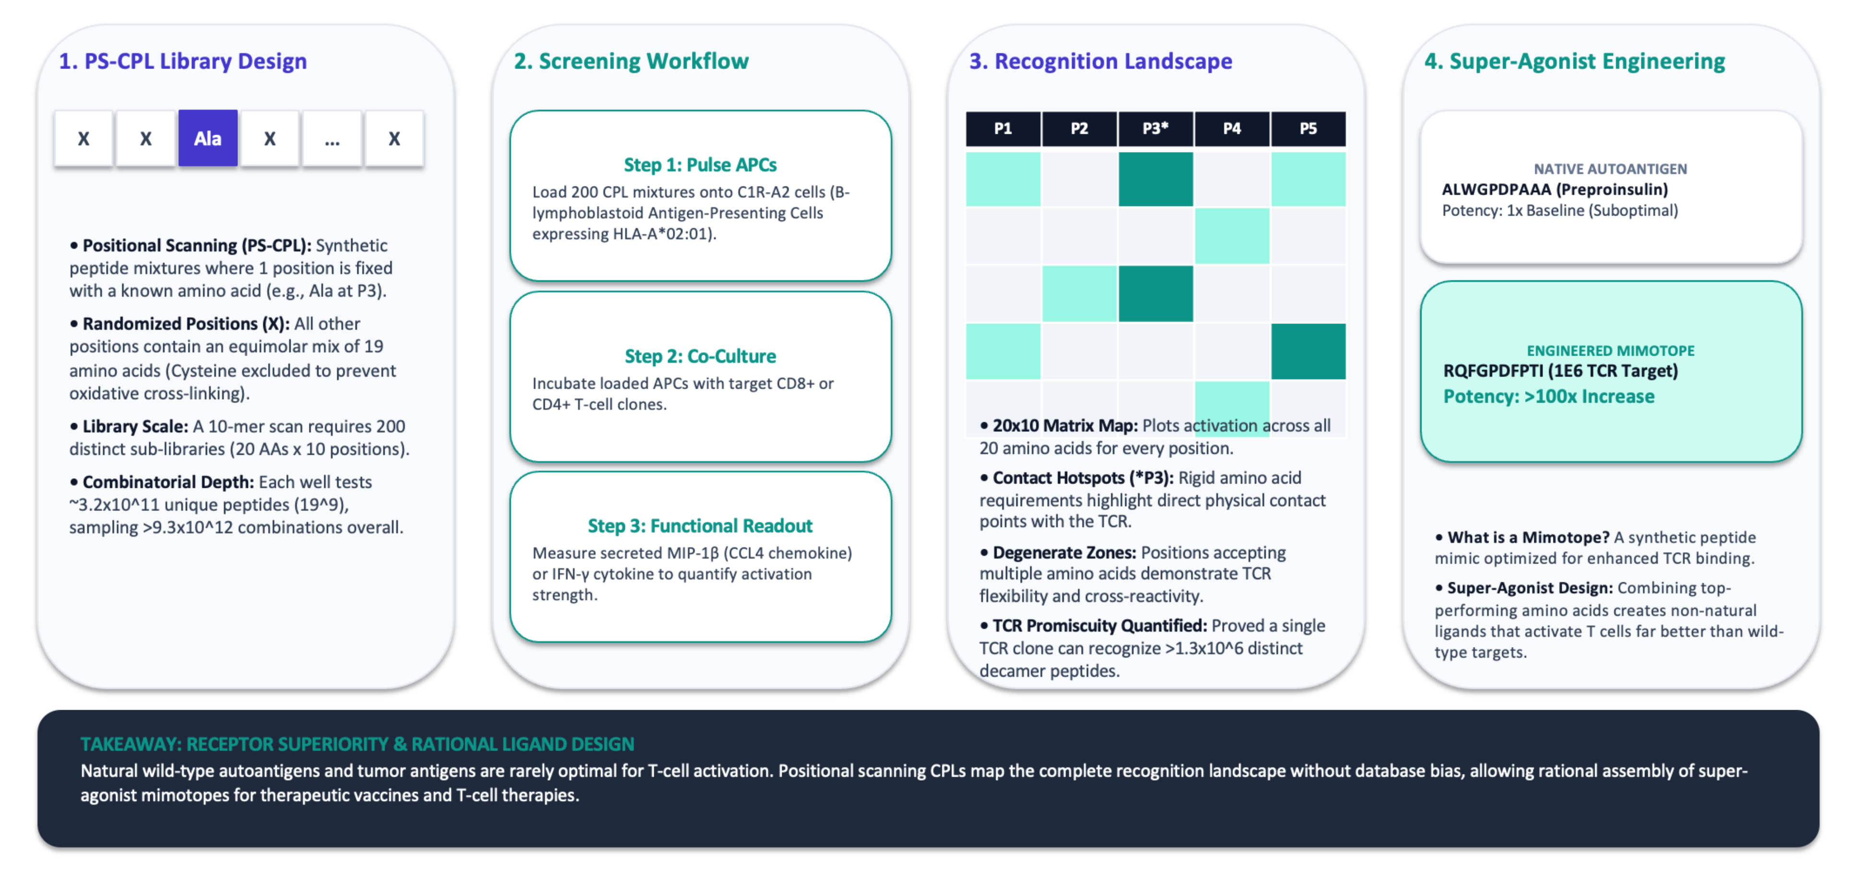
Andrew Sewell's Positional Scanning Approach
Synthetic Combinatorial Peptide Libraries (PS-CPLs)

Slide 9
What Is Missing in the Field?
  The "Positional Independence" Fallacy in CPLs
Standard CPL screening evaluates amino acid preferences at each position independently ignoring non-linear side-chain interactions, steric clashes, and cooperative pocket dynamics in 3D space.
2. Disconnect Between Sequence Predictors & Functional Activation
Current deep-learning models (NetMHCpan BA/EL) excel at predicting MHC presentation, but fail to predict true T-cell receptor (TCR) functional triggering potency or super-agonism.
3. The Computational Bottleneck of Unconstrained 3D Modeling
Running atomic-resolution structural screens (AlphaFold3 / Rosetta) across massive combinatorial spaces (10^11candidates) is computationally intractable without an empirical pre-filtration funnel.
4. Lack of Atomistic Rationale for Super-Agonism
Current approaches discover potent mimotopes empirically, but leave why they work as a black box missing the energetic (ΔG) and structural insights required for scalable rational design.

Slide 10

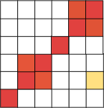

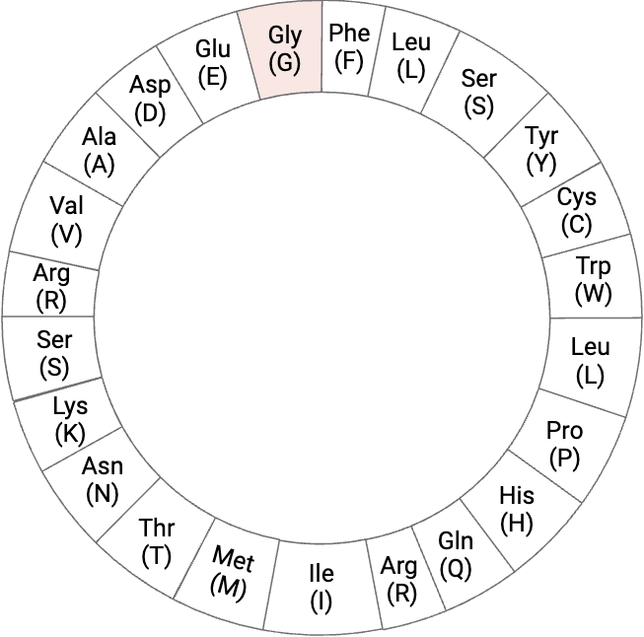

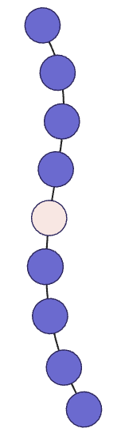


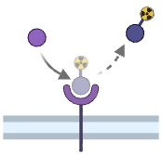

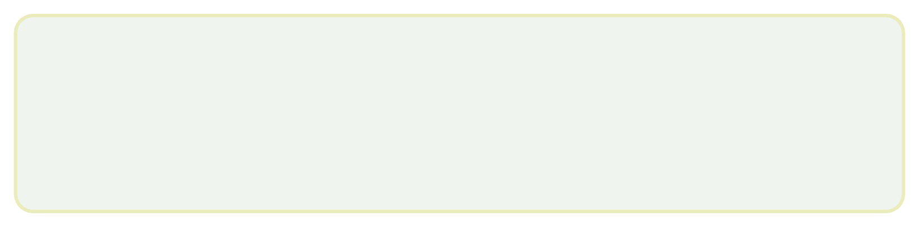




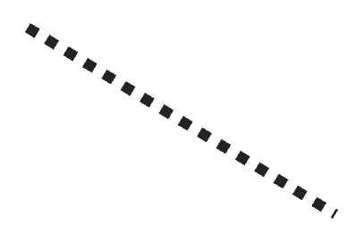


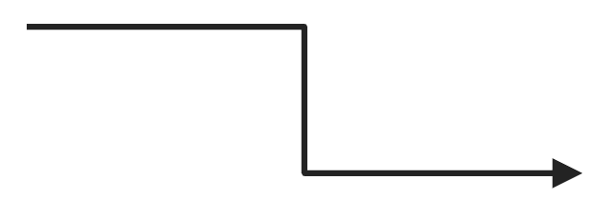



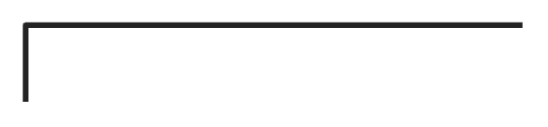
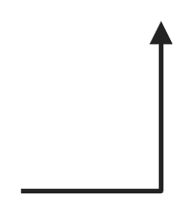


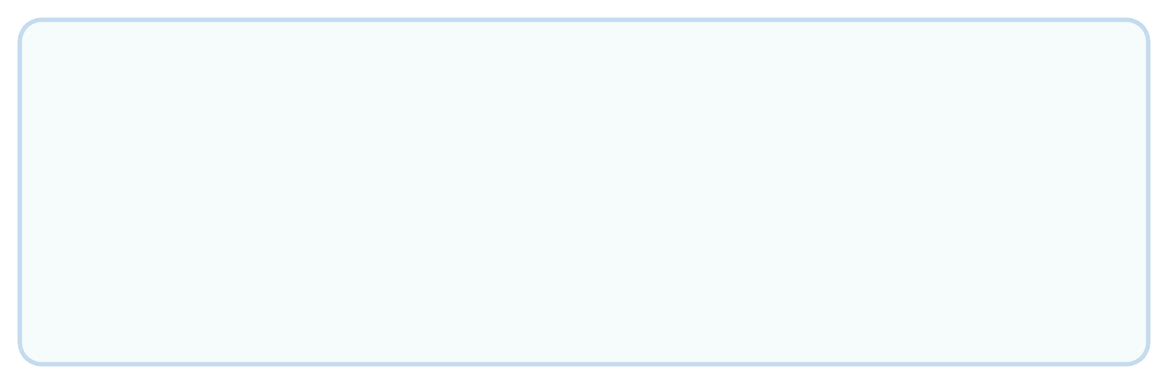
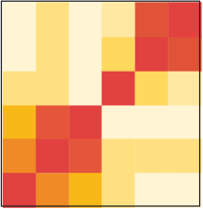
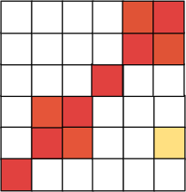




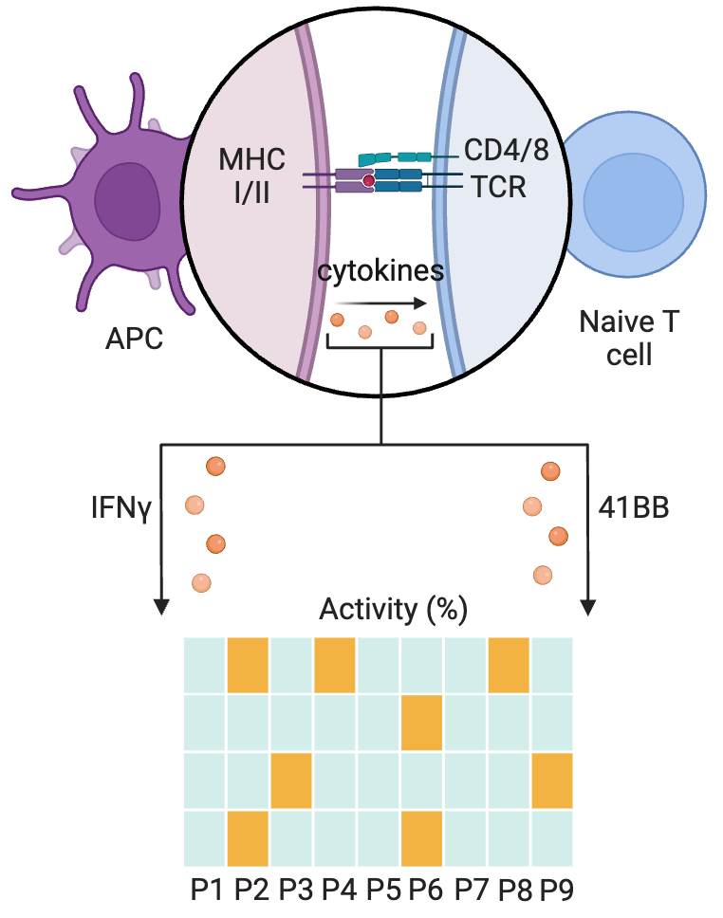
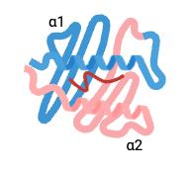

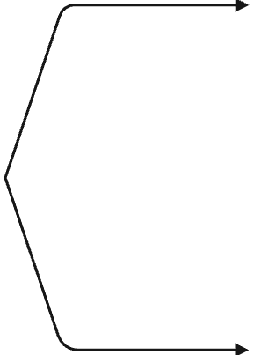
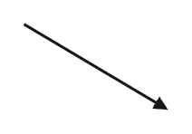


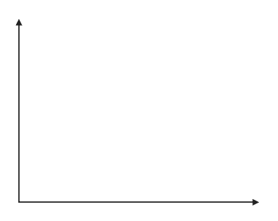







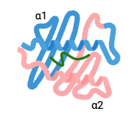
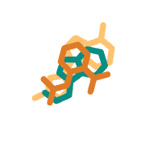





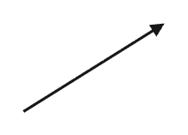

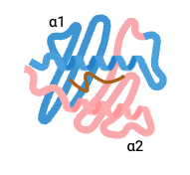
For all 9 positions, libraries for all 20 amino acids are generated systematically:
  1 amino acid is fixed
  the rest are randomized
QCFFCFKEL
SV-wild type (wt) 9mer
NetMHCPan
Binding Affinity
Elution Rank
AXXXXXXXX
..............
XXXXXXXXA
Donor 2 & Donor 3
1-AA candidates
CXXXXXXXX
XXXXXXXXC
Mutational Analysis
2-AA candidates
..............
..............
Selected Candidates
YXXXXXXXX
XXXXXXXXY
3,4,5,6, and 7 -AA candidates
PS-CPL guided Analysis
Donor 1:
CPL cytokines activity ratios
relative to the wt
Variant generation:
Fix 3-7 best scoring positions-aa; keep others WT
Best Scoring positions / aa
Candidate Peptides from Phase III
Molecular Dynamics Simulation
Top-scoring pHLA
Thermodynamic Scoring
ipTM
PAE
pLDDT
Rosetta
ΔG>0
Top candidates
AF3
Free energy
GROMACS
HLA-A*02:01
Final candidates with low RMSF

Slide 11
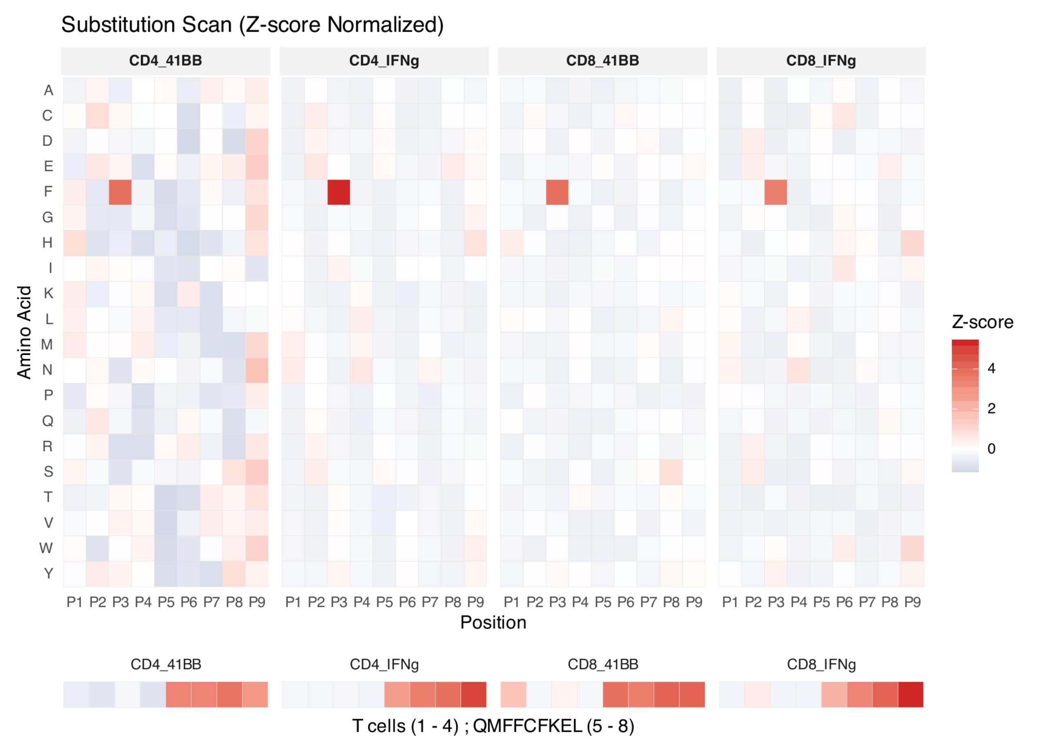
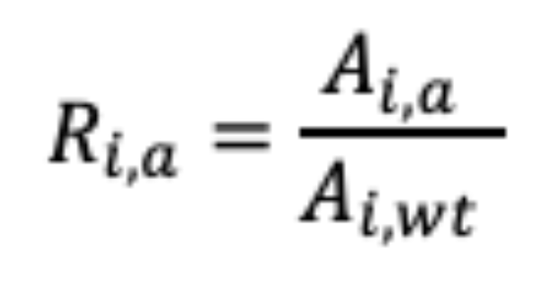
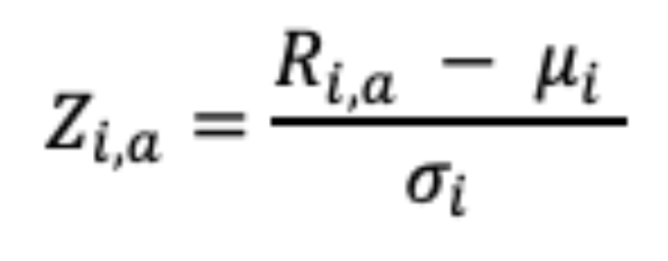
In Silico Variant Prioritization
Donor 1: PS-CPL Activity Ratios
  A_{i,a} = Activation (%) for amino acid a at position i
  A_{i,wt} = Activation (%) for the wild-type residue at position i
  R_{i,a} = Activity ratio
  μ_{i} = mean activity ratio at position i
  σ_{i} = standard deviation of activity ratios at position i
Activity Ratio:
Z-score normalization:

Slide 12
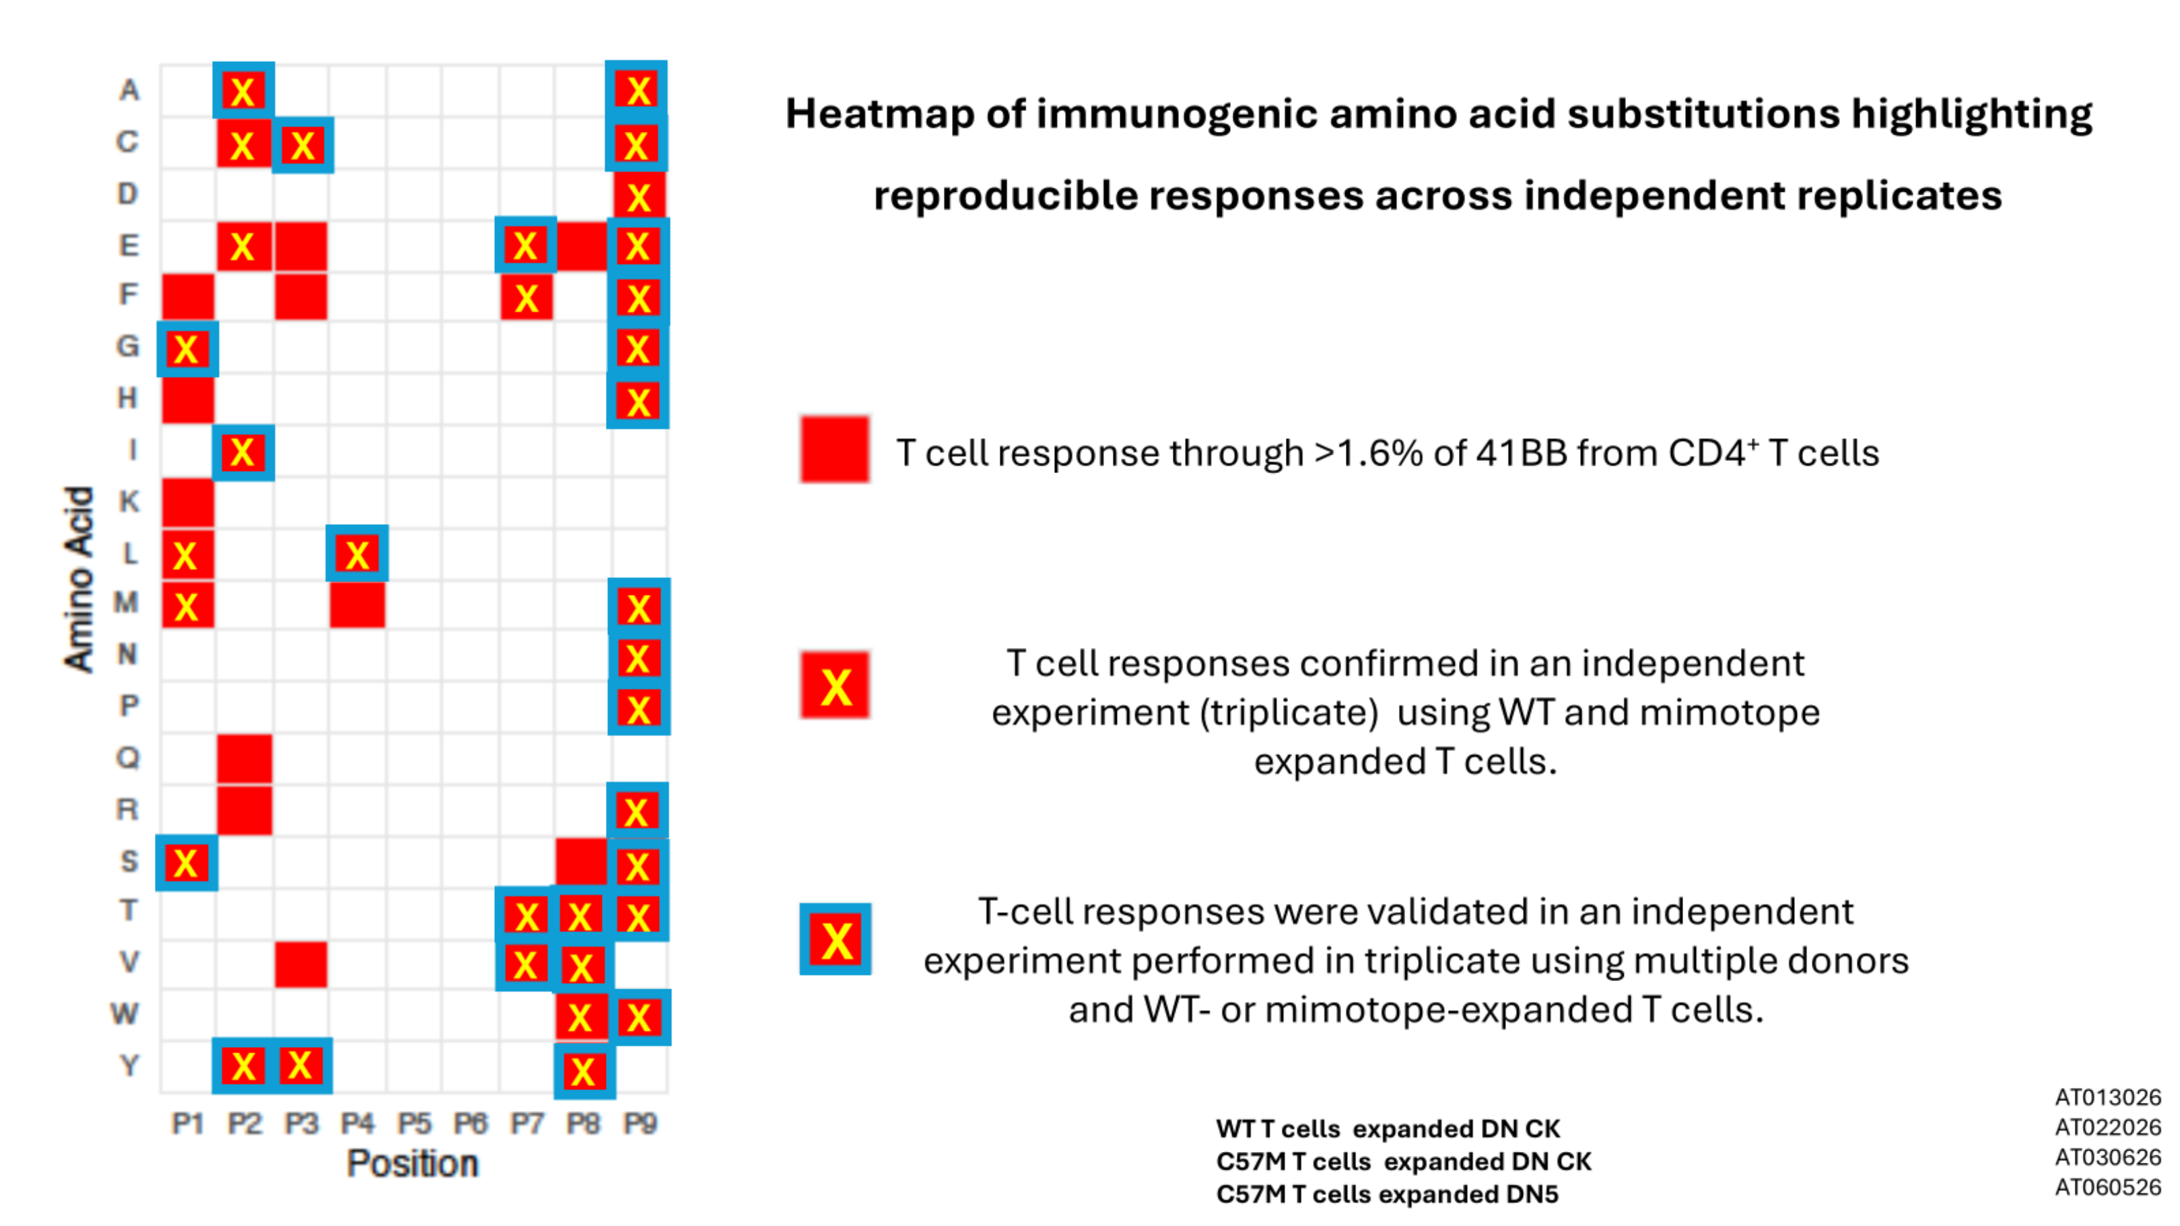
In Silico Variant Prioritization
Best scoring positions and amino acids

Slide 13
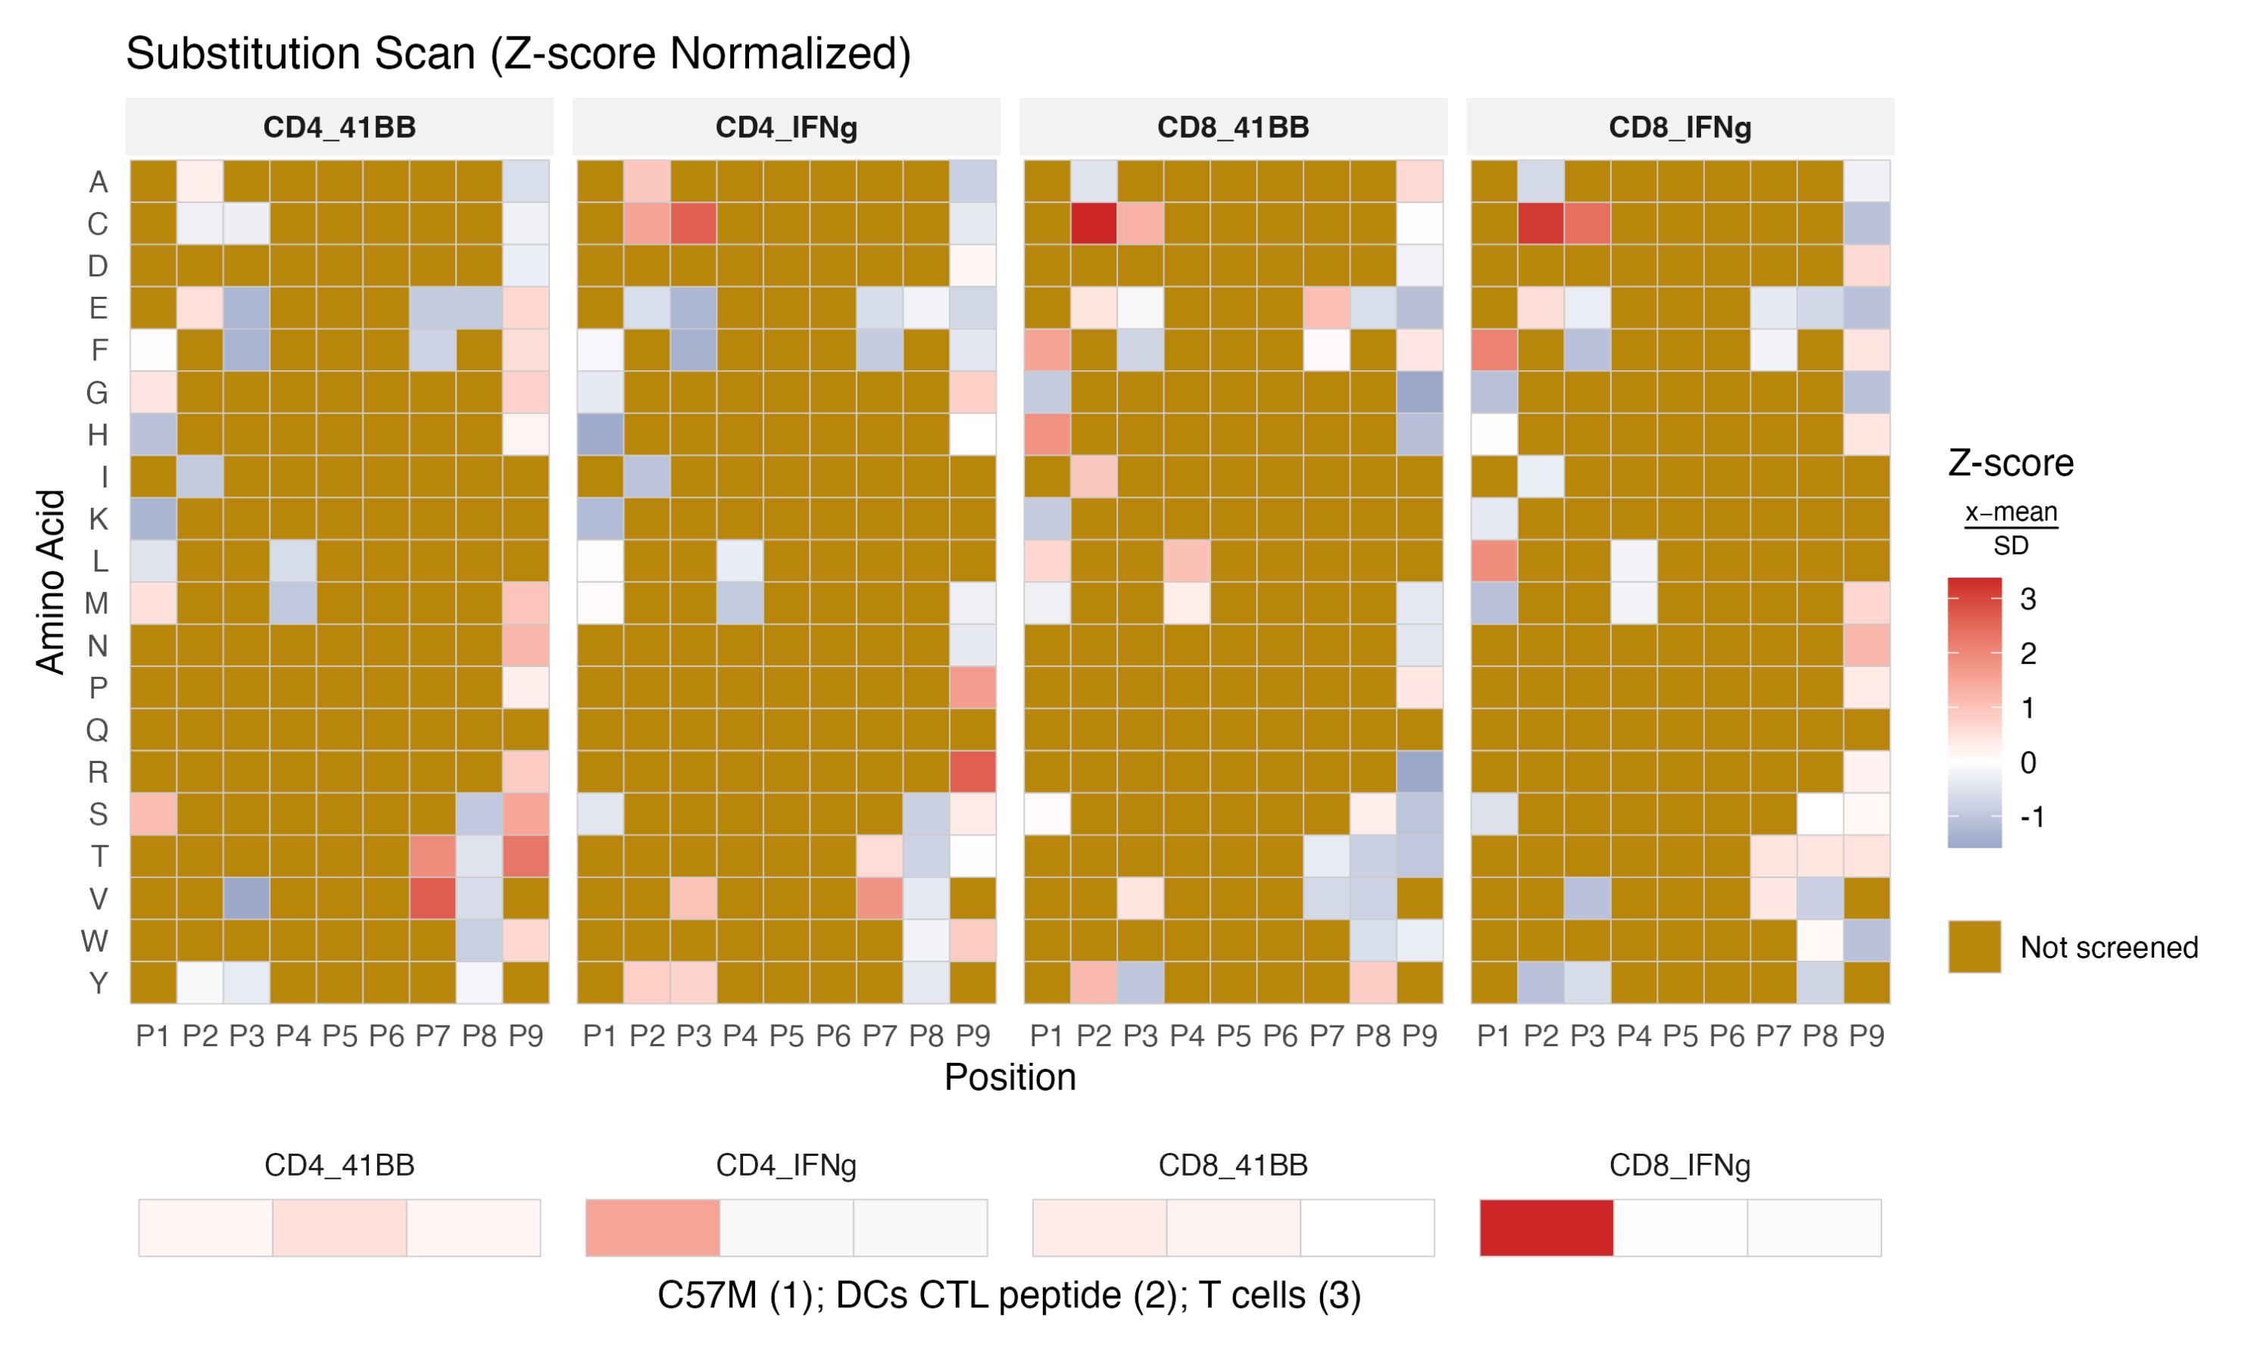
In Silico Variant Prioritization
Donor 2: PS-CPL Activity Ratios

Slide 14
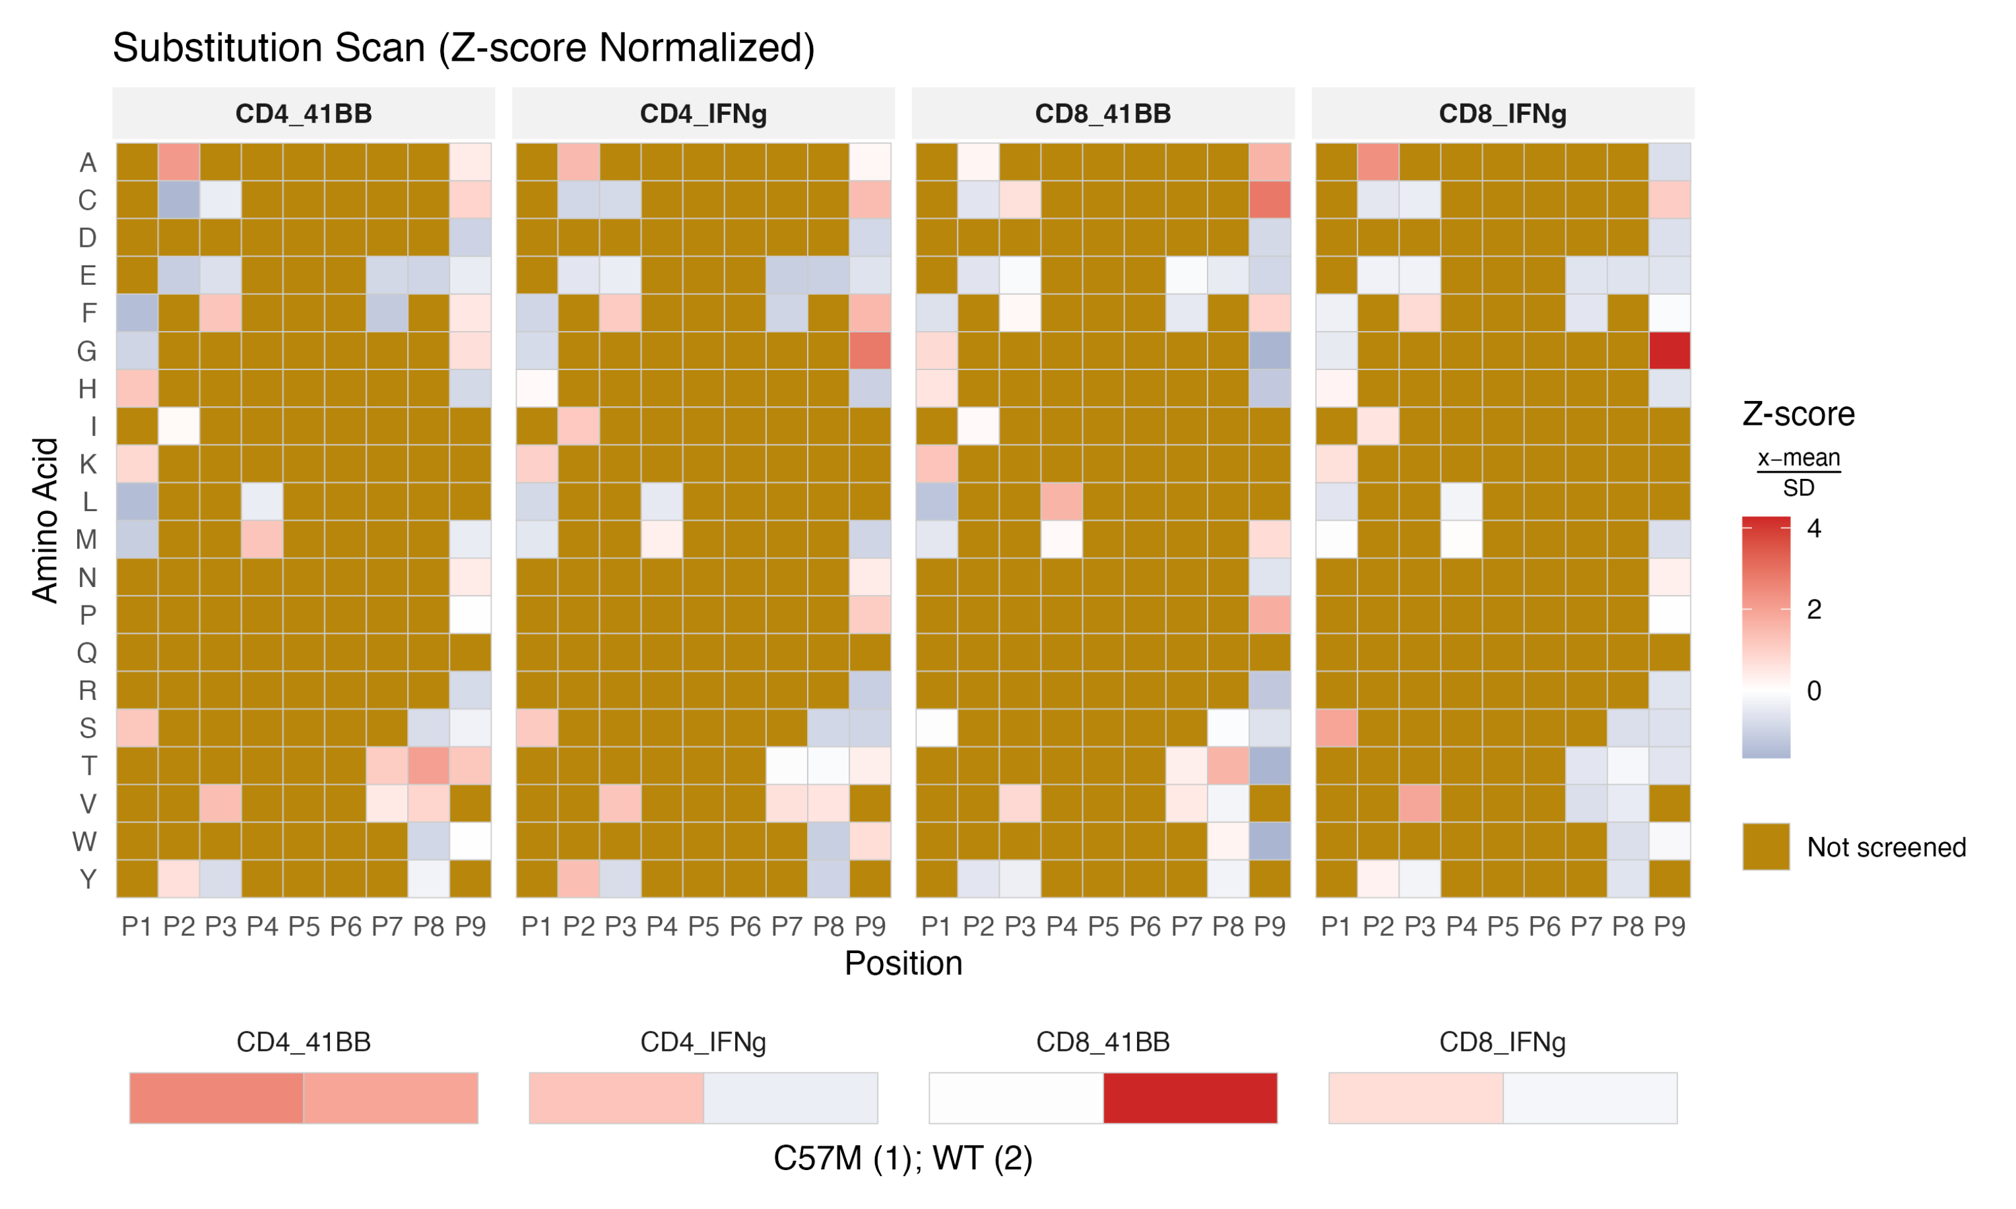
In Silico Variant Prioritization
Donor 3: PS-CPL Activity Ratios

Slide 15


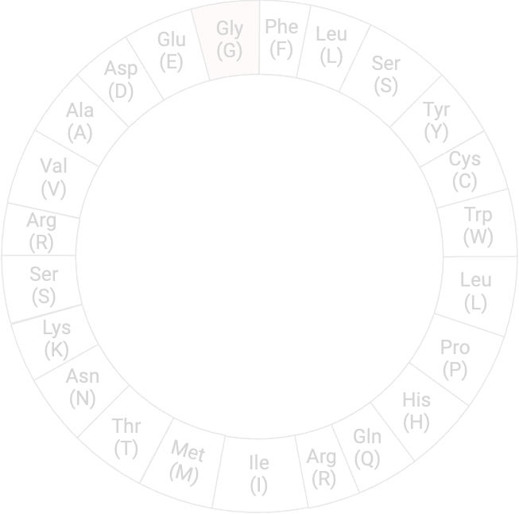






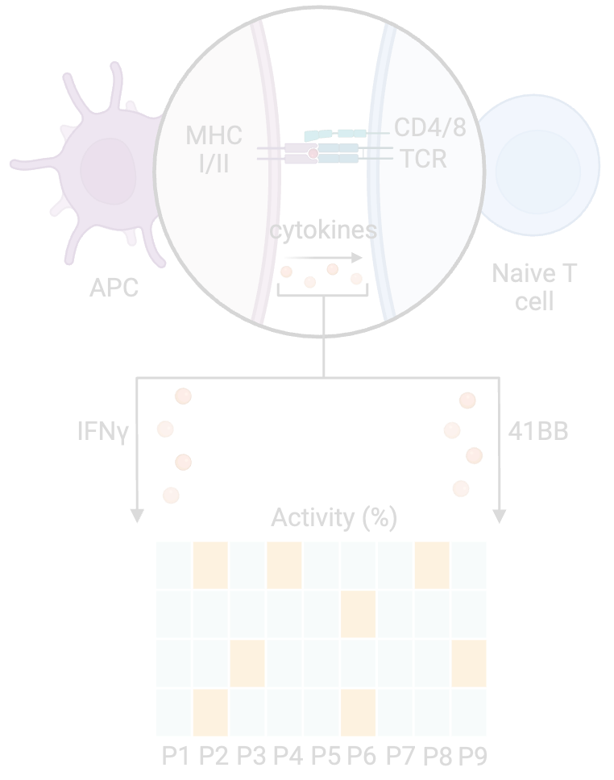

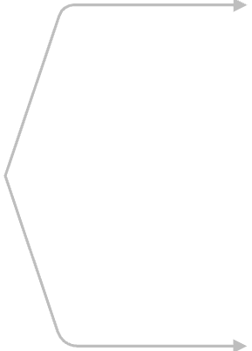
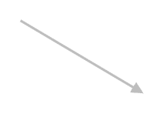





















For all 9 positions, libraries for all 20 amino acids are generated systematically:
  1 amino acid is fixed
  the rest are randomized
QCFFCFKEL
SV-wild type (wt) 9mer
NetMHCPan
Binding Affinity
Elution Rank
AXXXXXXXX
..............
XXXXXXXXA
Donor 2 & Donor 3
1-AA candidates
CXXXXXXXX
XXXXXXXXC
Mutational Analysis
2-AA candidates
..............
..............
Selected Candidates
YXXXXXXXX
XXXXXXXXY
3,4,5,6, and 7 -AA candidates
PS-CPL guided Analysis
Donor 1:
CPL cytokines activity ratios
relative to the wt
Variant generation:
Fix 3-7 best scoring positions-aa; keep others WT
Best Scoring positions / aa
Candidate Peptides from Phase III
Molecular Dynamics Simulation
Top-scoring pHLA
Thermodynamic Scoring
ipTM
PAE
pLDDT
Rosetta
ΔG>0
Top candidates
AF3
Free energy
GROMACS
HLA-A*02:01
Final candidates with low RMSF

Slide 16
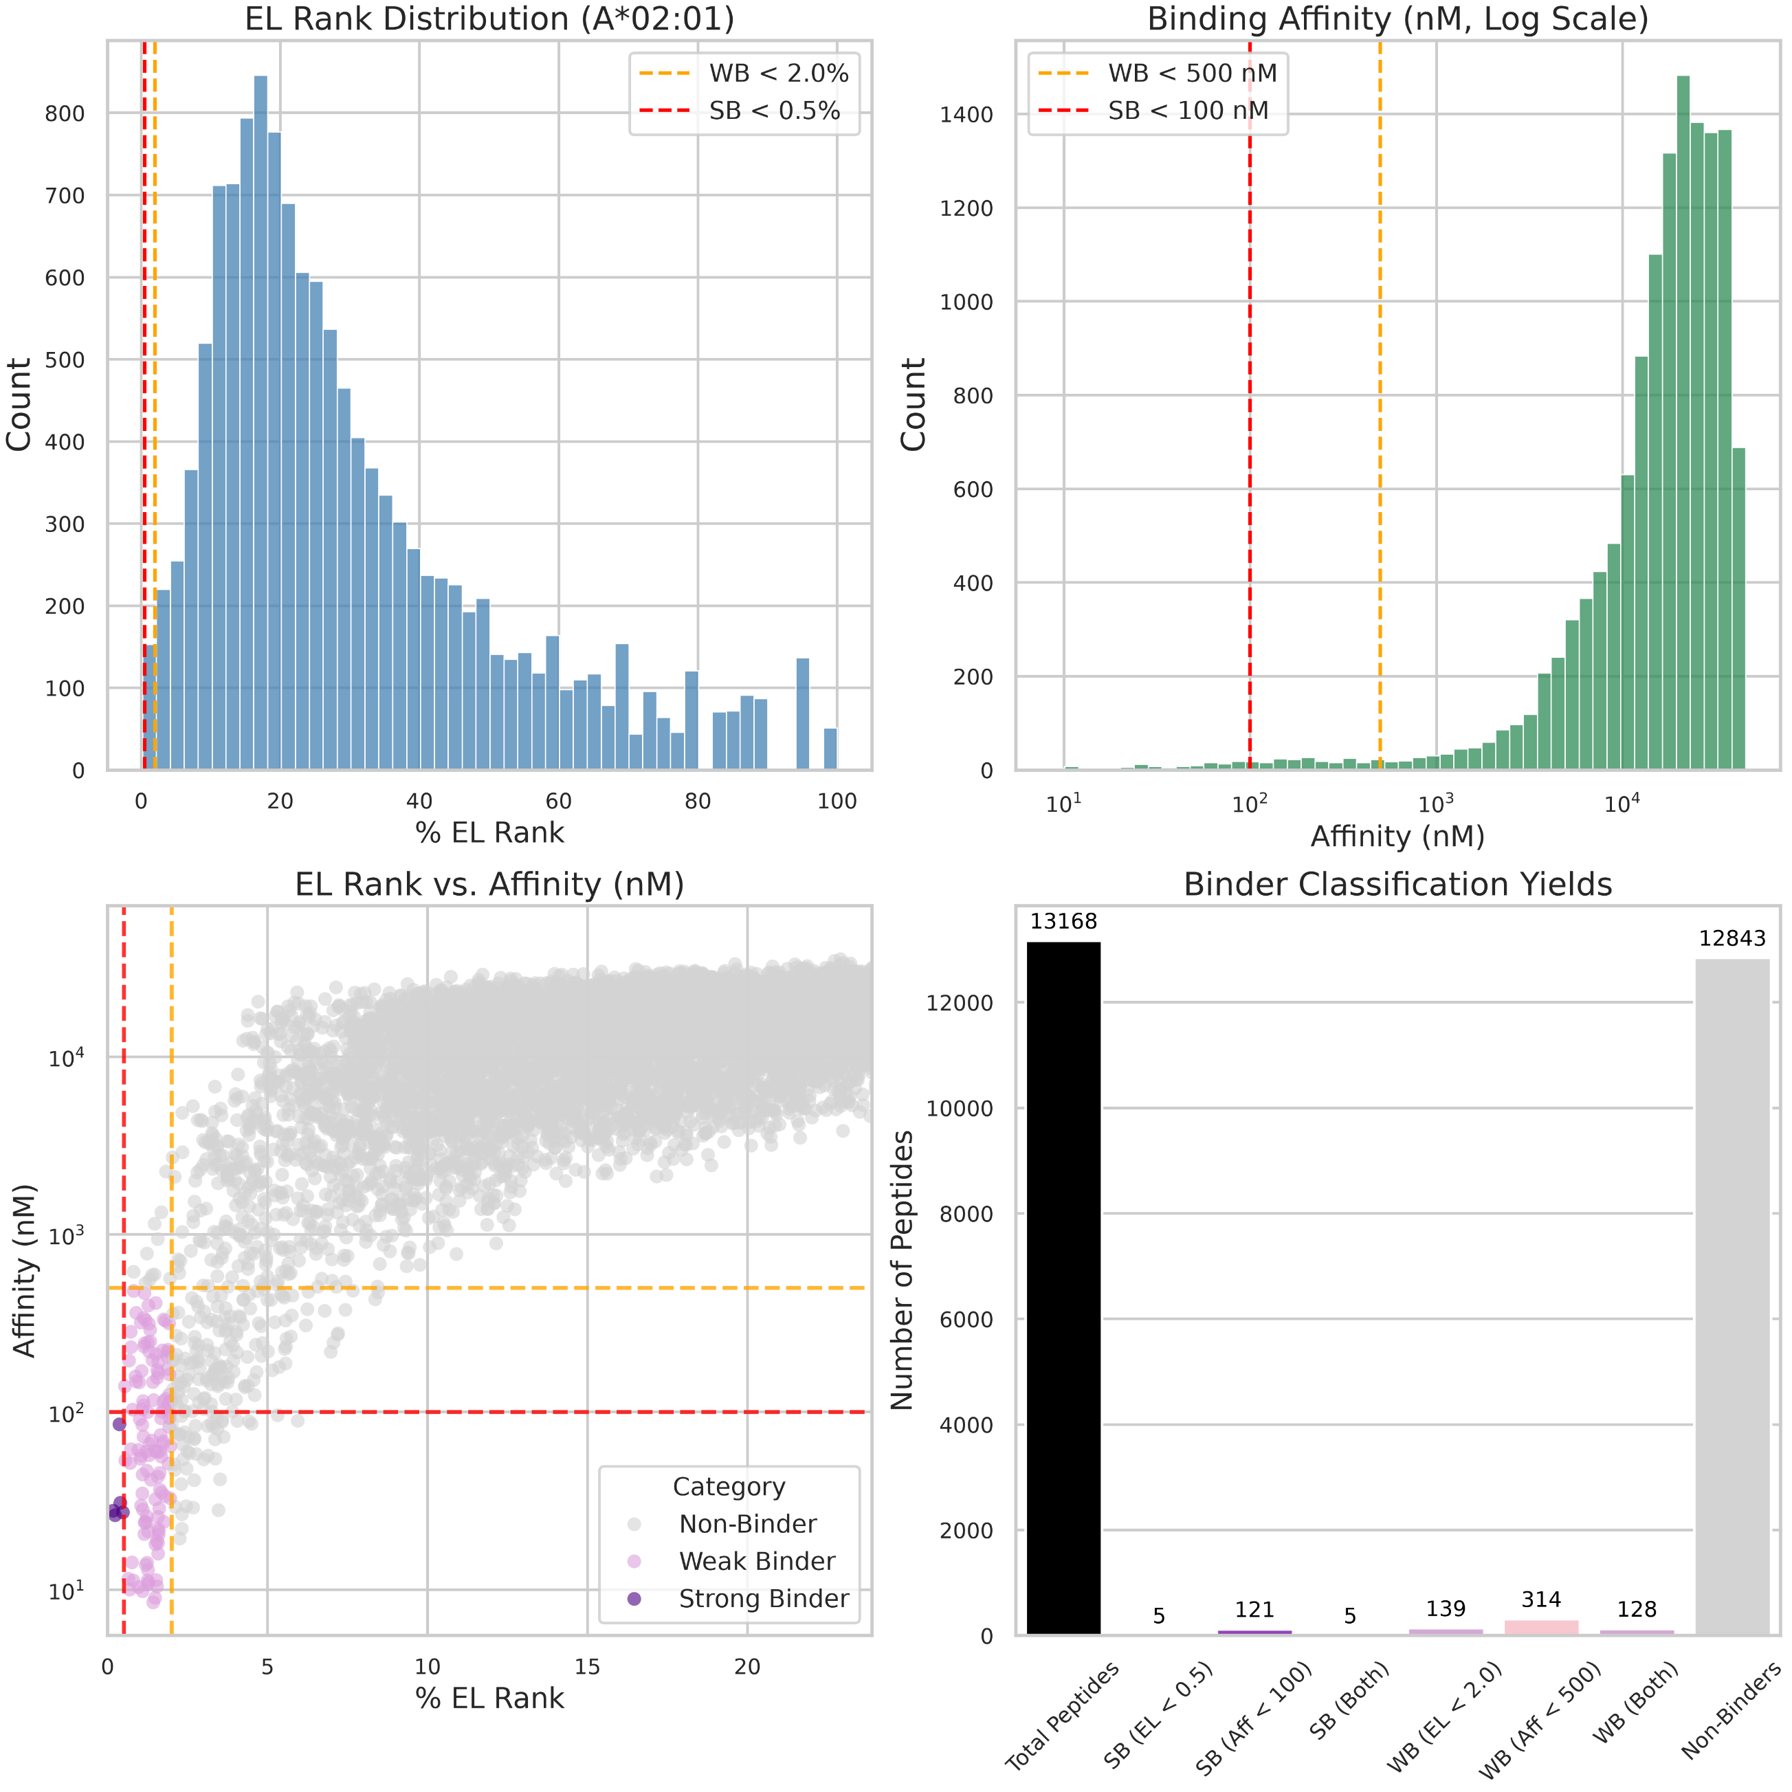
In Silico Variant Prioritization
Mutational Analysis
  1-AA: 171 candidates
  2-AA: 12,996 candidates
  Total 13,168 peptides (including WT)

Slide 17

In Silico Variant Prioritization
Mutational Analysis
Cytokine Composite Score Calculation
Purpose: Evaluate functional T-cell activation across donors while accounting for multiple activation readouts (4-1BB and IFNg expression) using two-stage aggregation.
Stage A: Donor-Specific Geometric mean
For each individual donor {donor 1, donor 2, donor 3}:
Stage B: Global Cross-Donor Compos
The global composite score for each T-cell (CD4 and CD8) is the arithmetic mean across all valid (non-NaN) donors k.

Slide 18


Slide 19

In Silico Variant Prioritization
Mutational Analysis
Tier
Name
%Rank_EL
CD8_Composite
CD4_Composite
1
High Binder & Dual Active
<2.0
>1.0
>1.0
2
High Binder & CD8 Active
<2.0
>1.0
NA
3
Borderline Binder & CD8 Active
<3.0
>1.0
NA
4
Non-Binder & CD8 Active
NA
>1.0
NA
5
Missing Data
NA
NA
NA

Slide 20


In Silico Variant Prioritization
Mutational Analysis
Tier
Name
%Rank_EL
CD8_Composite
CD4_Composite
1
High Binder & Dual Active
<2.0
>1.0
>1.0
2
High Binder & CD8 Active
<2.0
>1.0
NA
3
Borderline Binder & CD8 Active
<3.0
>1.0
NA
4
Non-Binder & CD8 Active
NA
>1.0
NA
5
Missing Data
NA
NA
NA

Slide 21

For all 9 positions, libraries for all 20 amino acids are generated systematically:
  1 amino acid is fixed
  the rest are randomized
QCFFCFKEL
SV-wild type (wt) 9mer
NetMHCPan
Binding Affinity
Elution Rank
AXXXXXXXX
..............
XXXXXXXXA
Donor 2 & Donor 3
1-AA candidates
CXXXXXXXX
XXXXXXXXC
Mutational Analysis
2-AA candidates
..............
..............
Selected Candidates
YXXXXXXXX
XXXXXXXXY
3,4,5,6, and 7 -AA candidates
PS-CPL guided Analysis
Donor 1:
CPL cytokines activity ratios
relative to the wt
Variant generation:
Fix 3-7 best scoring positions-aa; keep others WT
Best Scoring positions / aa
Candidate Peptides from Phase III
Molecular Dynamics Simulation
Top-scoring pHLA
Thermodynamic Scoring
ipTM
PAE
pLDDT
Rosetta
ΔG>0
Top candidates
AF3
Free energy
GROMACS
HLA-A*02:01
Final candidates with low RMSF

Slide 22

In Silico Variant Prioritization
PS-CPL guided analysis

Slide 23

In Silico Variant Prioritization
PS-CPL guided analysis

Slide 24





























For all 9 positions, libraries for all 20 amino acids are generated systematically:
  1 amino acid is fixed
  the rest are randomized
QCFFCFKEL
SV-wild type (wt) 9mer
NetMHCPan
Binding Affinity
Elution Rank
AXXXXXXXX
..............
XXXXXXXXA
Donor 2 & Donor 3
1-AA candidates
CXXXXXXXX
XXXXXXXXC
Mutational Analysis
2-AA candidates
..............
..............
Selected Candidates
YXXXXXXXX
XXXXXXXXY
3,4,5,6, and 7 -AA candidates
PS-CPL guided Analysis
Donor 1:
CPL cytokines activity ratios
relative to the wt
Variant generation:
Fix 3-7 best scoring positions-aa; keep others WT
Best Scoring positions / aa
Candidate Peptides from Phase III
Molecular Dynamics Simulation
Top-scoring pHLA
Thermodynamic Scoring
ipTM
PAE
pLDDT
Rosetta
ΔG>0
Top candidates
AF3
Free energy
GROMACS
HLA-A*02:01
Final candidates with low RMSF

Slide 25





Structural Modelling
AlphaFold3 Input & Metrics
129 Candidate 9-mers:
  49: 1-AA
  50: 2-AA
  30: CPL guided
HLA-A*02:01
B2M
Excluded:
  HLA signal peptide
  HLA transmembrane domain
  B2M signal peptide

Slide 26

Structural Modelling
AlphaFold3 vs Rosetta
Comparative Overview
Dimension
AlphaFold3 (AF3)
Rosetta (FastRelax / InterfaceAnalyzer)
Model Architecture & Training
Deep neural network (Pairformer + Generative Diffusion Module) trained end-to-end on experimental 3D structures in the PDB
Semi-classical physical force field (ref2015) parameterized from biophysical constants and statistical rotamer libraries.
Generates 3D atomic coordinates directly via a denoising diffusion process; outputs predicted distance error probability distributions.
Performs Monte Carlo sampling of torsional space (FastRelax), followed by explicit sidechain repacking and gradient-based minimization.
Prediction & Scoring Mechanics
Statistical co-evolution & spatial priors learned from solved crystallographic/cryo-EM databases.
Thermodynamic energy minimization based on fundamental atomic interactions and empirical physical chemistry.
Ground Truth Basis
Implicit stereochemical packing, spatial distance distributions, and inter-residue contact likelihoods.
Explicit thermodynamics: van der Waals, implicit solvation (Lazaridis-Karplus), hydrogen-bonding geometry, and Coulomb electrostatics.
Physical Properties Evaluated
Primary Metric & Limitation
Outputs confidence scores (pLDDT,, ipTM). Does not calculate physical free energy (ΔG).
Outputs physical binding free energy (ΔG in kcal/mol). Computationally intensive; sensitive to poor backbone starting poses.
Why we use both?
[ AF3: Deep Learning ] ──► Predicts highly accurate global backbone topology & pose
[ Rosetta: Physics ] ──► Repacks sidechains & calculates physical binding energy (ΔG)

Slide 27


Structural Modelling
AlphaFold3 Input & Metrics
  ipTM score ( interface Predicted Template Modeling)
What it measures?
Global structural alignment confidence between distinct chains (0 to 1 scale).
How is it calculated?
  TM- Score Mechanics: Global topology similarity between two structures by calculating pairwise Cα distance errors.
  AF3's ipTM: Modifies the standard TM-score by restricting the calculation to inter-chain residue.
  E.g. Cα pairs between HLA and Peptide
  2. pLDDT score (predicted Local Distance Difference Test)
What it measures?
Local structural confidence for an individual residue (0-100 scale).
How is it calculated?
  True IDDT: Fraction of Cα atoms in the true structure within 15 Å radius of a reference residue that preserve their pairwise distances.
Intuition:
"How confident is the model that this specific amino acid's local backbone and neighbors (within 15 Å) are correctly folded relative to each other?"

Slide 28

Structural Modelling
AlphaFold3 ipTM score

Slide 29

Structural Modelling
AlphaFold3 pLDDT score

Slide 30

Structural Modelling
AlphaFold3 Predicted Aligned Error (PAE)
PAE (Predicted Aligned Error)
How is it calculated?
PAE(i, j) = Expected distance error (in Å) at residue j when the predicted structure is aligned on residue i.
Value ranges from 0 to 31.75 Å.
Why PAE Excels for pMHC?
  Sub-Matrix Isolation: focus on peptide residues in the binding groove
  Anchor Pocket resolution: Highlights critical positions, such as HLA anchor positions (P2-P9)
pLDDT is 1D: local 3D geometry of a single residue neighborhood.
PAE is 2D: how confident in the relative distance and orientation of two specific residues

Slide 31

Structural Modelling
AlphaFold3 Predicted Aligned Error (PAE)

Slide 32

Structural Modelling
AlphaFold3 Predicted Aligned Error (PAE)

Slide 33

Structural Modelling
AlphaFold3: Selecting candidates for Rosetta

Slide 34

Structural Modelling
Rosetta candidates evaluation

Slide 35

Structural Modelling
Rosetta candidates evaluation

Slide 36



Structural Modelling
Final candidates selected
Composite Score = 0.30 x Z_{EL_Rank} + 0.30 X Z_{AF3_PAE} + 0.25 x Z_{Rosetta_dG} - 0.15 x Z_{T_half}

Slide 37
Next Steps
  Functional Assays for the 10 selected candidates.
  Single Cell TCR sequencing to reconstruct the full receptors of our donors.
  Structural 3D predictions for the pMHC-TCR complex with our top candidates

Slide 38
Conclusions & Discussion
  Combinatorial & Predictive Integration: We established a novel mimotope discovery platform by combining Andrew Sewell-inspired combinatorial peptide library (CPL) positional scanning with deep-learning predictions for binding affinity, elution rank, and complex half-life.
  Multi-Tier Variant Screening: In silico prioritization successfully navigated large single-amino-acid (1-AA), double-amino-acid (2-AA), and CPL-guided variant spaces to identify candidate cross-reactive mimotopes.
  Structural Proteomics Refinement: AlphaFold3 and Rosetta structural modeling verified that selected variants retain optimal pMHC backbone geometry, favorable interface energetics (ΔG), and high anchor-pocket stability (pLDDT/PAE).
  Validated Candidate & Control Panels: Using an orthogonal 4-pillar composite scoring framework, we narrowed the final list to 22 high-confidence positive candidates alongside distinct panels of unbiased binding and structural negative controls for donor cytokine validation.

Slide 39
References
  Galloway et al. (2019)Front Immunol | Peptide Super-Agonist Enhances T-Cell Responses to Melanoma.
  Sewell, A. K. (2012)Nat Rev Immunol | Why must T cells be cross-reactive?
  Wooldridge et al. (2012)J Biol Chem | A Single Autoimmune T Cell Receptor Recognizes More Than a Million Different Peptides.
  Dolton et al. (2023)Cell | Targeting of multiple tumor-associated antigens by individual T cell receptors during successful cancer immunotherapy.
  Fenstermaker et al. (2016)Cancer Immunol Immunother / NCI | Clinical study of a survivin long peptide vaccine (SurVaxM).
  Madura, Cole et al. (2015)Eur J Immunol | Structural basis for ineffective T-cell responses to MHC anchor residue-improved "heteroclitic" peptides (PMID: 25471691).
  Rosenberg et al. (1998 / 2004)Nat Med | Immunization of patients with metastatic melanoma using a modified gp100 peptide (g209-2M).
  McMaster et al. (2026)bioRxiv | Characterising AlphaFold 3's ability to predict T cell antigen specificity (PAE Aggregator).
  Abramson et al. (2024)Nature | Accurate structure prediction of biomolecular interactions with AlphaFold 3.
  Leaver-Fay et al. (2011)Methods Enzymol | ROSETTA3: an object-oriented software suite for macromolecular simulation and design.

Slide 40



Acknowledgements
Shukla Lab:
Sachet A. Shukla
Abel Trujillo-Ocampo
Bohu Pan
Chunlei Yu
Juan Gallegos
Julian Gascoyne
Beatriz Alvarado Hernández
Kuhu Rai
Dustin McCurry
Juline Deppen
Srinath Lakshmivenkatesh
Samer Mathkour
Salam Almriri
Meredith A. Brienen
Na Qiao
Aya Albittar
Nakul Shah

Slide 41

Donor 1

Slide 42


Slide 43
1. Full Pairwise Extraction ($N \times N$)AlphaFold3 generates a full $N \times N$ matrix containing a predicted distance error (in Ångströms) for every possible pair of residues $(i, j)$ in the structure.
2. Inter-Chain Sub-Matrix FilteringInstead of using the full $N \times N$ matrix, the pipeline isolates the inter-chain sub-matrix:$$\text{Sub-Matrix} = \{ \text{PAE}(i, j) \mid i \in \text{Peptide}, \; j \in \text{MHC Binding Cleft} \}$$Self-distances (Peptide-to-Peptide or MHC-to-MHC) are discarded.
3. Position Equivalence MappingTo compare different peptides or alleles fairly, equivalent residue positions are mapped across complexes:Peptide Anchor P2 $\rightarrow$ MHC Pocket B residues (e.g., Tyr7, Val67)Peptide Anchor P9 $\rightarrow$ MHC Pocket F residues (e.g., Leu81, Tyr116)Peptide Core (P4–P7) $\rightarrow$ TCR-facing / Cleft Rim residues
4. Learned Weighting ($w_{i,j}$) & Noise SubtractionThis is the core innovation of McMaster et al. (2026):Simple Mean Failure: A simple average treats a flexible, non-interacting side chain the same as a critical anchor locked deep in Pocket B.Learned Weights: A machine learning model assigns spatial weights ($w_{i,j}$) to equivalent residue pairs based on their structural importance.Baseline Correction: It subtracts the intrinsic self-confidence noise of the MHC and peptide backbones to isolate the pure interface interaction signal:$$\text{PAE Aggregator Score} = \sum_{i \in \text{Peptide}} \sum_{j \in \text{MHC}} w_{i,j} \cdot \Big( \text{PAE}(i,j) - \text{Baseline Noise}_{i,j} \Big)$$

Slide 44


Get the BioRender Add-in for PowerPoint
Our integration allows you to unlock the power of BioRender, right inside PowerPoint:
  Export your BioRender presentation as an editable .PPTX file.
  Edit BioRender figures without leaving your PowerPoint slides.
  Sync updates from BioRender with just one click.
  Effortlessly manage sharing and permissions with your team.
  Access your entire BioRender library at your fingertips.
  Need a transparent background? Toggle it on or off, anytime.
BioRender for PowerPoint is hosted safely and securely in the Microsoft AppSource.
This presentation was created in BioRender
To access the original source of this presentation, visit:
https://app.biorender.com/illustrations/69b96f2a1430d46b77cb34d9
Sign up for your own BioRender account at www.biorender.com
Get the add-in now:
https://appsource.microsoft.com/en-us/product/office/wa200006038?src=product&mktcmpid=pptx_export

