Slide 1

Chaplaincy – Adding to the Armor

Slide 2

Chaplaincy Goals
Provide pastoral care to police officers and firefighters.
Provide emergency pastoral care to citizens in crisis.
Build a bridge of understanding and communication between law enforcement and the citizens

Slide 3
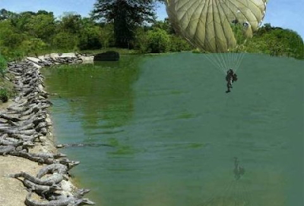
This is how Police/Fire Chaplaincy can feel!

Slide 4
APPREHENSIONS ABOUT DEATH NOTIFICATIONS
Feeling Untrained or Unprepared
Over-Identification with the Victim’s Family
Personal Vulnerability
4. Fear of Being Labeled by Colleagues

Slide 5
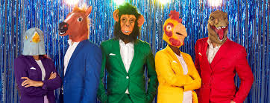
SELECTION OF THE NOTIFIER IS AS CRUCIAL AS THE PROCEDURE ITSELF.

Slide 6
DEATH MODELS
Shock and Disbelief
Denial
Anger
Depression
Acceptance
Recovery

Slide 7
Survivors Needs During Death Notification
Information
Ventilation of Emotions
Calm, Reassuring Authority
Restoration of Control
Preparation and Prediction

Slide 8
PRACTICES
Be absolutely certain of identity of deceased
Be absolutely certain of relationship of person to the deceased.
Get as much medical information as possible
Go. Don’t Call
If possible, take someone with you.

Slide 9
Practices
Present Credentials. Ask to come inside.
Remove distractions. Have children go into another room if at all possible.
Sit down. Ask them to sit down. Be sure you have the nearest next of kin.
Inform simply and directly ..with compassion

Slide 10
What NOT to Say
I know how you feel
Time heals all wounds
You’ll get over this
She was in the wrong place wrong time
You must go on with your life
He didn’t know what hit him
You have other children
Someone is always worse off than yourself

Slide 11
Disempowering Statements
It’s best to remember him the way he was
You don’t need to know that
You don’t want to see her
I can’t tell you that.

Slide 12

Unhealthy Expectations
You must be strong for the children
You must get hold of yourself
I’m going to be sure this guy gets the death penalty

Slide 13
What To Say
I’m so sorry
They did everything they could
It’s harder than most people think
Most people who have gone through this react similarly to you
Is there anything you would like to tell me or ask me?
I’ll check back tomorrow to see if there is anything more I can do for you

Slide 14

Body
Mind
Spirit

Slide 15
