Slide 1
Applied Data Science
95-852
Fall 2017 (Distance)
Project Team DAJJ
Weekly Progress
Dan Houli, Andrew Charland, Jayakumar Jayakrishnan, Jason Popowski

Slide 2
Week 1 - 2
Formed Team
Scheduled weekly cadence of team meeting (Mondays 8pm ET)
Discussed, debated, and selected team project goal and scope
Documented Project Proposal

Slide 3
Week 3
Began ‘Story Board’ list of user stories to represent Agile methodology of breaking down project scope into manageable chunks of work.
Demonstrated R Shiny package capabilities
Created first R function to subset data by user-selected parameters (Genre, Rating)

Slide 4
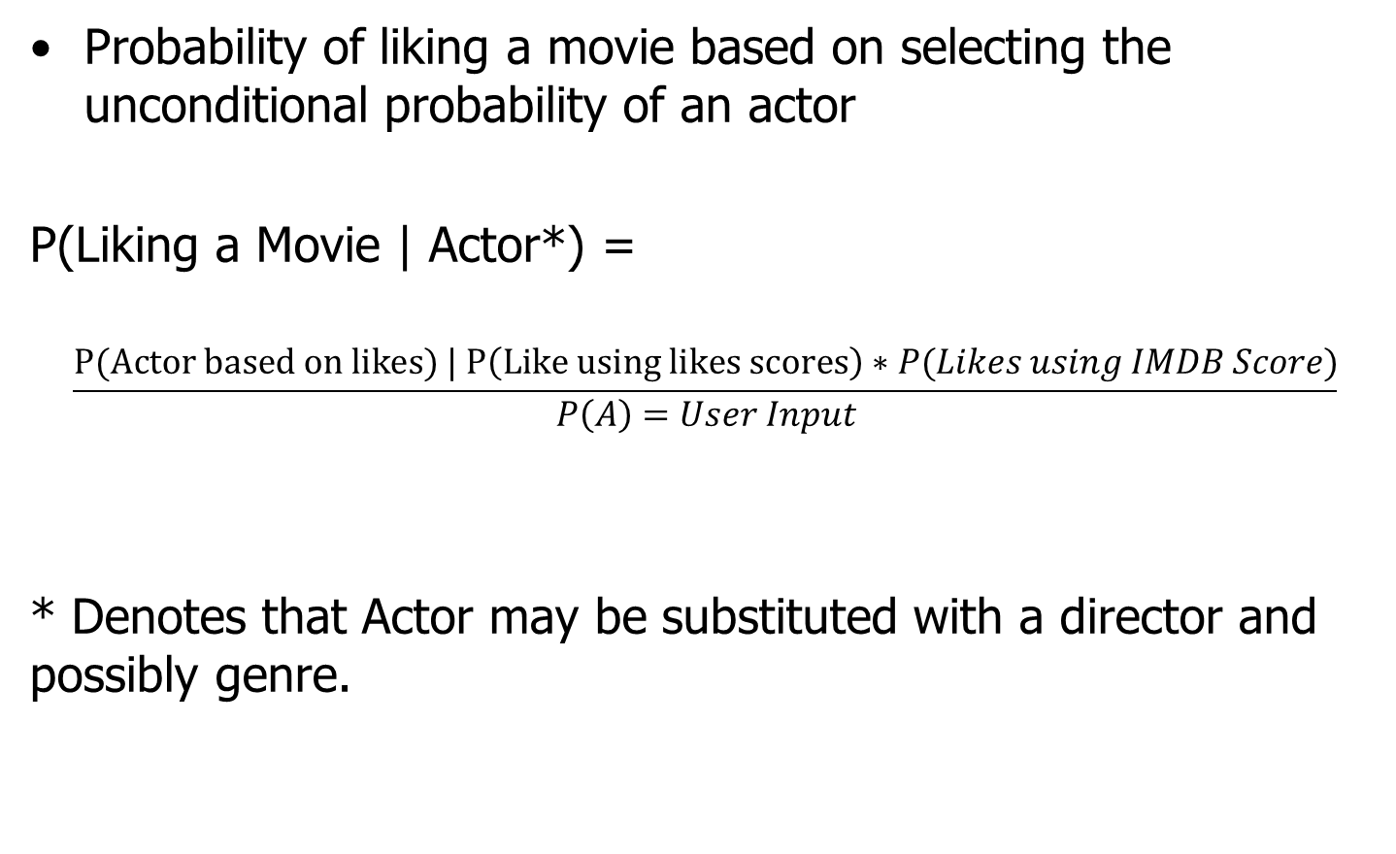
Concept
Probability of liking a movie based on selecting the unconditional probability of an actor
P(Liking a Movie | Actor*) =
$$\frac{P(Actor based on likes) | P\left(Like using likes scores\right)∗P(Likes using IMDB Score)}{P\left(A\right)=User Input}$$
* Denotes that Actor may be substituted with a director and possibly genre.

Slide 5
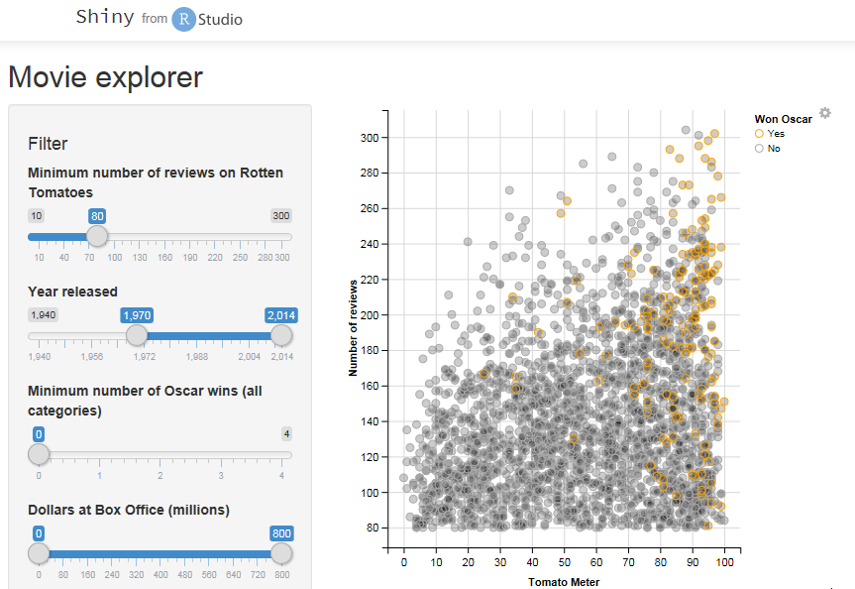
User Interface
Users interface with select input variables:
How well do you like an actor?
Director?
Other?
The output provides a probability of liking the movie using Bayes inference.
Shown in the left is a density plot just as an example. The team will explore some graphs to help visualize the recommendation.
Example from
https://shiny.rstudio.com/gallery/movie-explorer.html

