Slide 1
Applied Data Science
95-852
Fall 2017 (Distance)
Project Team DAJJ
Weekly Progress
Dan Houli, Andrew Charland, Jayakumar Jayakrishnan, Jason Popowski

Slide 2
Week 1 - 2
Formed Team
Scheduled weekly cadence of team meeting (Mondays 8pm ET)
Discussed, debated, and selected team project goal and scope
Documented Project Proposal

Slide 3
Week 3
Began ‘Story Board’ list of user stories to represent Agile methodology of breaking down project scope into manageable chunks of work.
Demonstrated R Shiny package capabilities
Created first R function to subset data by user-selected parameters (Genre, Rating)

Slide 4
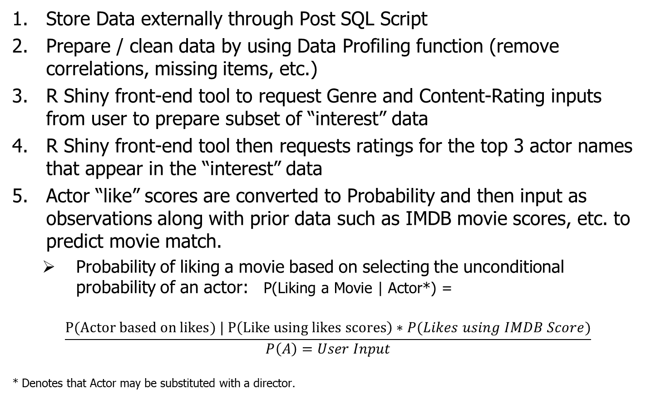
Concept
Store Data externally through Post SQL Script
Prepare / clean data by using Data Profiling function (remove correlations, missing items, etc.)
R Shiny front-end tool to request Genre and Content-Rating inputs from user to prepare subset of “interest” data
R Shiny front-end tool then requests ratings for the top 3 actor names that appear in the “interest” data
Actor “like” scores are converted to Probability and then input as observations along with prior data such as IMDB movie scores, etc. to predict movie match.
Probability of liking a movie based on selecting the unconditional probability of an actor: P(Liking a Movie | Actor*) =
$$\frac{P(Actor based on likes) | P\left(Like using likes scores\right)∗P(Likes using IMDB Score)}{P\left(A\right)=User Input}$$
* Denotes that Actor may be substituted with a director.

Slide 5
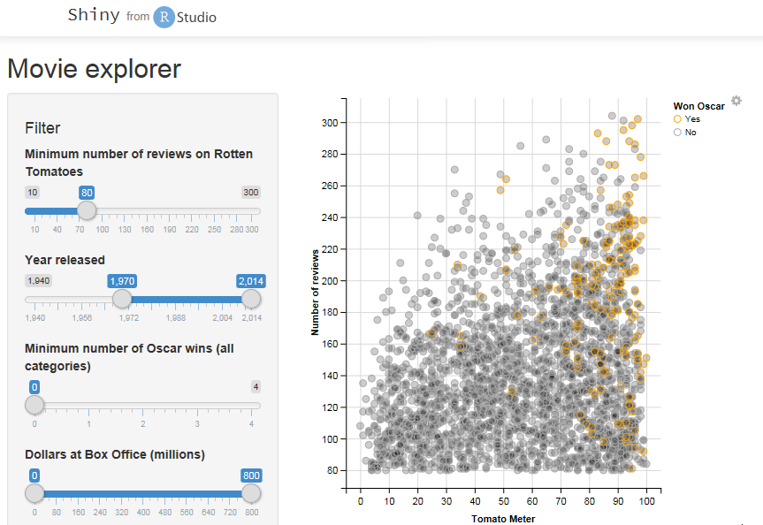
User Interface
Users interface with select input variables:
How well do you like an actor?
Director?
Other?
The output provides a probability of liking the movie using Bayes inference.
Shown in the left is a density plot just as an example. The team will explore some graphs to help visualize the recommendation.
Example from
https://shiny.rstudio.com/gallery/movie-explorer.html

