Slide 1
Madonna’s Web: A Reservation Website for Madonna’s Garden Resort and Event Center
Project Management | YOUNIX
June 8, 2023

Slide 2
Team Members
Denzel Edward Mana-ay​ | Princess Nicole Ricafort​ | Jan Red Esguerra ​ | Dennyson Castillo​ | Neil Gareth Lavarias​
Work breakdown Structures​ Work Breakdown Structure Packages​ Human Resources Management Plan​ | Project Charter​ Cost Management Plan​ Procurement Management Plan​ ​ | Quality Management Plan​ Time Management Plan​ Change Management Plan​ | Business Case Plan​ Risk Management Plan​ Implementation Plan | Communication Management Plan​ Scope Management Plan

Slide 3

Introduction
Madonna’s Garden Resort and Event’s Place is a Public Resort in Malvar Batangas.
Established in 2020
Built during the pandemic times as a place where people can rest and relax.
Madonna’s Resort

Slide 4
Problem Statement
Currently uses these methods for reservation:
Pen and paper
Google form
Spreadsheets
The current method is more laborious and prone to conflicts
Madonna’s Resort

Slide 5
Project Purpose/Justification
Business Needs
Business Objectives

Slide 6
Project Deliverables and Milestones
New system is adopted and used by the Madonna’s Resort.
Ensure conflict in reservation be reduced to 0.
Fully eliminate the use of manual reservation.
New system has been successfully finalized and deployed.

Slide 7
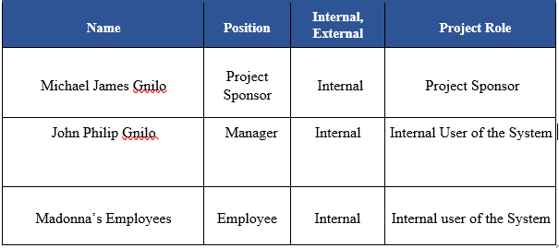
Stakeholder register

Slide 8
Project Management Approach
Project Sponsor has full authority in terms of giving the go-signal to execute plans.
Project Manager has the responsibility for managing and executing the project.
All project and subsidiary management plans are reviewed and approved by project sponsor.
Any delegation of approval authority is done by project manager.

Slide 9
Product Development Methodology
Utilize agile method such as Scrum and employ traditional project management methods which is Waterfall.
Methodology includes the following steps:
Project Initiation
Planning
Execution
Monitoring and Controlling
Closure

Slide 10
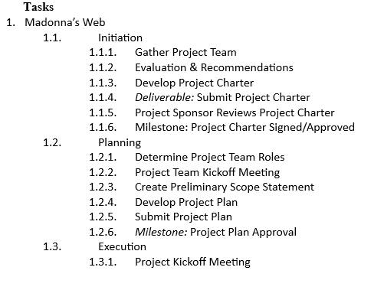
WBS

Slide 11
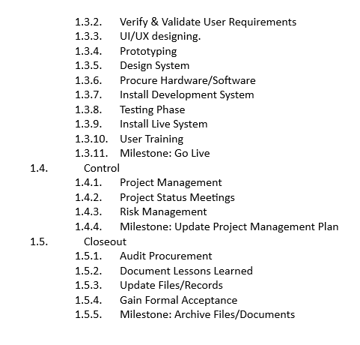
WBS

Slide 12
Technical Architecture
Madonna’s web will be hosted on a low-cost virtual private server (VPS).
The VPS is Linode, containing the source code to extend security and minimizing technical maintenance.
Will ensure that the application is robust, secure, and open to changes.

Slide 13
Key Stakeholders
A follow-up to identify stakeholders, the project team will also identify key stakeholder that has the most influence on the project.
Once identified, the project manager will develop a plan to obtain their feedback.

Slide 14
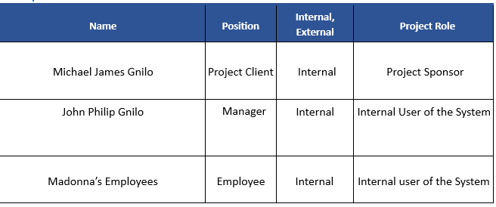
Key Stakeholders

Slide 15
Stakeholder Analysis
The project team will categorize and analyze each stakeholder, based on their organization or department. Once categorized, the team will utilize power/interest matrix to illustrate potential impact on each stakeholder.
The purpose is to determine the stakeholders’ capability.

Slide 16
Scope Management Approach
Below are further explanations of the approach for the scope:
1. Plans for implementation and any necessary modifications must be approved.
2. Aligning Madonna’s web with the broader strategic aims and objectives.
3. Improving administration and employee online involvement.
4. Simpler to record and create a statement of the user schedule.
5. Project sponsor and other important stakeholder will accept and approve the final deliverable and once acknowledge, the project be declared complete.

Slide 17
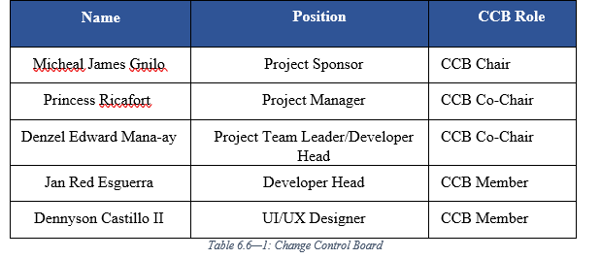
Change Control Board

Slide 18
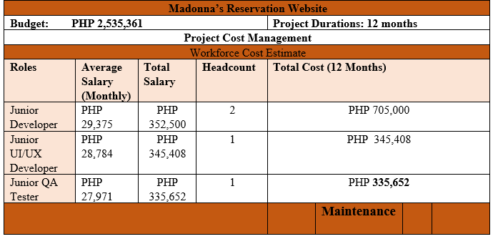
Budget Summary

Slide 19
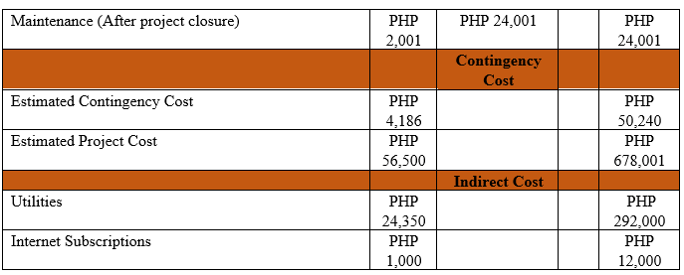
Budget Summary

Slide 20
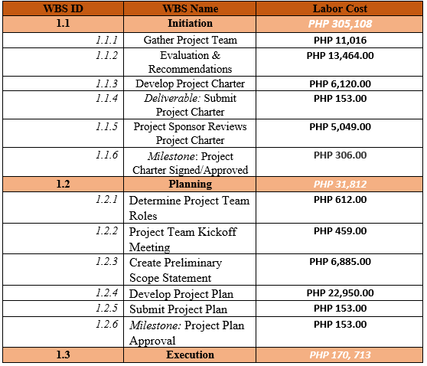
Labor Cost Distribution Summary

Slide 21
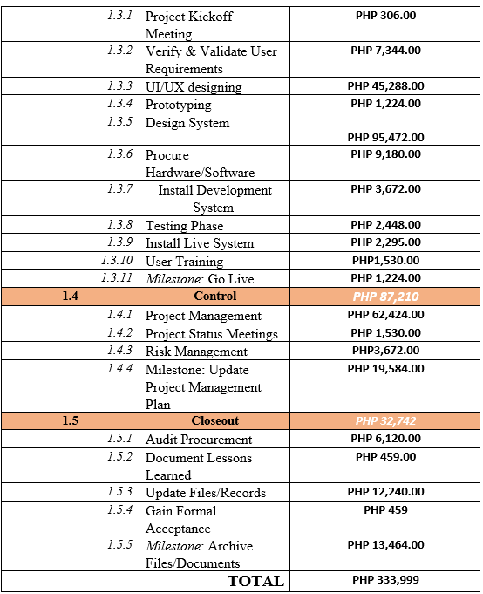
Labor Cost Distribution Summary

Slide 22
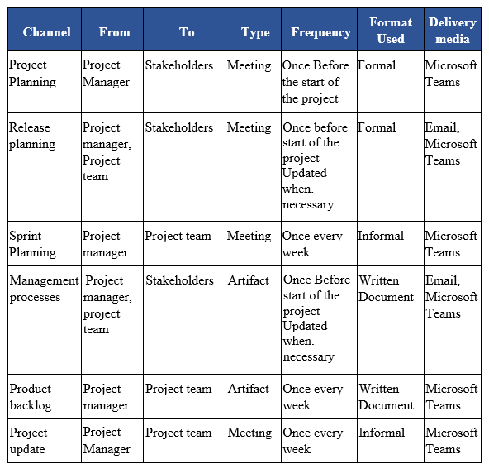
Communication Matrix

Slide 23
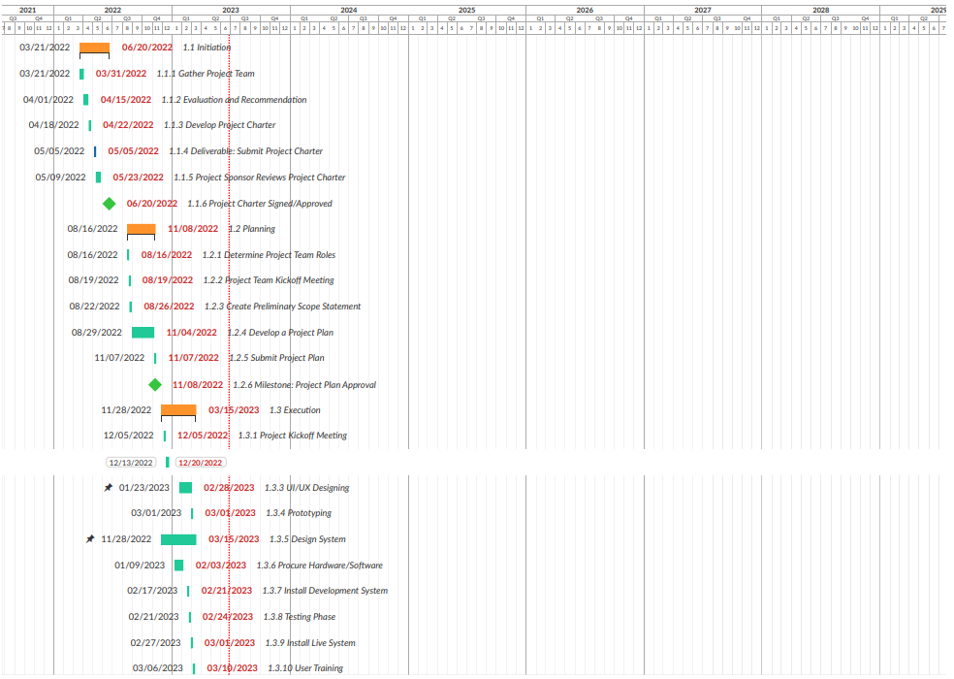
Schedule

Slide 24
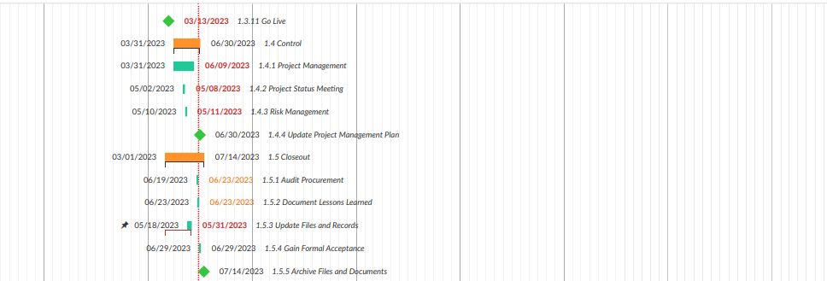
Schedule

Slide 25
Risk Management Plan
The plan emphasizes proactive risk identification, evaluation, and mitigation.
These are the following considerations should be made when developing a comprehensive plan for Madonna’s web risk management:
Risk Assessment and Identification
Strategies for Mitigating Risks
Planning for Emergencies
Report Writing and Communication
Review and Monitoring of Risks

Slide 26
Top Three Risks
The following are Madonna’s web risks:
Technical Danger
Resource Danger
Data Losses

Slide 27
Risk Identification
The following are some of the potential dangers identified for the project:
Resources are scarce
Limit Creep
Problems with security
Unpredictable circumstances

Slide 28
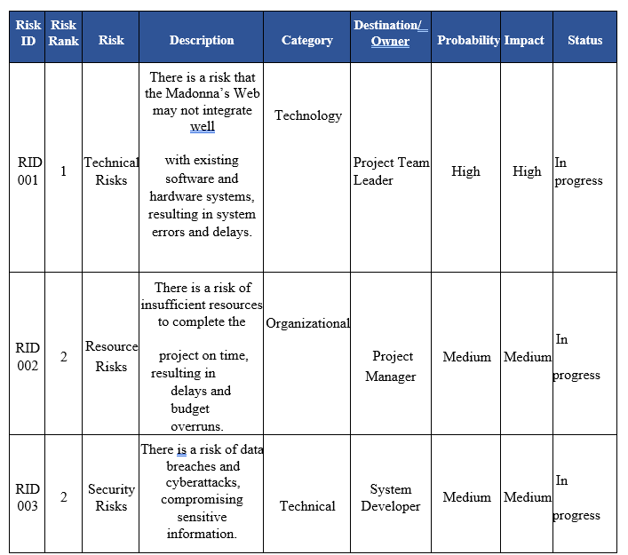
Risk Register
Updated on a regular basis throughout the project.
Provides in-depth explanations of the risk of the project.
Reviews and updates are accurately reflects the project’s current state.

Slide 29
Implementation Plan
A transition out plan has been developed. Smooth transition of system to its new owner during the closeout phase.
The plan purpose is to enable the project team to successfully complete the project that is both fully functional and long-lasting.

Slide 30
Implementation Plan
Workplace Execution during Transition
These are few important activities need to be done during transition period:
User Education
Mock Exams
Documentation of the Learned Lessons
Changing Records and Files
Acceptance in Writing
Document and File Archiving
Meeting to close the project

Slide 31
Implementation Plan
Handover and Acceptance
Initiating the process will follow the completion of transition plan.
On handover meeting, the project team will present the finalized transition plan to the project sponsor and other stakeholders.
The contract of the transition plan will provide a transparent and detailed roadmap for execution and ensure stakeholders satisfaction

