Slide 1
Ovs userspace vxlan and geneve tunnel tso
2023/11/20
Dexia Li
www.jaguarmicro.com

Slide 2
Agenda
Backgroud: kernel performance limit
Userspace vxlan and geneve tso
Implementation
Supported tunnel type
Limitations
Performance improvement
Problems and solutions

Slide 3
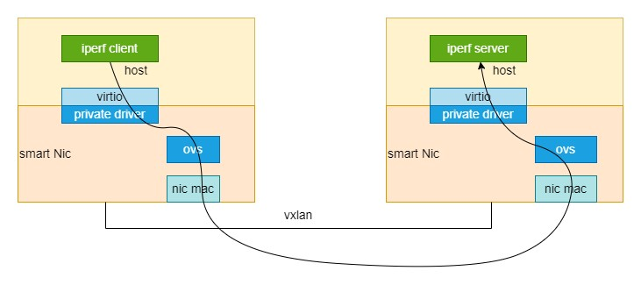
Backgroud
In DPU scenario, kernel performance tested by iperf is an important metric. Tcp and udp checksum caculating cost a lot, offloading checksum to back-end nic is a good choice. Ovs does not support tunnel inner checksum offload and tso, so we propose userspace vxlan and geneve tunnel tso to improve performance.

Slide 4
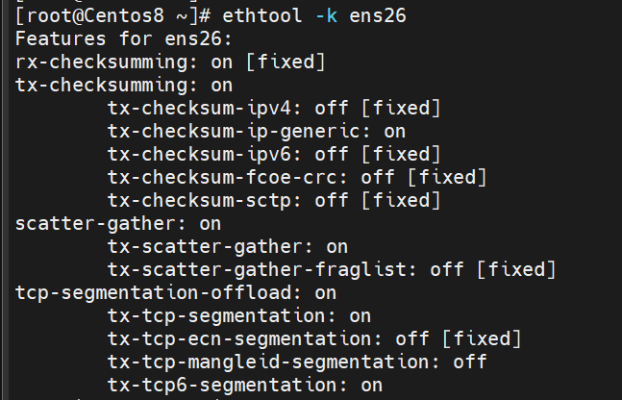
Enable checksum offload and tso
Enable checksum offload and tso
ethtool -K ens26 tx on
Disable checksum offload
ethtool -K ens26 tx off
Disable tso
ethtool -K ens26 tso off
Enable tso
ethtool -K ens26 tso on

Slide 5
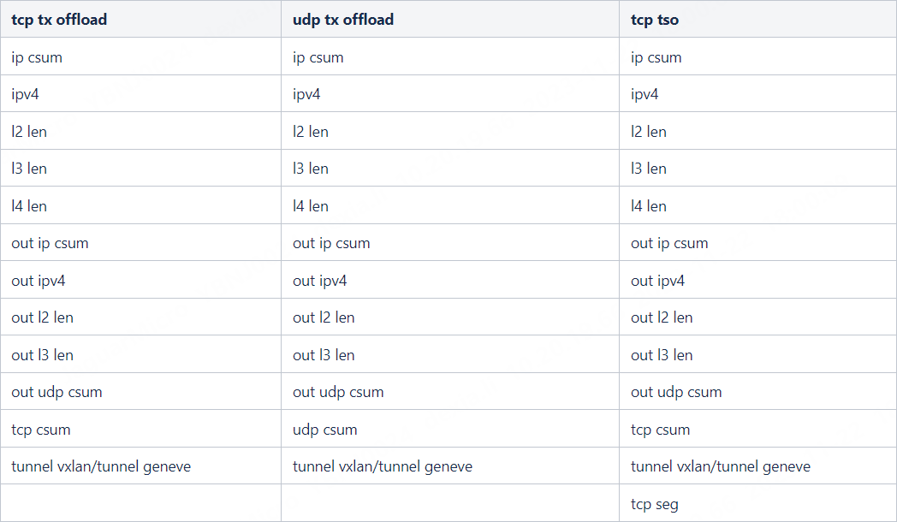
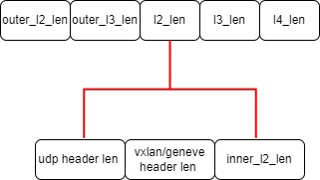
Userspace vxlan and geneve tso implementation
Set suitable of_flags to rte_mbuf
Set correct outer and inner len to rte_mbuf
The follow table shows the parameters should be set to rte_mbuf, out ipv4 and inner ipv4 for example.

Slide 6
Userspace vxlan and geneve tso supports
Tunnel type：vxlan and geneve with option extend header
Ipv4 and ipv6:
Out ipv4 and inner ipv4
Out ipv4 and inner ipv6
Out ipv6 and inner ipv4
Out ipv6 and inner ipv6

Slide 7
Userspace vxlan and geneve tso limitations
Only physical ports support tunnel tso
Netdev-linux or dpdk-vhost ports do not support tunnel tso
If the front-end device open tx offload but the nic does not support tunnel tso, the packets will be dropped

Slide 8
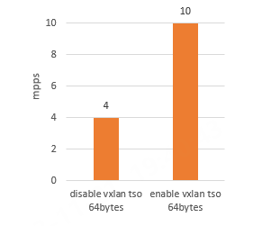
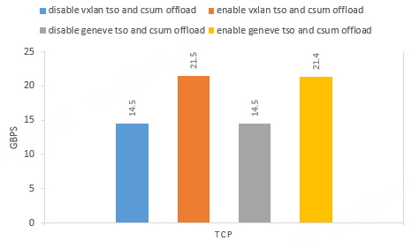
Userspace vxlan and geneve tso performance improvement
Using 25G E810 nic

Slide 9
Userspace vxlan and geneve tso problems and solutions
Problem:
Set RTE_MBUF_F_TX_TCP_SEG and RTE_MBUF_F_TX_TCP_CKSUM flags meanwhile result in nic hang.
Reason:
Maybe there is something wrong in firmware when processing the two flags meanwhile.
Solution:
When enable tso, just set RTE_MBUF_F_TX_TCP_SEG in ovs as testpmd csum engine also set RTE_MBUF_F_TX_TCP_SEG only at this time. Whatever the bug is fixed in Dpdk 22.11 in commit d082b37d081e6de467700128f217e14b5e852bf6.

Slide 10
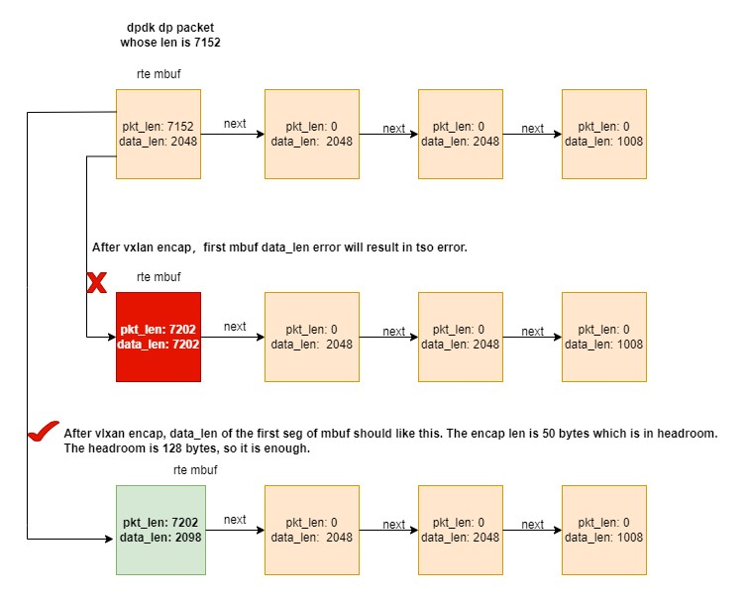
Userspace vxlan and geneve tso problems and solutions
Problem:
With enable tso, the last frag packet missed and the nic hang.
Reason:
When encaping tunnel header, the first mbuf data_len is setted wrong.
Solution:
Set right data_len of the first mbuf.

Slide 11
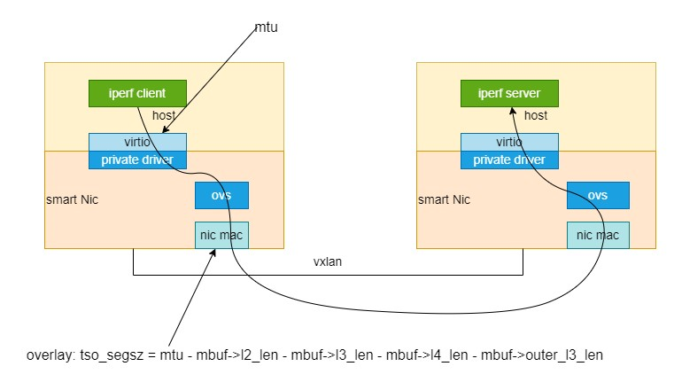
Userspace vxlan and geneve tso problems and solutions
Full-path MTU configuration
Nic mtu should >= virtio mtu, virtio mtu should be passed to rte_mbuf for calculating tcp segment size

Slide 12
Thank you !
dexia.li@jaguarmicro.com

