Slide 1
Affinitizing guest flows
Thilak Raj Surendra Babu

Slide 2
Problem statement
With higher-density NICS single RX queue will not be sufficient.
VM can have the memory backed in any of the NUMA.
VMs can have a single RX-queue.
RSS could place the Guest flow on a non-optimal queue leading to the below bottlenecks.
Spin lock contentions amongst PMD threads when different flows belonging to the same VM are serviced by two different threads
Remote NUMA access due to the flow being serviced by a PMD thread that is from a different NUMA than the VM.
VM1
VM2
NUMA-0
Spin Lock
NUMA-1
PMD-Threads
Spin Lock
VM1-FLOW
VM2-FLOW
Cross Numa
RSS
NIC
Figure 1

Slide 3
Solution
VM1
VM2
Having all the flows destined towards a VM placed on the same RXQ will avoid spinlock contention.
Steering the flows towards the PMD thread on the same NUMA as the guest would avoid cross-NUMA access.
Optimize PMD’s mempool access by providing mempool based on the NUMA on which the PMD is running instead of the NUMA on which the interface is attached.
NUMA-0
NUMA-1
PMD-Threads
VM2-FLOW
VM1-FLOW
flow steering based on guest attributes
NIC
Workflow:
Hypervisor is multi-NUMA node and has mutli-queue enabled for the physical interface.
On a VM being provisioned use the Guest MAC address and VM’s backing memory to place a steering rule.
ovs-vsctl set interface enp59s0f1 options:rxq-steer-params=“0|00:00:00:00:00:01,1|00:00:00:00:00:02“

Slide 4
Tests/Results/Analysis
4 PMD threads,
2 on each NUMA,
On Each NUMA one servicing the physical Interface RXQ and other servicing vhostuser
VM1
VM2
PKTGEN-DPDK
NUMA-0
NUMA-1
flows 2 Entropy at DST MAC
4k Entropy at SRC/DST port
PMD-Threads
VM2-FLOW
VM1-FLOW
 | Spin lock | Remote Numa Access
Master | Yes | NUMA 0 and NUMA 1
Rxq_steer | NO | NUMA1
RXQ_steer with Local Mempool | NO | No Significant Remote DRAM access
Connect –X4

Slide 5
Possible Applications
Better performance due to lower contention and better NUMA aware placement.
Providing Isolation for a particular guest.

Slide 6
Thank you
[ovs-dev,RFC] netdev-dpdk: add mac based rxq steering option - Patchwork (ozlabs.org)

Slide 7
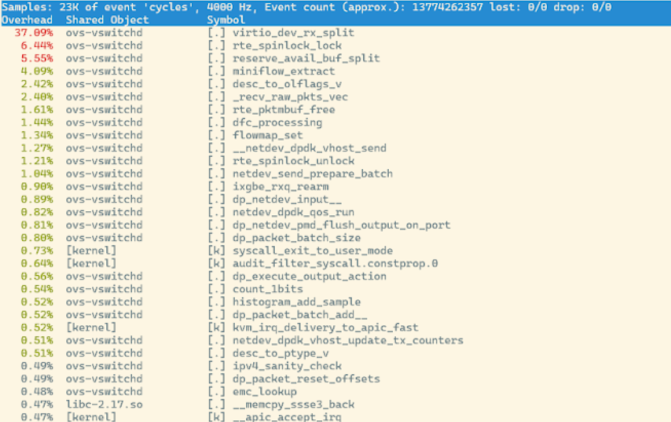
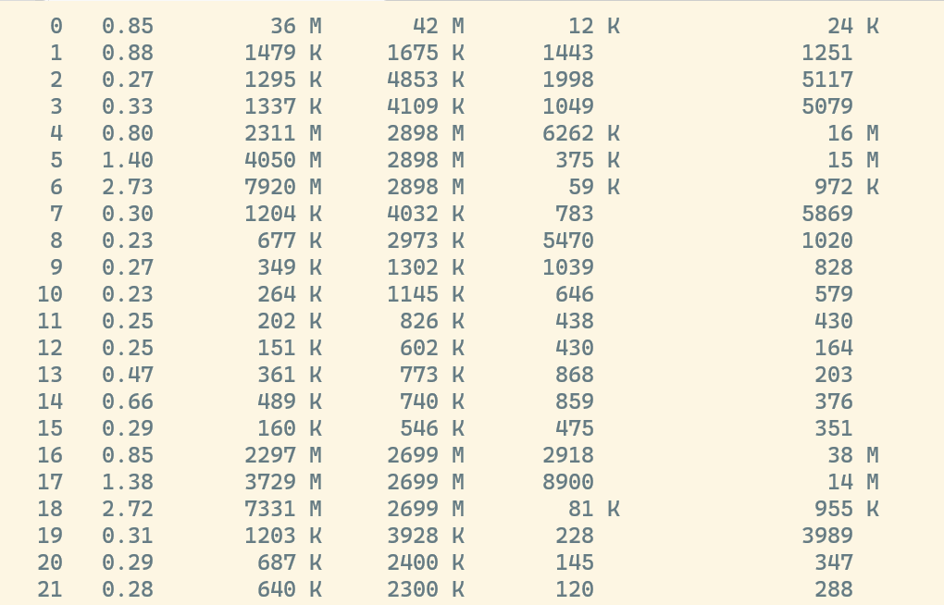
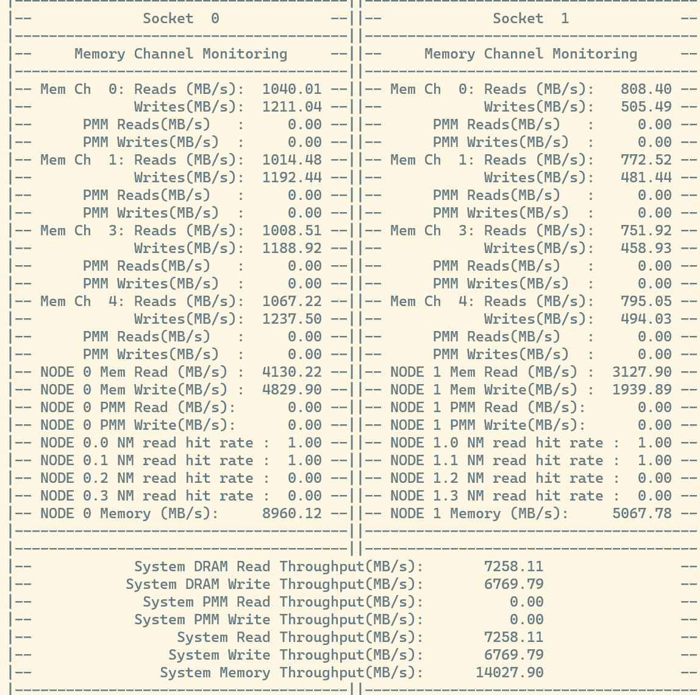
Analysis

Slide 8
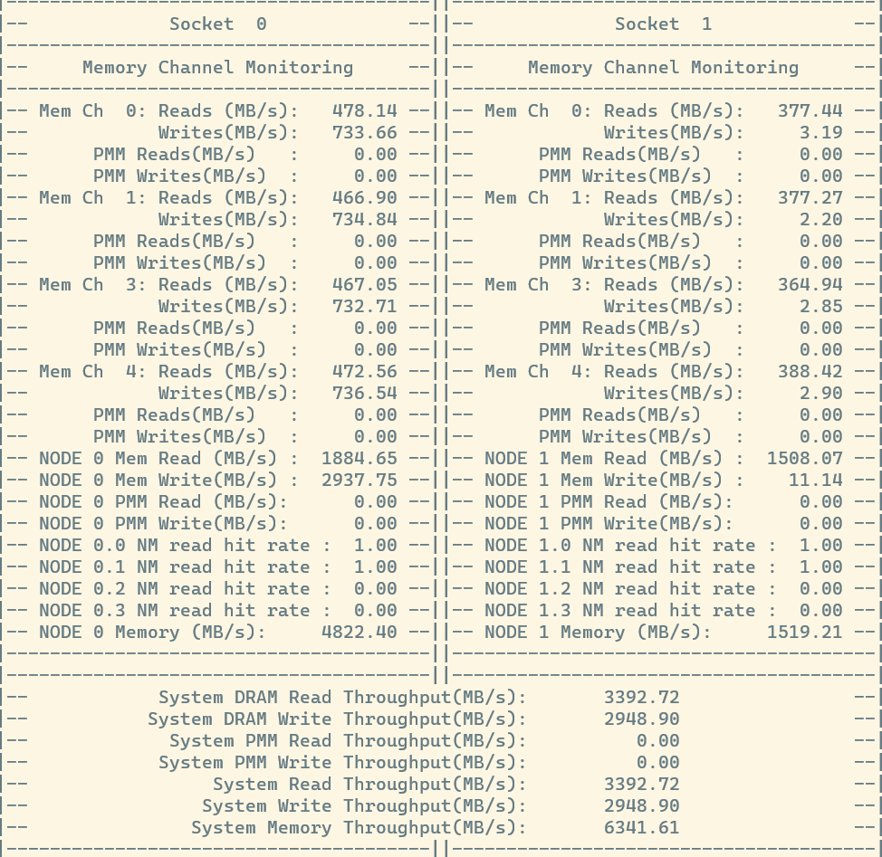
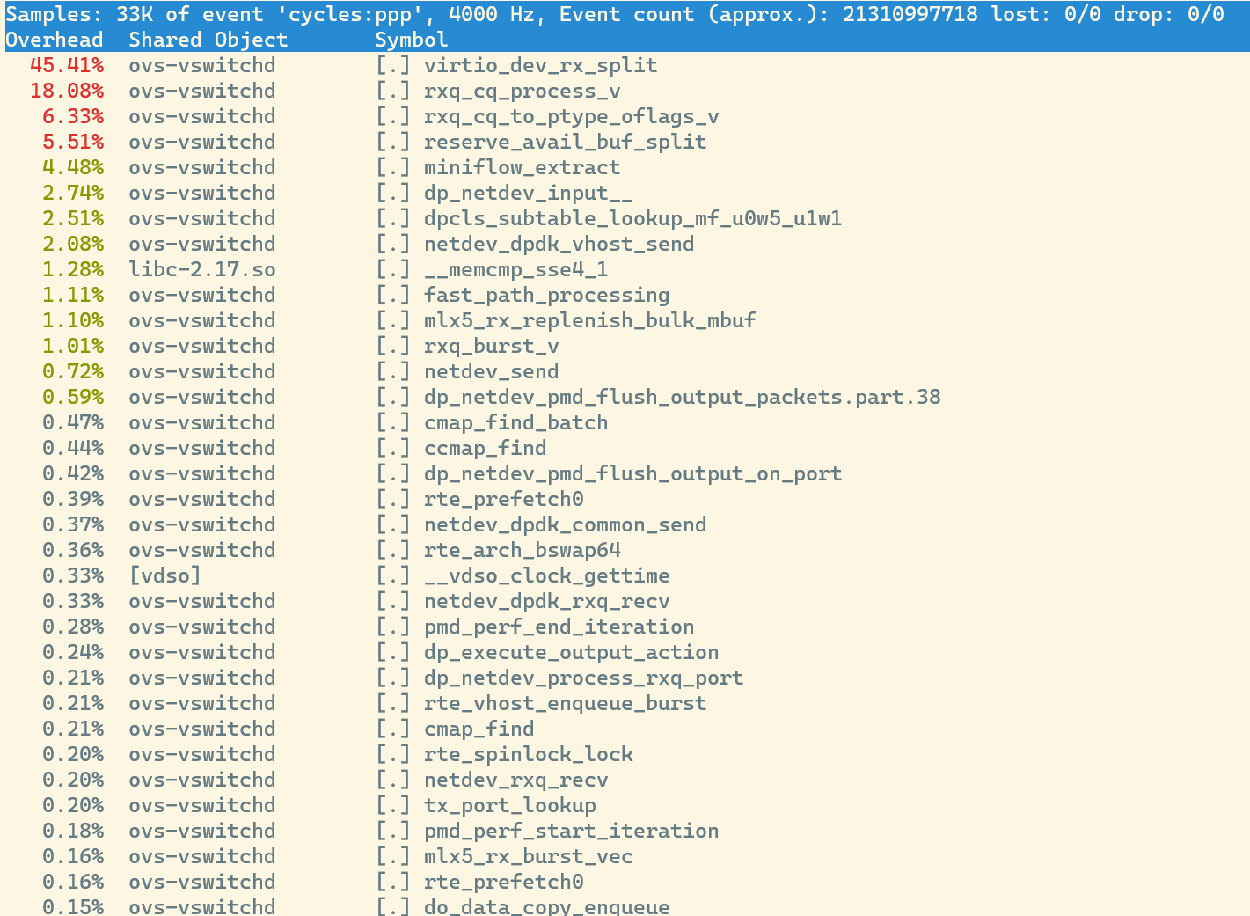
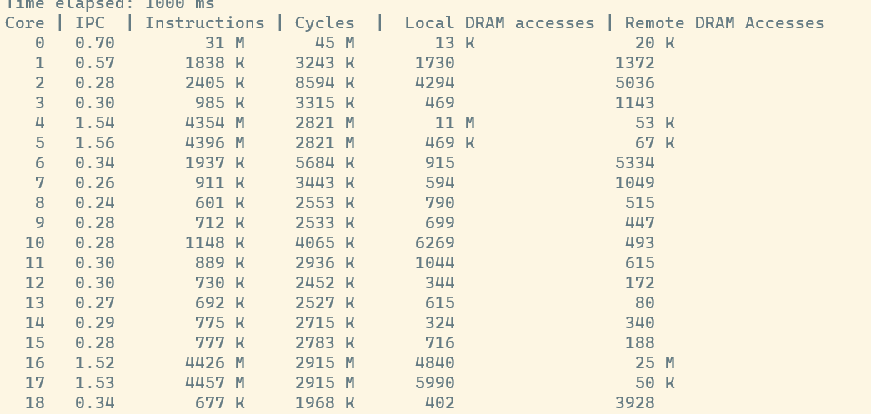
Analysis

Slide 9
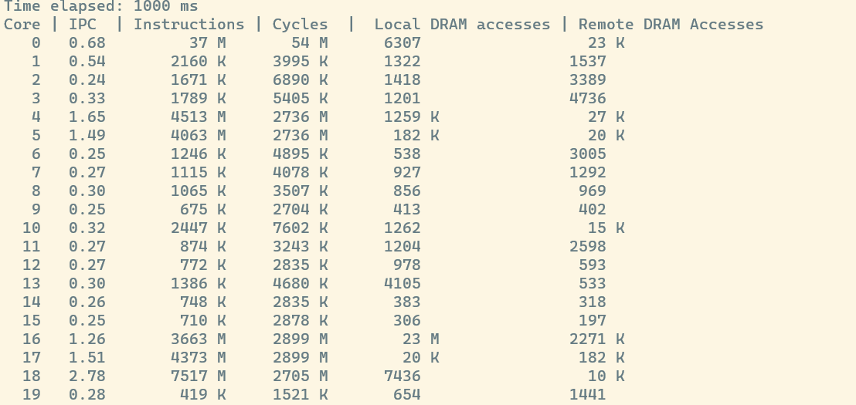
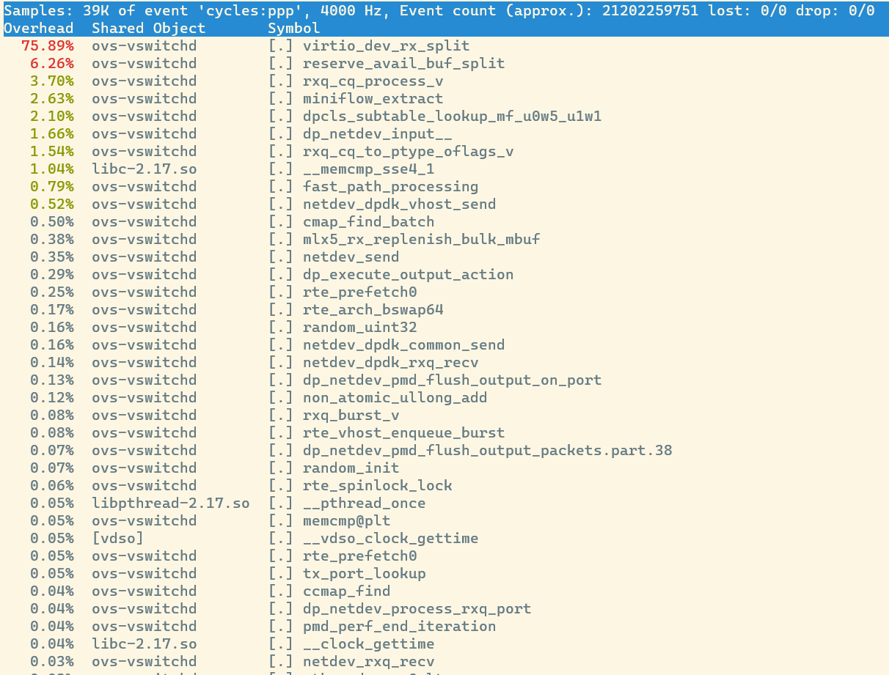
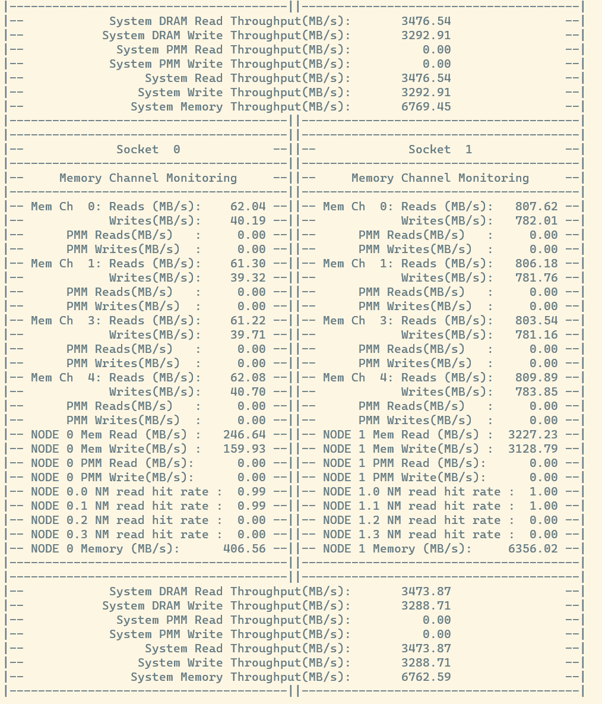
Analysis

