Slide 1
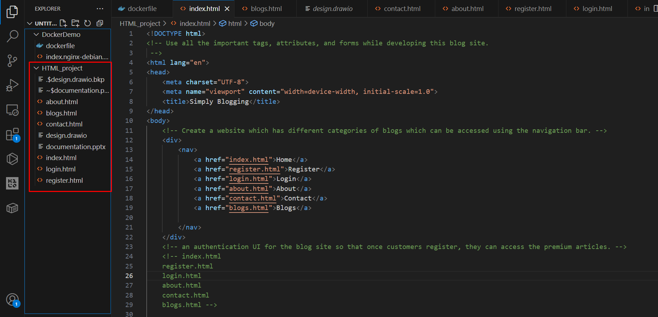
Created all the pages as their own .html files

Slide 2
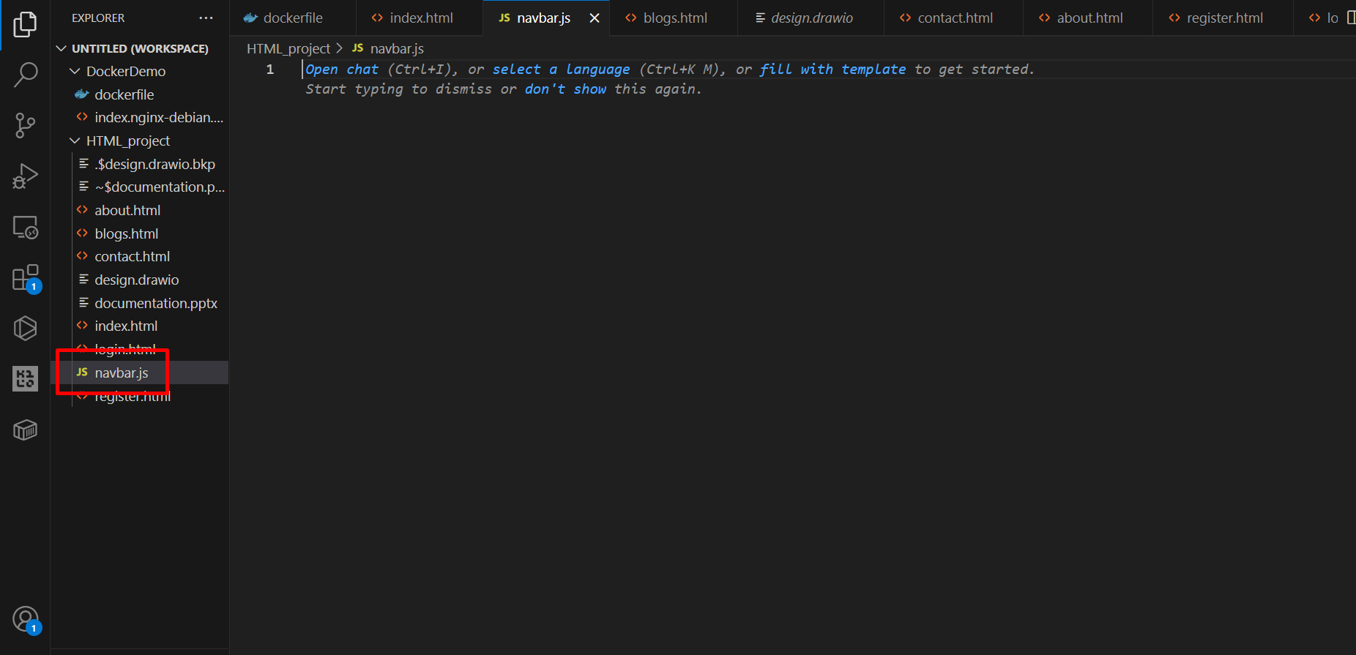
Created a navbar.js file to inject the navbar to every page

Slide 3
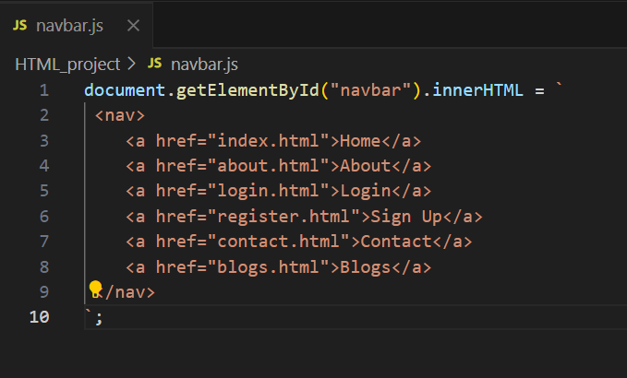
We are going to use the script (navbar.js) before the ending body tag (</body)
Because we need to make sure that the script doesn’t block the page from rendering itself
Putting non critical scripts like navbar script would block the page from rendering itself until the script is loaded and executed.
We will use defer so that the script is only run after the html parsing so that the immediate interactive elements are available sooner before executing the scripts preventing the script from blocking page rendering ☺
Backend scene:
Document.getElementById(“navbar”).innerHTML
Document.getElementById(“navbar”) finds the empty div element with id “navbar”
InnerHTML sets the inner string of the <nav> tag/markup with the real html links
Applied the navbar to these pages-
index.html
About.html
Blogs.html
Contact.html

Slide 4
Set up Firebase project
Go to firebase console> enable authentication for email/password provider
Add firebase imports in each page where
The firebase auth is being used
Signup, login, blogs/premium page
Configure static site’s folders
/signup.html
/login.html
/premium.html or /blogs.html [premium gated content page]
/js/firebase-config.html [contains firebase credentials and setup]
/js/auth.js [common JS authentication logic]
After all of the setups
Open hosting url to check out the static site
Step 3: Firebase Config (js/firebase-config.js)
Create a folder and file under that like that and add the firebase configs in to that file
Step 4: Build the Sign Up Page
Forms
Imports from firebase
Scripts for authentication
Upload the files to static hosting on firebase hosting
Install firebase cli
npm install -g firebase-tools
Login to firebase
Run: firebase login
Initialize Firebase Hosting
Firebase init hosting [cmd]
upload the files to github repo during this phase
Move Files into Public Directory
Deploy Your Site
firebase deploy --only hosting
Step 5: Build the Login Page
Step 6: Build the Premium Content Page
Step 7: Deploy Your Static Site

