Slide 1
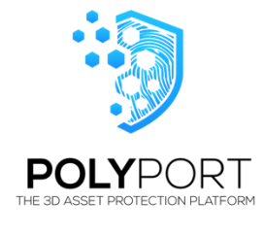
React Finalist Project – Justin Martinez

Slide 2
Electron.js – Cross Platform Desktop Apps
Building a desktop app with React / Electron
Create React App
Creating public/electron.js
Updateing package.json

Slide 3
MSMQ
How to get .NET scripts (C#) to run in a Node.js application
Challenges for an OSX user
Activating MQMS in Windows 10

Slide 4
Edge.js – The Bridge
Edge.js allows developers to run .NET code in a Node process, and vice-versa
Challenges to getting Edge to run on a Node server.
Node Versions matter
Pre-compiling is an option
Using the node-msmq package in a Node server

Slide 5
Server.js
Building an Express server to run the Create React App application allows server endpoints on our React server.
Add an endpoint that runs the Edge.js and node-msmq package to communicate with the MSMQ
Works when Node server is running on the same Windows OS that is running MSMQ

Slide 6
Using NVM to Juggle Node
This implementation uses an old package “node-msmq” to save time.
Caveat is that “node-msmq” requires an older version (4.1.1) of Node.js to work with Edge.js (a dependency)
For an enterprise application, we would use Edge.js to run our own custom built API in C#
Create React App uses tools that require newer versions of Node
NVM helps us switch between Node versions easily.
Solution: Run server.js in Node v4.1.1 and run electron.js start script in newer version of Node

