Slide 1

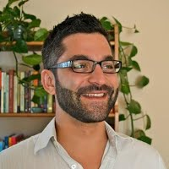

Applied Economics (APEC) Masters Thesis Symposium
Jacob Harris DICE-Py: Open-Source Implementation and Enhancement of the DICE Model in Python
Joseph Whitney Effects of Institutional Spending on College Graduation & Retention Rates: Where Should Universities Spend Their Money?
Kristi Getschel The Growth Potential of Minnesota Aquaculture
Aiden Opatz Weathering the Storm: a Gravity Model Analysis of Hurricanes' Effect on Migration in the US
Derek Kelly FM360 Vendors’ Experiences at Farmers Markets: 2016-2023
Friday, April 12th 1 PM – 2 PM
Ruttan Hall 119 https://umn.zoom.us/j/97156270931

