Slide 1

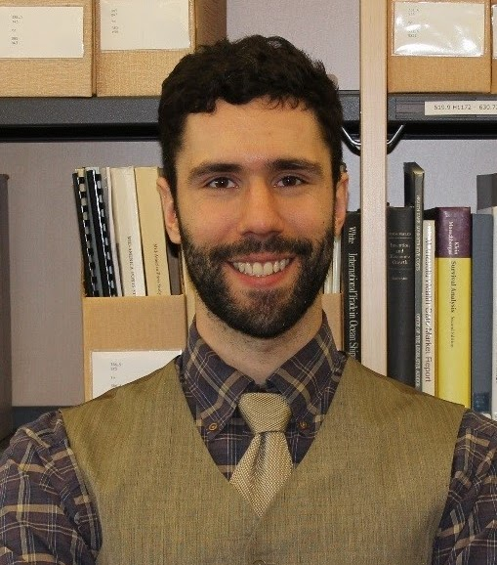

Applied Economics (APEC) Skills Workshop
Thomas Durfee
PhD Student
Tuesday,
March 19
12 PM – 1 PM
Ruttan Hall 119
https://umn.zoom.us/j/93809319397?pwd=NVBMRDgrZVFYYUk0cHMxTXU4WjBFUT09
Title:
The UMN Supercomputer and Large Dataset Best Practices
Food and Beverages will be provided. Reach out to the organizer (Ryan McWay) if you have any questions: mcway005@umn.edu

