Slide 1

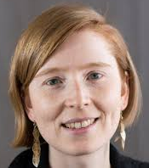

Applied Economics (APEC) Student Seminar
Caroline Krafft
Humphrey Faculty
2015 Alumni
Wednesday
October 23
11 AM – 12 PM
Ruttan Hall 119
https://umn.zoom.us/j/97280645601
Title:
Surveys Design

