Slide 1

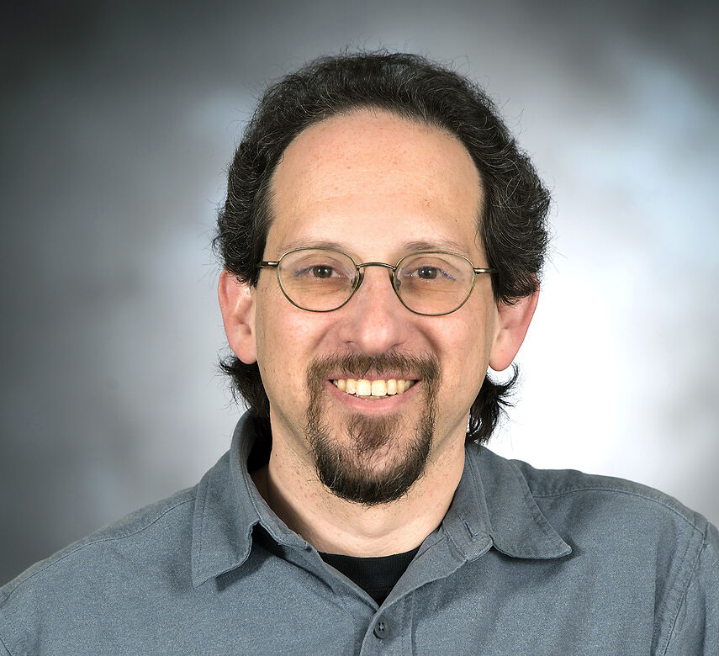

Applied Economics (APEC) Student Seminar
David Redish
Neuroscience Faculty
Wednesday
November 20
11 AM – 12 PM
Ruttan Hall 119
https://umn.zoom.us/j/97280645601
Title:
Applications of Neuroscience in Economics

