Slide 1

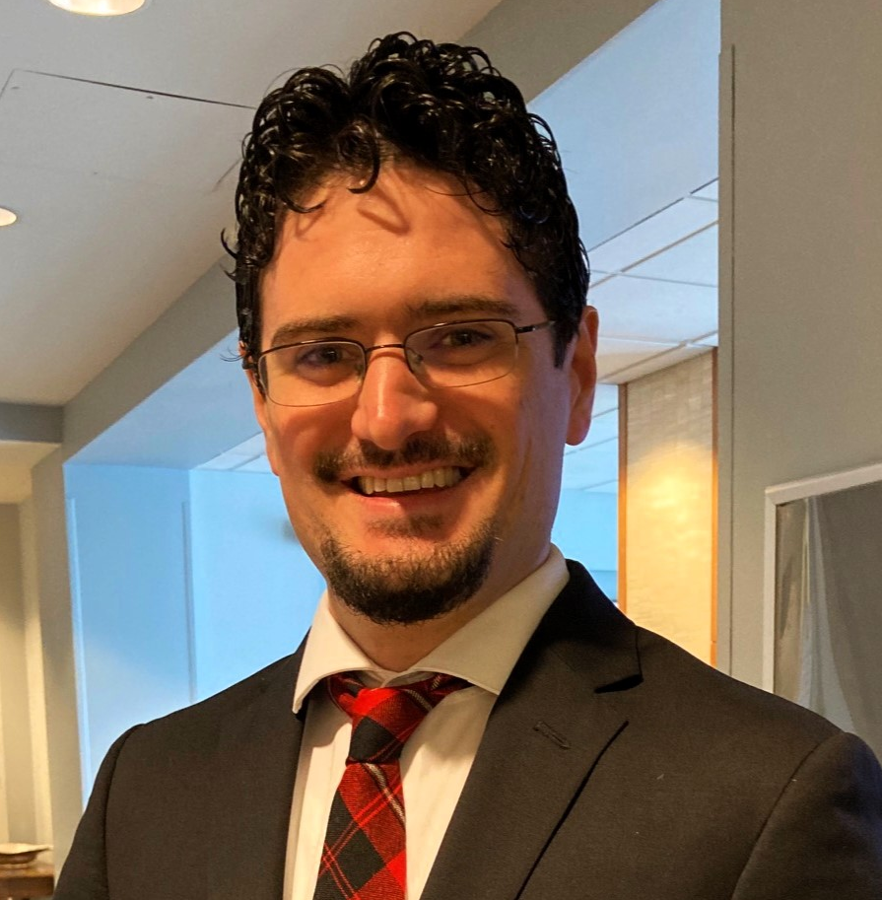

Applied Economics (APEC) Student Seminar
Evan Cunningham
ECON JMC
Wednesday
October 16
11 AM – 12 PM
Ruttan Hall 119
https://umn.zoom.us/j/97280645601
Title:
Local Labor Market Effects of Amazon

