Slide 1

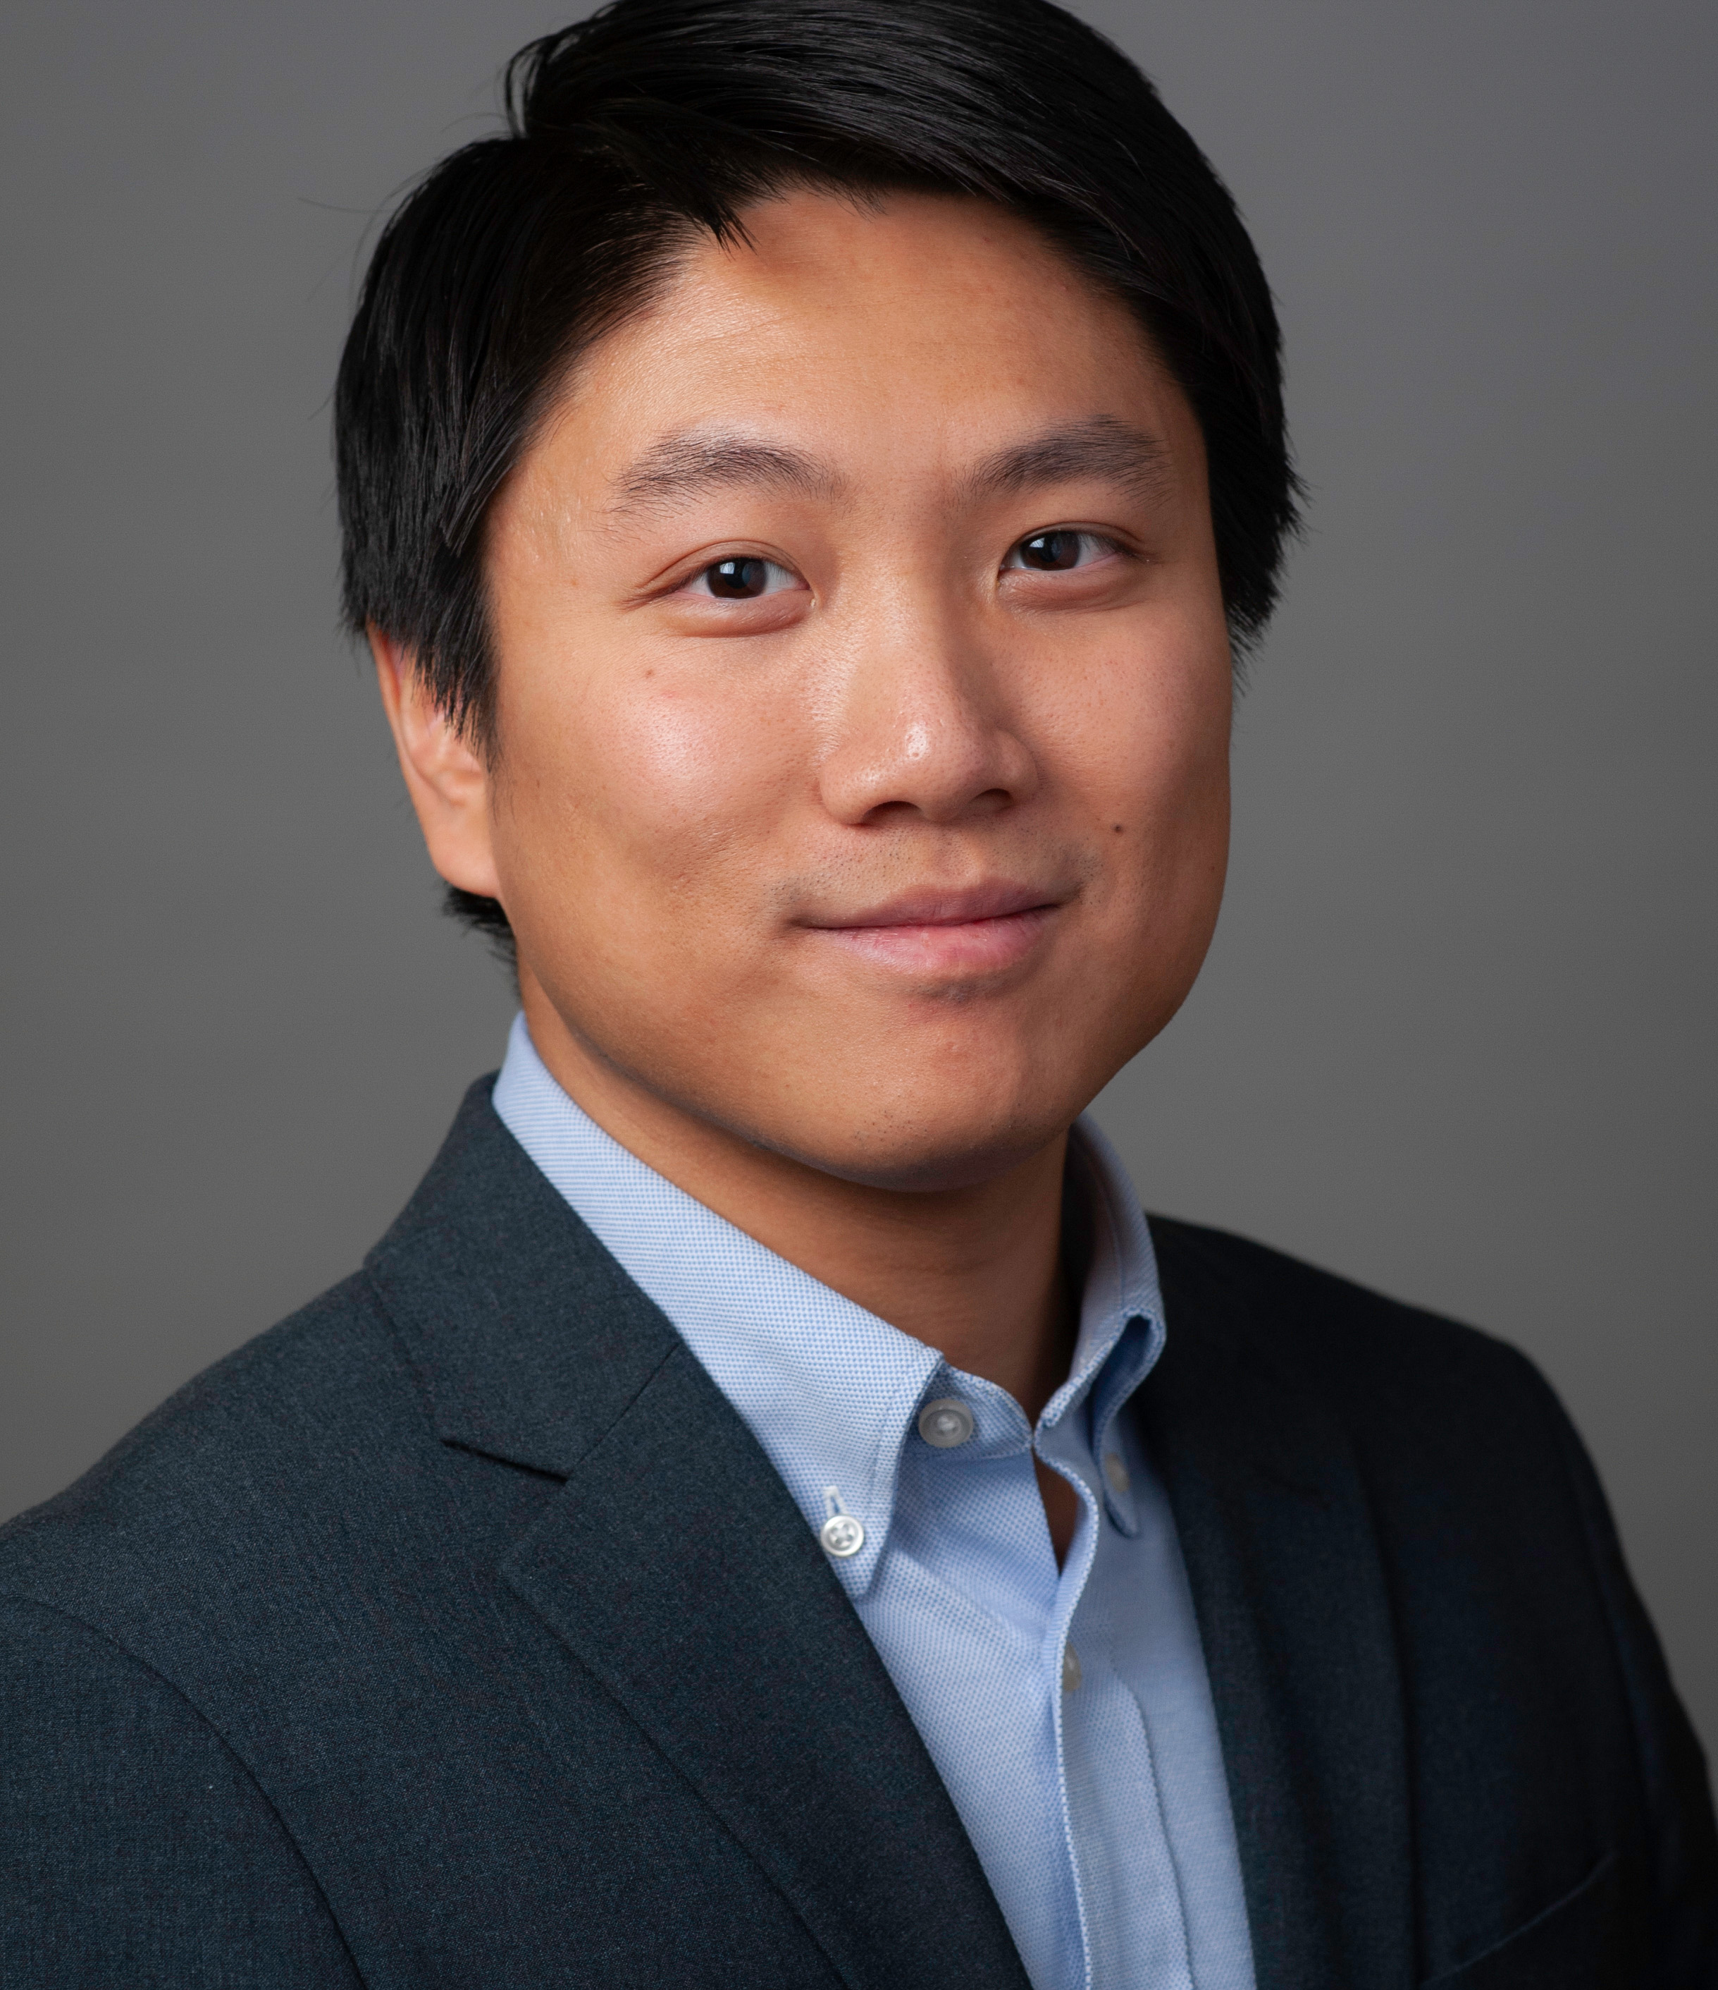

Applied Economics (APEC) Student Seminar
Jiuchen Deng
APEC JMC
Wednesday
October 2
11 AM – 12 PM
Ruttan Hall 119
https://umn.zoom.us/j/97280645601
Title:
The Development of Personality Traits and Cognitive Skills in Adolescence: Evidence from a Skill Formation Model and a Control Function Approach

