Slide 1

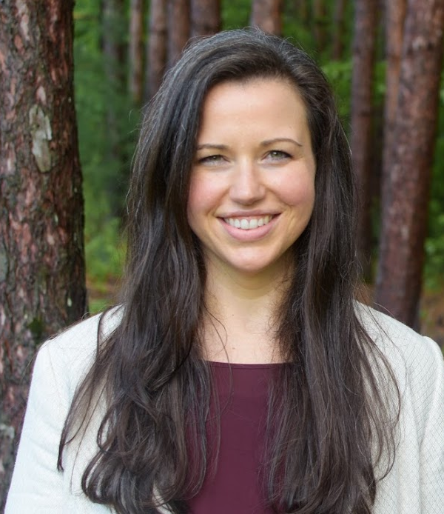

Applied Economics (APEC) Student Seminar
Lindsey Novak
Reed College
2017 Alumni
Wednesday September 18
11 AM – 12 PM
Ruttan Hall 119
https://umn.zoom.us/j/97280645601
Title:
Overall Research Agenda and Tips for the Job Market

