Slide 1

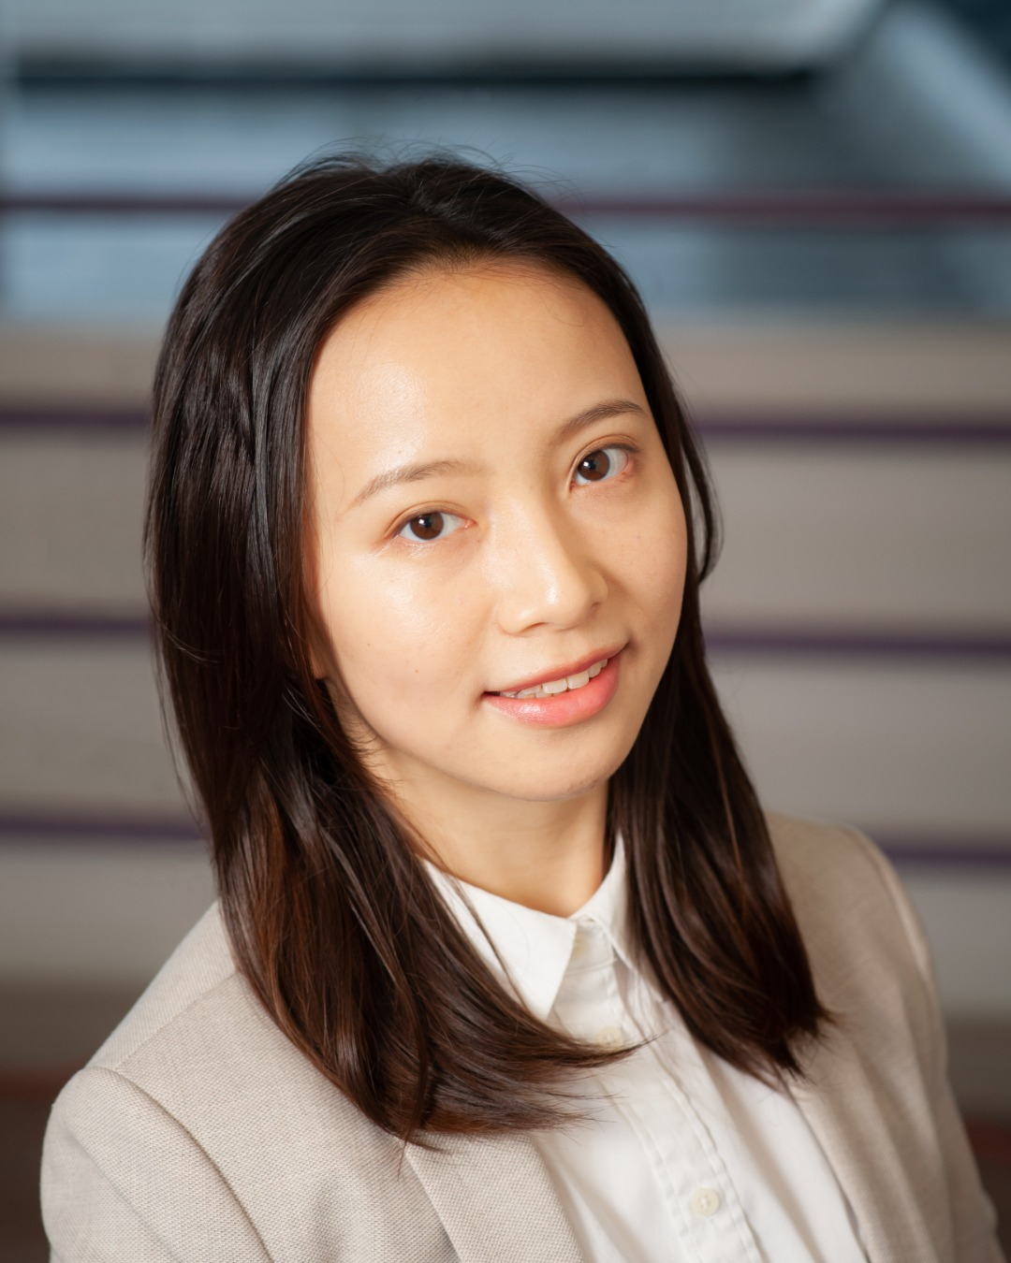

Applied Economics (APEC) Student Seminar
Ling Yao
APEC JMC
Wednesday September 4
11 AM – 12 PM
Ruttan Hall 119
https://umn.zoom.us/j/97280645601
Title:
Agricultural Mechanization and Structural Transformation

