Slide 1

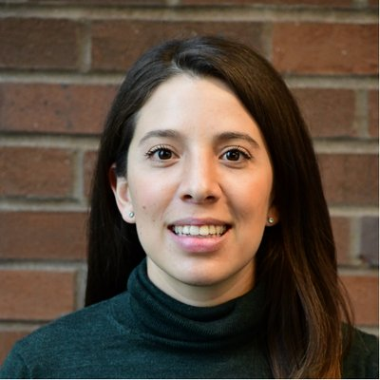

Applied Economics (APEC) Student Seminar
Natalia Ordaz Reynoso
Meta
2021 Alumni
Wednesday
December 4
11 AM – 12 PM
Ruttan Hall 119
https://umn.zoom.us/j/97280645601
Title:
Working in Tech Sector as an Economist

