Slide 1

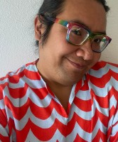

Applied Economics (APEC) Student Seminar
Willy Lee
ISRDI
Wednesday
October 9
11 AM – 12 PM
Ruttan Hall 230
https://umn.zoom.us/j/97280645601
Title:
Diversity, Equity, and Inclusion (DEI) in Academia and DEI Statements for the Job Market

