Slide 1

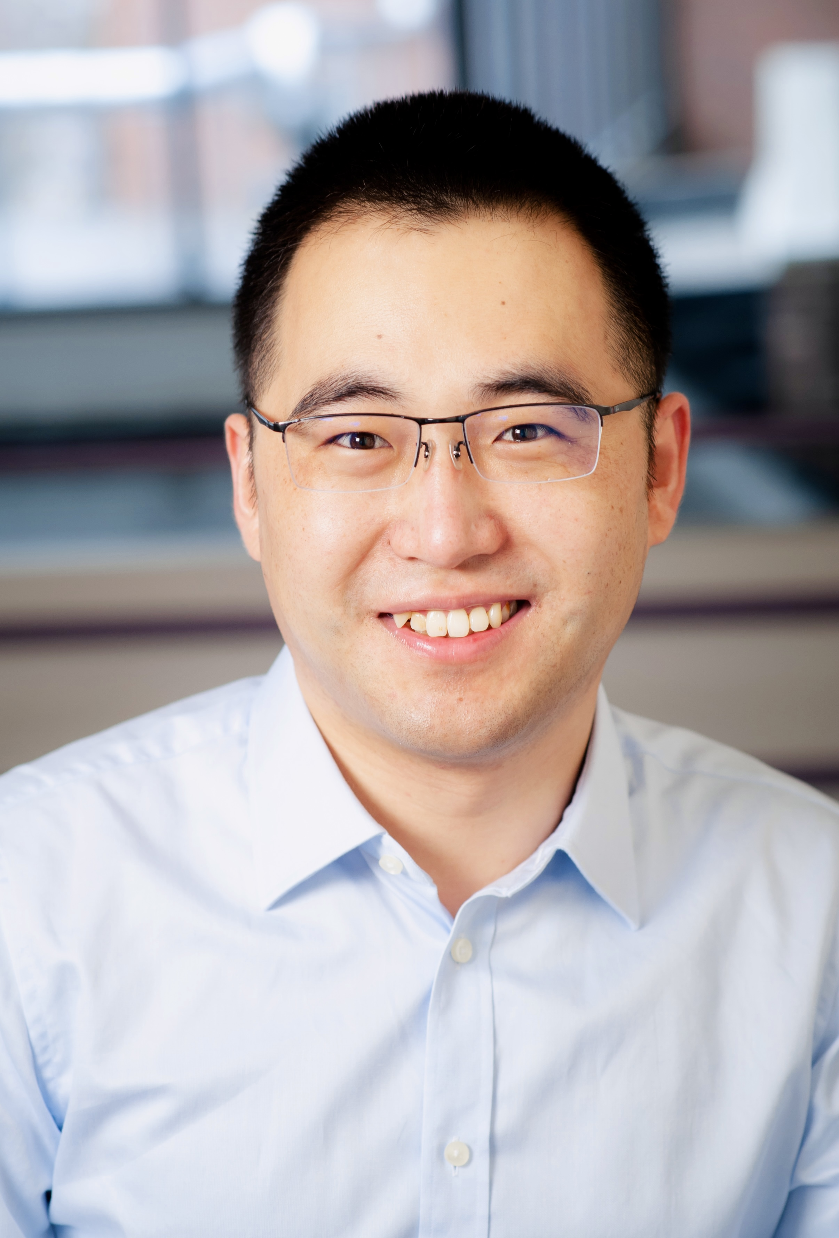

Applied Economics (APEC) Student Seminar
Yanxu Long
APEC JMC
Wednesday
November 27
11 AM – 12 PM
Ruttan Hall 119
https://umn.zoom.us/j/97280645601
Title:
Payments for Ecosystem Services, Reforestation and Rural Livelihoods

