Slide 1

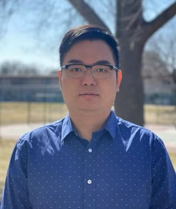

Applied Economics (APEC) Student Seminar
Yufeng Lai
Amazon
2021 Alumni
Wednesday September 11
11 AM – 12 PM
Ruttan Hall 119
https://umn.zoom.us/j/97280645601
Title:
Non-traditional Skills for Economists to Deliver in the Tech Sector

