Slide 1

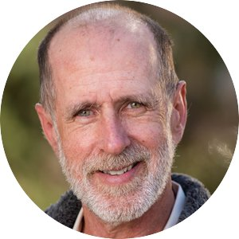

Applied Economics (APEC) Skills Workshop
Jay Coggins
APEC Faculty
Wednesday,
February 21
12 PM – 1 PM
Ruttan Hall 119
https://umn.zoom.us/j/97156270931
Title:
Creating Theory in Practice: An Application from Environmental/Welfare Economics
Food and Beverages will be provided. Reach out to the organizer (Ryan McWay) if you have any questions: mcway005@umn.edu

