Slide 1

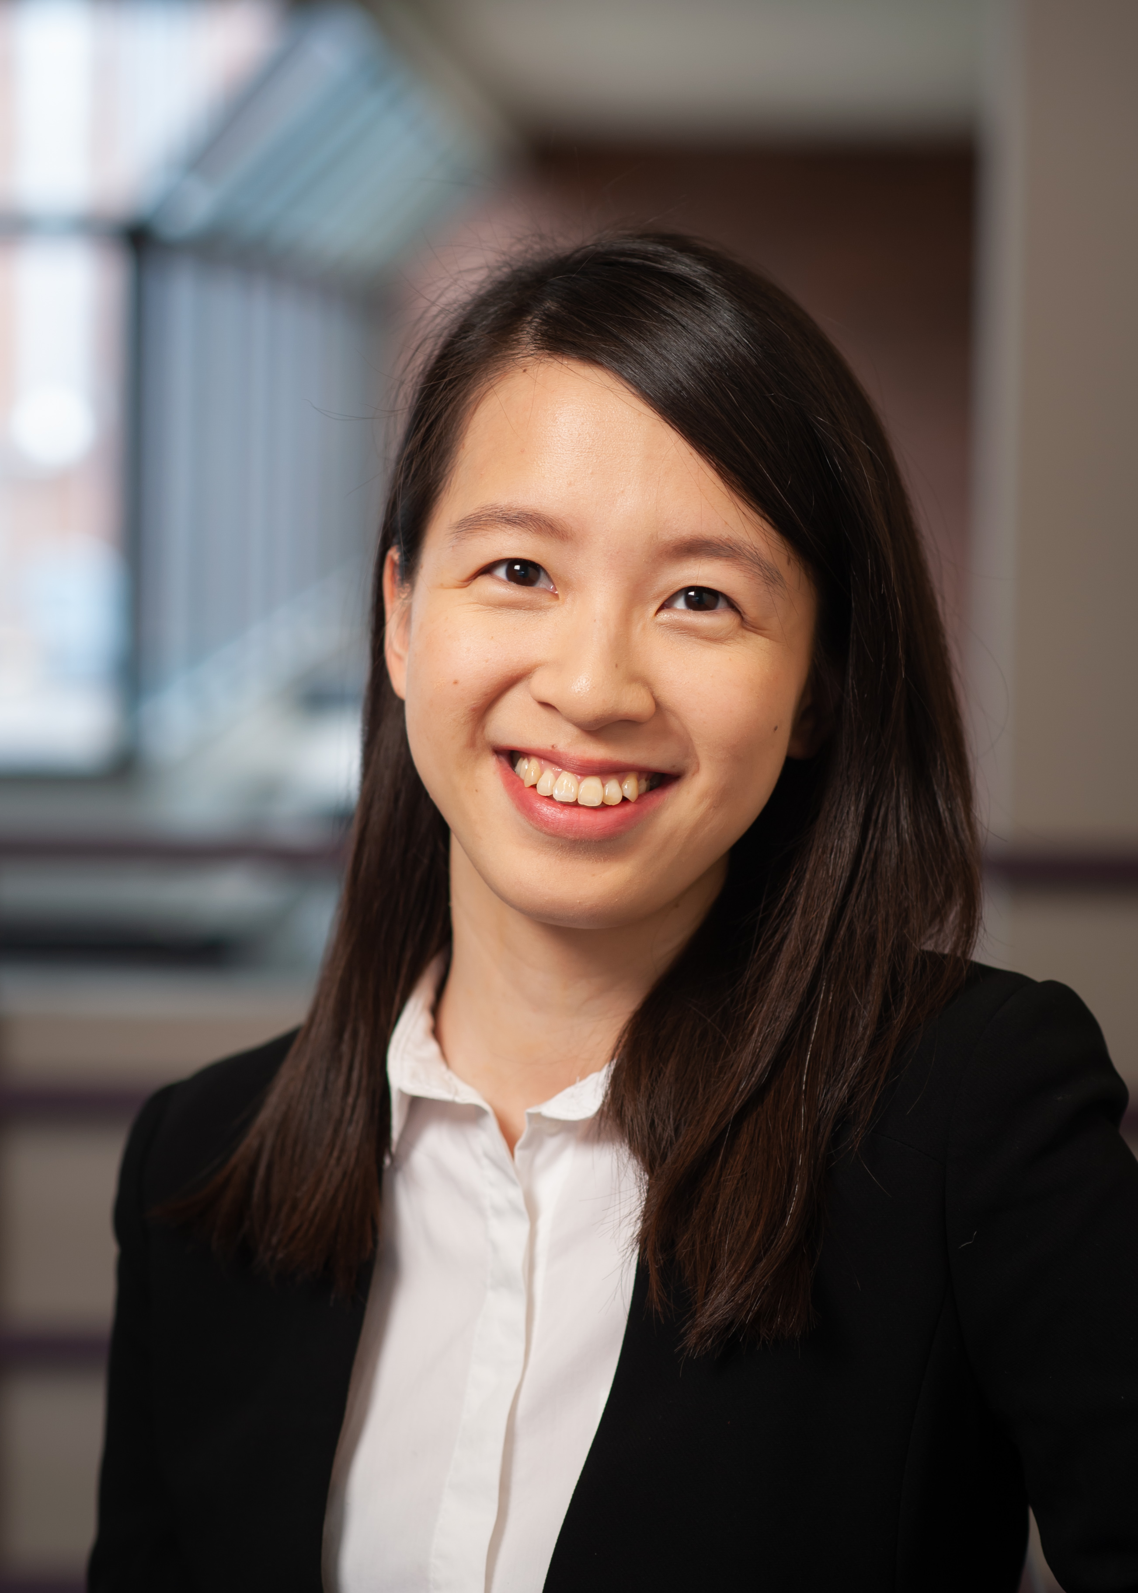
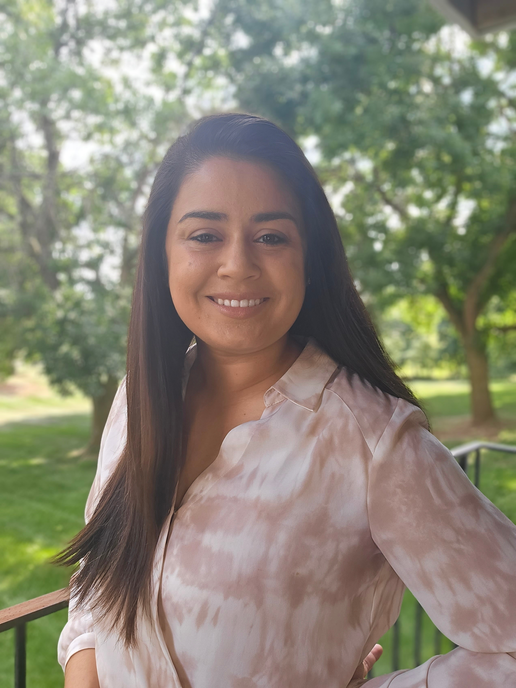
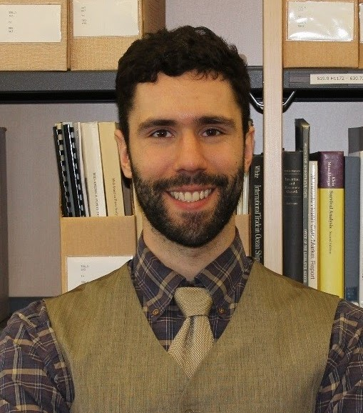

Applied Economics (APEC) Skills Workshop
Jhih-Yun Liu, Caitlyn Keo,
Thomas Durfee
Job Market Candidates
Tuesday, April 16
12 PM – 1 PM Ruttan Hall B35
https://umn.zoom.us/j/97156270931
Title:
Reflections and Advice about the Job Market
Food and Beverages will be provided. Reach out to the organizer (Ryan McWay) if you have any questions: mcway005@umn.edu

