Slide 1

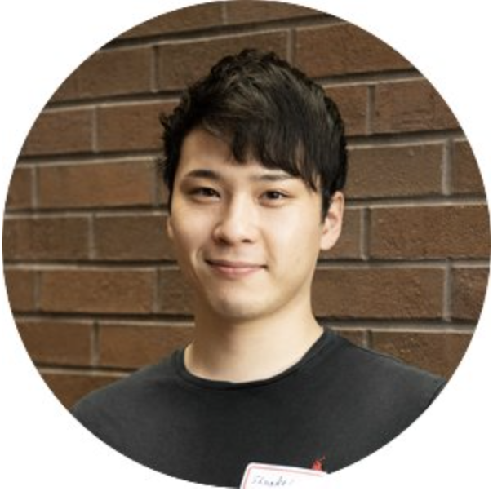

Applied Economics (APEC) Skills Workshop
Shunkei Kakimoto
PhD Student
Tuesday,
April 30
12 PM – 1 PM
Ruttan Hall 119
https://umn.zoom.us/j/97156270931
Title:
Introduction to Making Presentation Slides with Xaringan
Food and Beverages will be provided. Reach out to the organizer (Ryan McWay) if you have any questions: mcway005@umn.edu

