Slide 1
EDLD 651: Final Project

Slide 2
Project Overview

Slide 3
Challenges
Challenges faced along the way (5)

Slide 4
Missing Data
The GSS codes missing data as either ".i: Inapplicable", ".n: No answer", ".d: Do not Know/Cannot Choose", and ".s: Skipped on Web. For the purposes of this project, we are considering all of the above as missing values. Below we recode all these indicators as NAs. This is necessary to rice mice imputations to address missing values.

Slide 5
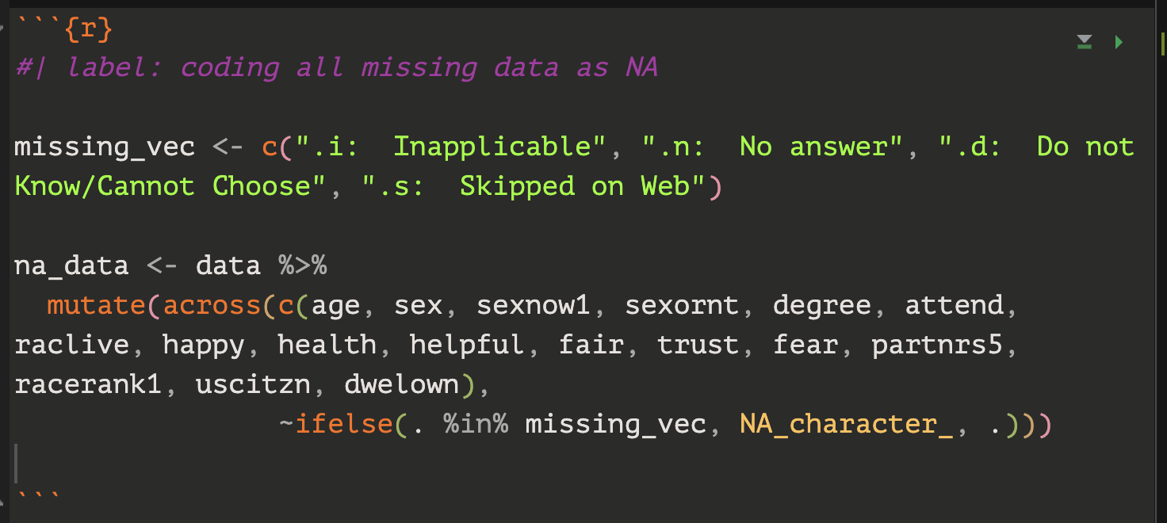

Slide 6
Current Challenges
Challenges your are still facing (5)

Slide 7
Victories
Victories and things to celebrate (5)

Slide 8
Findings
Substantive Findings/ Interpretations (5)

Slide 9
Next R Hurdle

