Slide 1

Social Determinants of Fear
Alejandra Pedraza and W. Jamie Yang

Slide 2

Project Overview
Research Question
What social determinants condition the experience of fear?
Data
General Social Survey
1972 - 2022
Measures related to health, marriage, family, work, politics

Slide 3
Theoretical Grounding

Slide 4
Codebook
Dependent Variable
Independent Variables/ Controls
Is there any area right around here--that is, within a mile--where you would be afraid to walk alone at night?
Sex
Race
Education
Residential composition
Happiness
Health
Religious participation
Number of sexual partners

Slide 5

Challenges
Notes:
Challenges encountered along the way

Slide 6
Missing Data
GSS codes missing data as either
.i: Inapplicable
.n: No answer
.d: Do not Know/Cannot Choose
.s: Skipped on Web
Recoded all as NA
Mice Imputation
Notes:
.i: Inapplicable <- valid skip

Slide 7
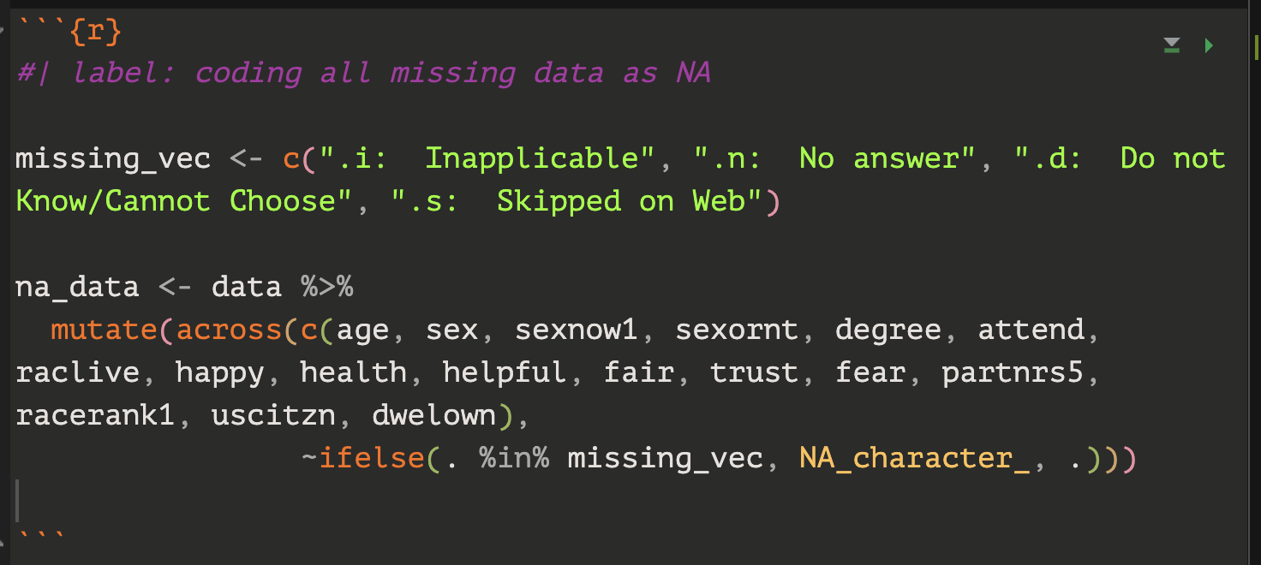
Coding data as NA

Slide 8
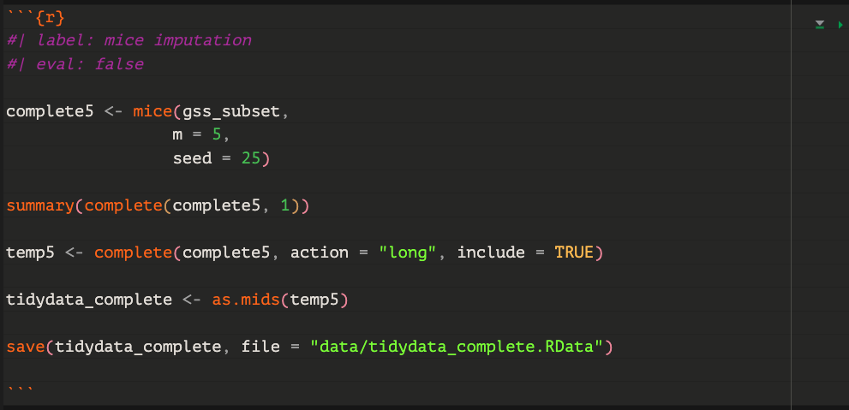
Mice Imputation
Notes:
Ran into an issue with mice imputations
Creates a larger dataset

Slide 9
Current Challenges

Slide 10
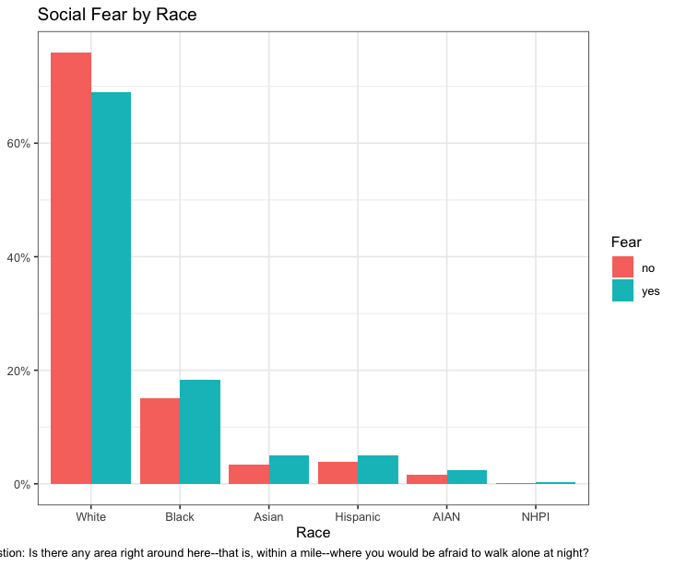
1. Displaying data accurately in plots

Slide 11
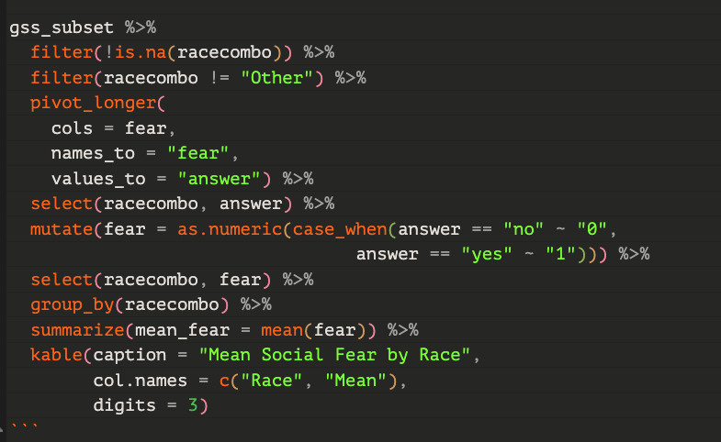
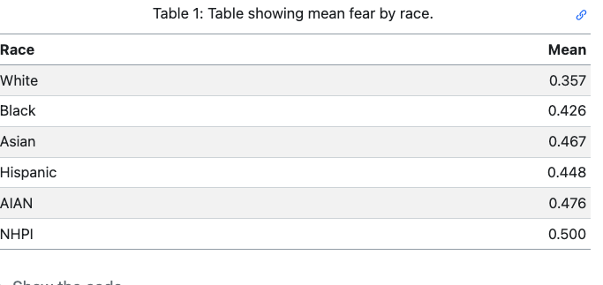
2. Pivot Wider and Pivot Longer

Slide 12
Victories
Accurately incorporating different functions we learned in this class
Using quarto and changing the YAML and code chuck options to do different things
Github Collaboration

Slide 13
Findings

Slide 14
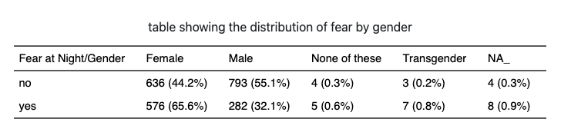

Slide 15
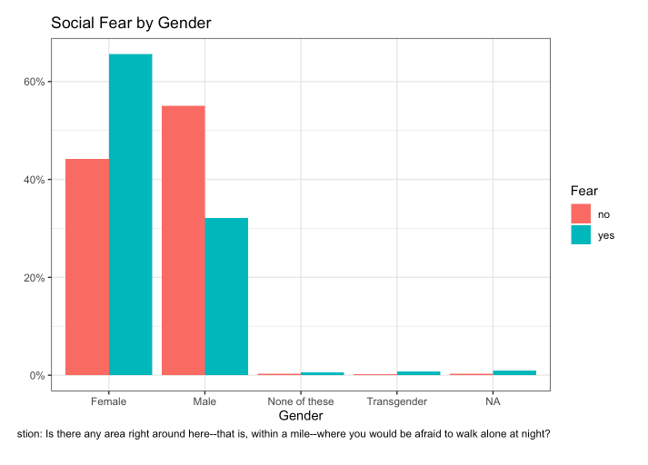

Slide 16
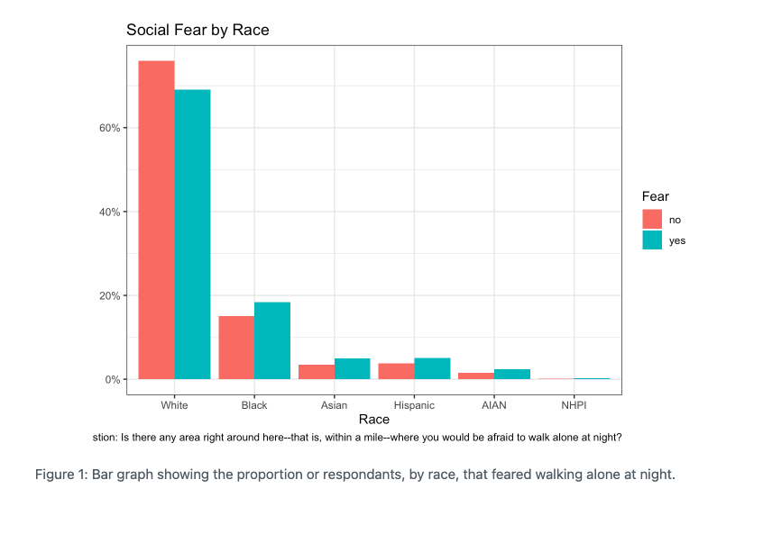

Slide 17
Next R Hurdle
Use complete analytical dataset (created from mice imputation) to run different models.
Github merge conflicts

