Slide 1

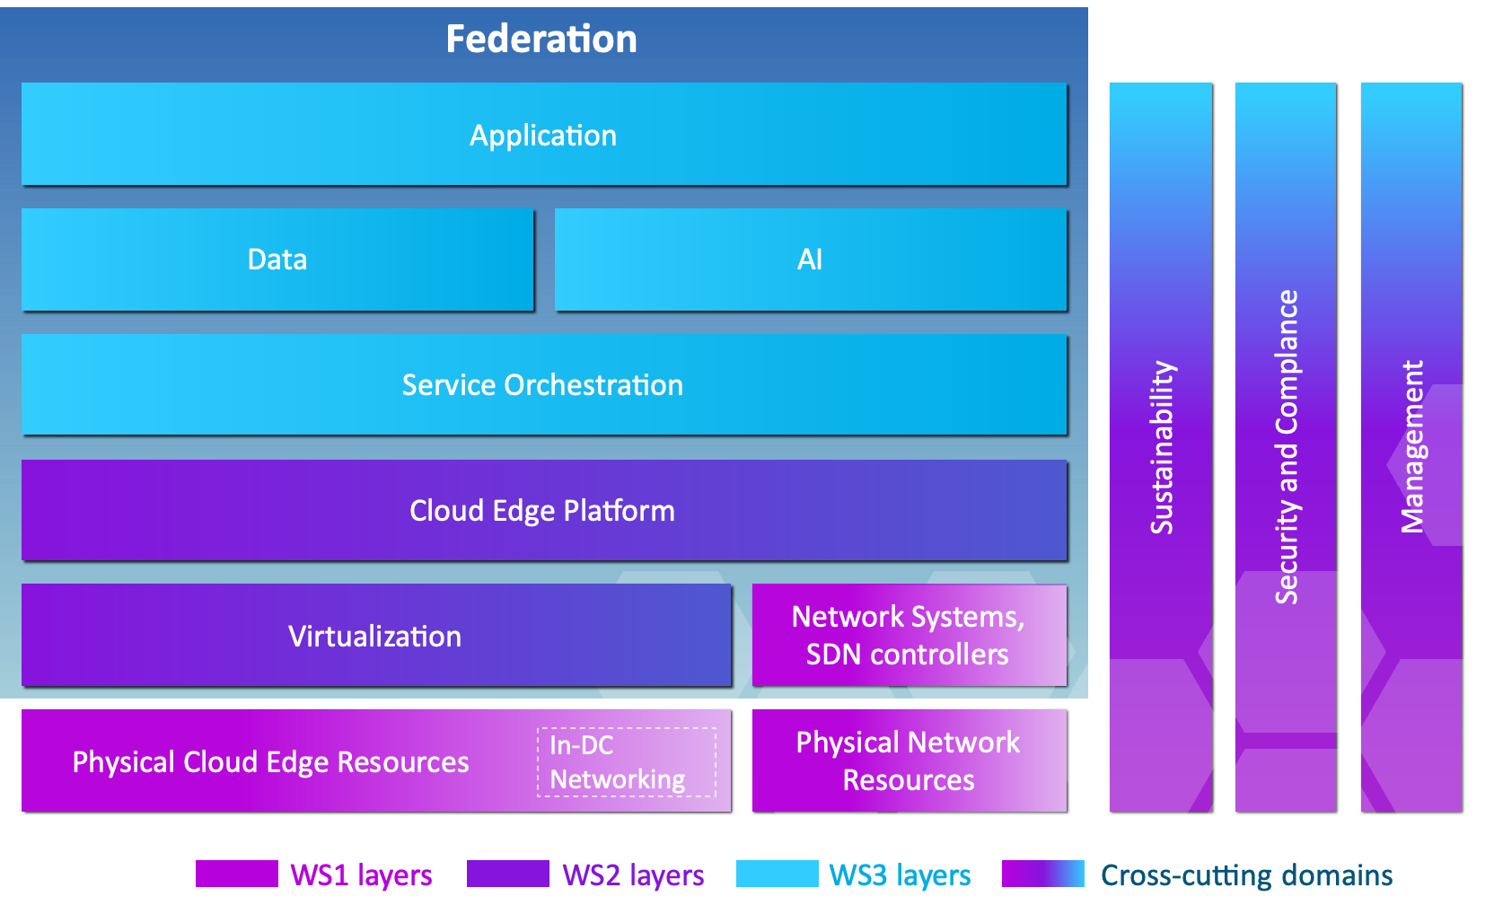










ApeiroRA and the IPCEI-CIS Reference Architecture
Konfidence

