Slide 1






Covid19 Airport Operations
Mayuri Nijai
Tulasi Kishore
Alekhya Kadiri
Apeksha
Khandelwal
Anudeepsri
Bathina
Shalini
Siddabathula

Slide 2
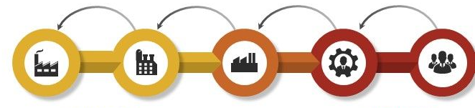


Our 7 min Journey….
Design & Implementation
Views & Reports
Introduction
Server Side Modules
Q&A

Slide 3
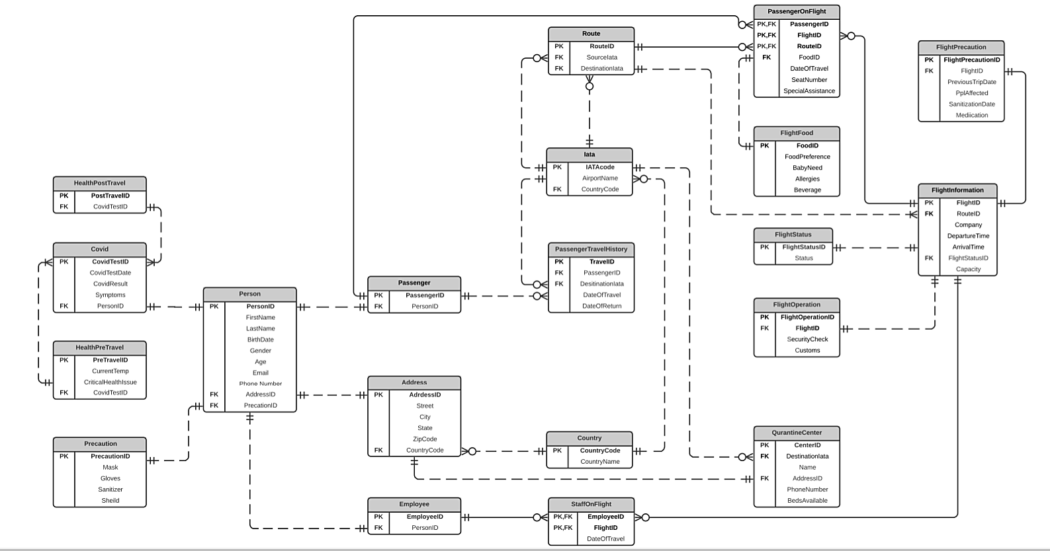
Database Design

Slide 4
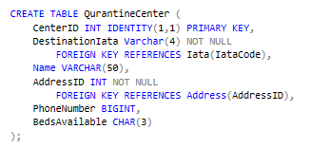
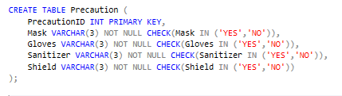
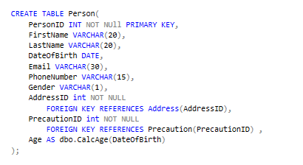
continue….

Slide 5
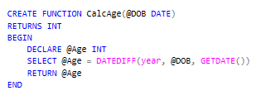
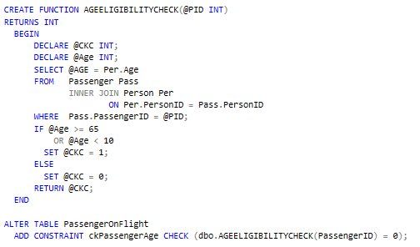
Server Side Modules
Calculate Column Using Function
Table Level Check Constraint

Slide 6
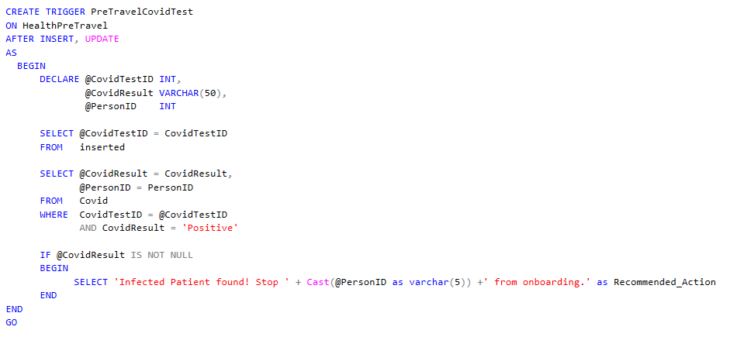

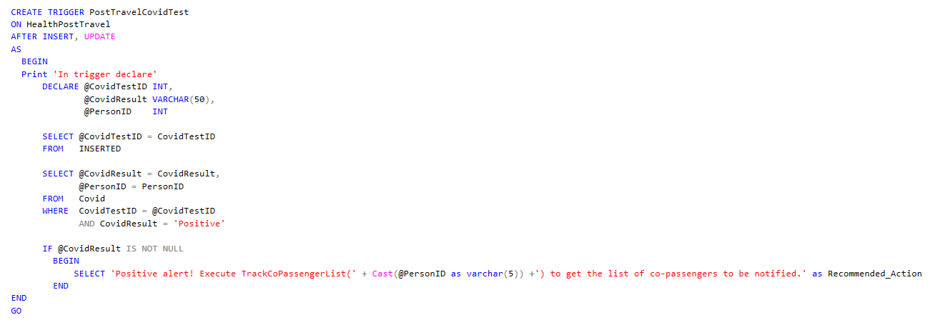
Triggers
continue….

Slide 7
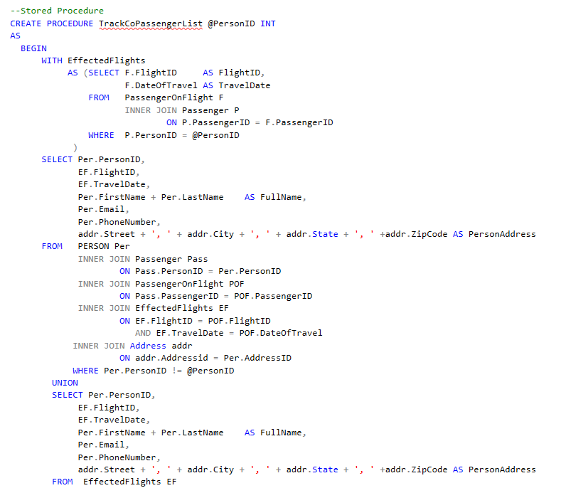
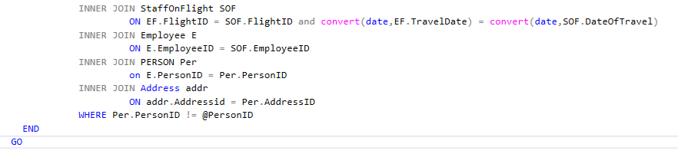
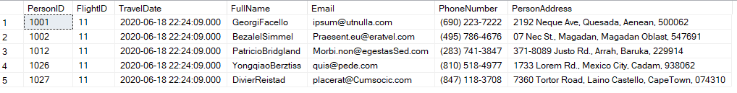
Stored Procedure
continue….

Slide 8
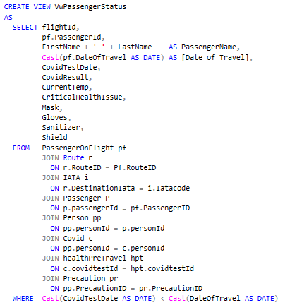
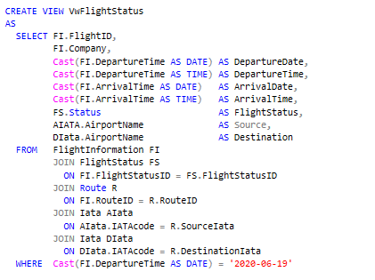
Views & Reports

Slide 9
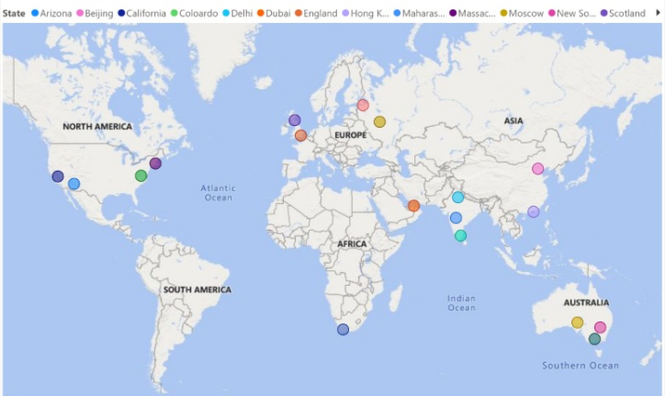
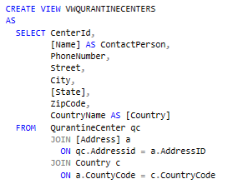
Views & Reports

Slide 10
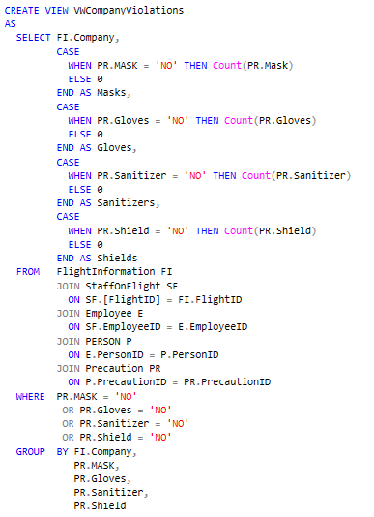
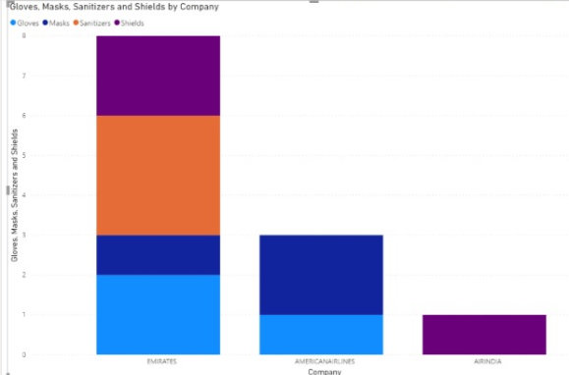
Views & Reports

Slide 11
Q&A
Thank You!

