Slide 1
PITSTOP
MALL OF ASIA → BIG BAY · NH44
Which highway stop has a clean washroom?
Mayur S P & Apeksha S · Atria University, Bengaluru
Mall of Asia
47 stops, coloured by what reviewers say about the washroom
Big Bay
Notes:
Pitstop answers one question drivers actually ask: where can I stop with a clean washroom? We looked at every well-rated restaurant on the 66 km drive from Phoenix Mall of Asia to Big Bay on NH44. The line at the bottom is the real route: each dot is a stop, in order, green for good washrooms, yellow for moderate, red for bad, grey for no data.

Slide 2


STAR RATINGS DON’T TELL YOU ABOUT THE WASHROOM
THE PROBLEM
1
Drivers stop for the washroom. On a long highway drive, a clean washroom decides where you pull over.
A HIGHWAY STOP
4.5
2
One score mixes everything. Food, service, price and parking all blend into a single star rating.
3
The answer is buried. Washroom comments are rare and scattered across thousands of reviews.
Washroom: no idea
Our goal: show what reviewers really say about the washroom at every stop.
Notes:
The problem in one line: star ratings can’t tell you whether a highway stop has a clean washroom. That’s the thing drivers care about most on a long trip, but the rating mixes food, service and price, and washroom comments are rare and buried in thousands of reviews. Pitstop digs them out for every stop on the route.

Slide 3




ONE ROAD, EVERY REVIEW THAT MATTERS
THE DATASET
47
5,162
372
168
restaurants rated above 3.5 stars
Google Maps reviews, 2016 to 2026
reviews that talk about the washroom
photos posted with the reviews
Only 1.4% of reviews mention the washroom, so finding them is the hard part.
Phoenix Mall of Asia to Big Bay, NH44 · github.com/apeksha0463/Pitstop
Notes:
47 restaurants on one 66 km stretch, 5,162 reviews merged from two sources, and 372 of them are about the washroom. The thin yellow sliver is the point: washroom comments are about 1.4% of reviews, which is why we had to be clever about finding them.

Slide 4
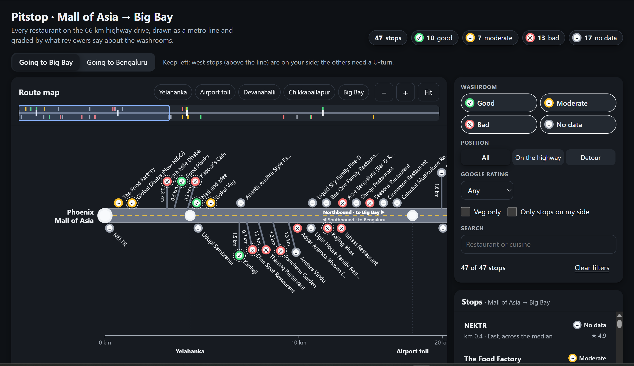
EVERY STOP, ON ONE LINE
THE WEBSITE
West-side stops sit above the road, east-side below. Detours hang on a spur with their distance.
Notes:
This is the website view. The whole route is one metro line, each restaurant a station, coloured by what reviewers say about its washroom. You can pick your direction and see only the stops on your side of the road, so no U-turns.

Slide 5
WHAT REVIEWERS SAY
Positive
Neutral
Negative
All 372 reviews
51% positive
MOST POSITIVE
Big Bay food court
91% of 75
Samara’s Veg
90% of 10
Koteshwaram
79% of 33
MOST NEGATIVE
Seasons Restaurant
86% of 7
Devanahalli Gowdru
80% of 10
A2B Airport Road
58% of 53
Share of each stop’s washroom reviews, positive or negative · only stops with 5 or more washroom reviews
Notes:
Overall, half the washroom comments are positive and a third negative. Each bar is one stop’s washroom reviews split by sentiment; the percentage is the positive share for the top three and the negative share for the bottom three. Only stops with at least five washroom reviews are ranked, so one angry review can’t sink a place. Big Bay wins and also has the most evidence: 75 washroom reviews.

Slide 6





HOW WE BUILT IT, IN FOUR STEPS
METHOD
1
2
3
4
Pick the stops
Collect reviews
Find washroom talk
Score the feeling
Searched each stretch of the route and kept the 47 restaurants rated above 3.5.
Apify for the newest reviews, SerpApi for washroom searches, merged so each review counts once.
An aspect-based sentiment model rated each sentence as positive, neutral or negative.
Matched washroom words and misspellings, and kept only those sentences.
The scores track the star ratings: r = 0.63 across 372 reviews.
Notes:
Four steps. We picked the stops, collected reviews from two sources, pulled out just the washroom sentences, and scored how reviewers felt about the washroom, not the food. The model’s scores line up with star ratings: negative washroom passages average 2.4 stars, positive ones 4.5.

Slide 7

WHAT WE LEARNED
22 of 57
Stars ≠ clean
31 of 47
Test every shortcut
Score the sentence
Mind the gaps
Google’s search found only 22 of Big Bay’s 57 washroom reviews, so we downloaded them all.
A five-star review can love the biryani and hate the toilet.
Stops with fewer than five washroom reviews, too few to rank.
Next: the data moves to Supabase, behind a live route website.
Thank you · Mayur S P & Apeksha S
Notes:
Three lessons. Test your shortcuts, because Google’s own search hid most of the washroom reviews. Judge the washroom sentence, not the overall star rating. And be honest about gaps: most stops still have too few washroom reviews to rank. Next we’re putting the data in Supabase behind the route website.

