Slide 1
Industry project
Imagine you have a huge amount of invoice with you and you are asked to store the total amount of every invoice! Would you rather check every pdf for the total amount? I assume not! But this package does the work for you with one click!
All you have to do is give your pdf file name as an input and within milliseconds you are there with your desired value!
The only packages required for this are- pdf2image, pytesseract
The source code is of only up to 50 lines of code and is divided into functions for- conversion of pdf to image, extraction of text from the image and finally extracting the total amount which can be easily understood!
This code doesn’t save the converted pdf to image, thus saving the space of your local machine.
It removes the special characters like “,” and “$” from the numbers thus giving an accurate value.

Slide 2
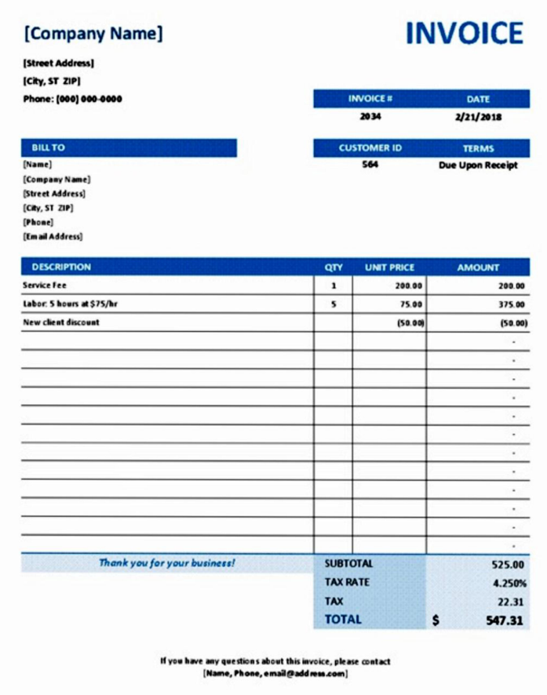
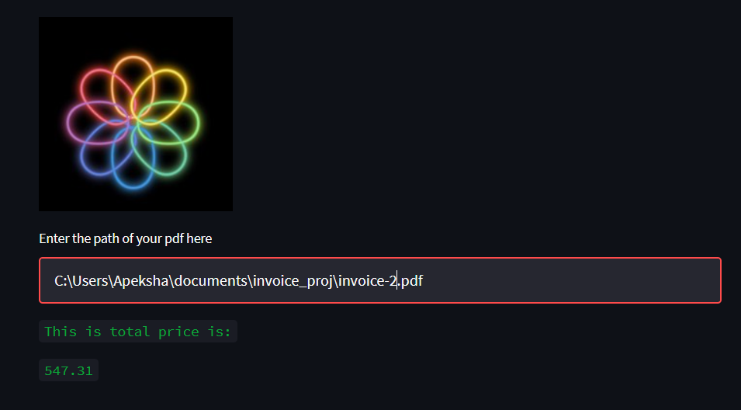
Industry project
This has been tried and tested for 10 pdf!
One of the output is given below:

